Slide 1
Welcome

Slide 2
Week 1:
Introduction

Slide 3
Overview of tonight:
Introduction
What is Sahaja Yoga?
Self Realisation
Inner Peace video
What’s next?

Slide 4
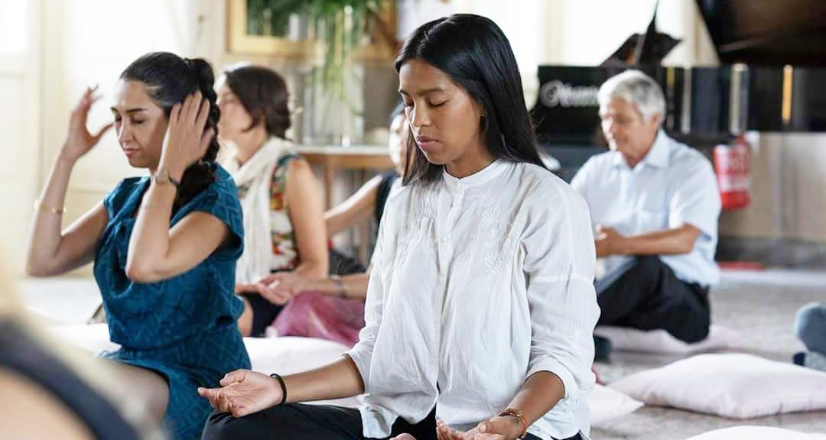
What is Sahaja Yoga meditation?

Slide 5
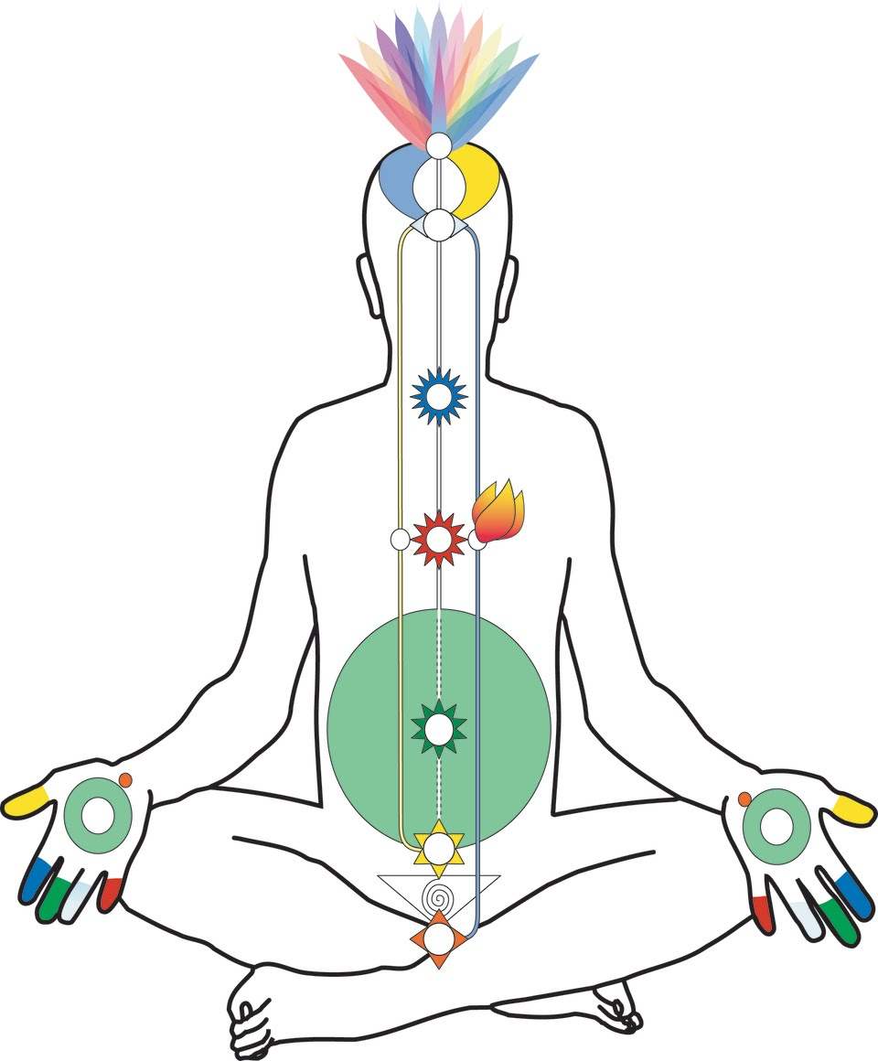
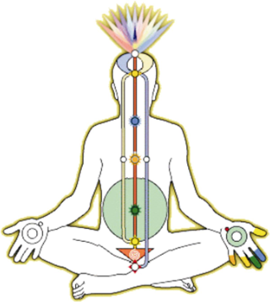
Self-realisation

Slide 6
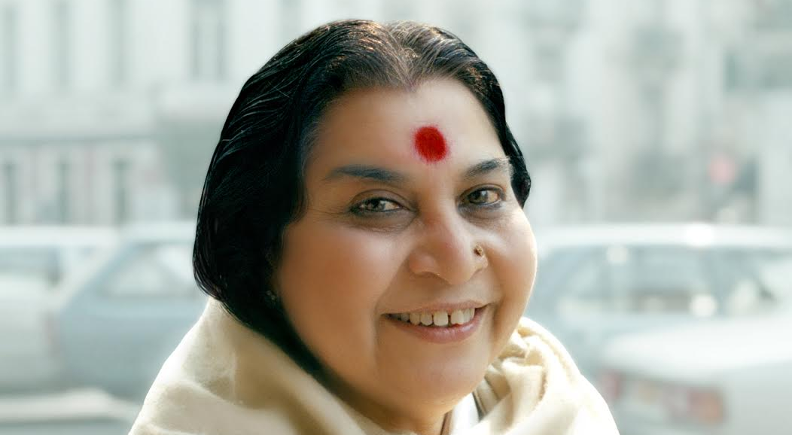

Slide 7
Start meditating at home on:
wemeditate.co

Slide 8
You are welcome next week
on zoom

Slide 9
Thank you for joining!

