Slide 1
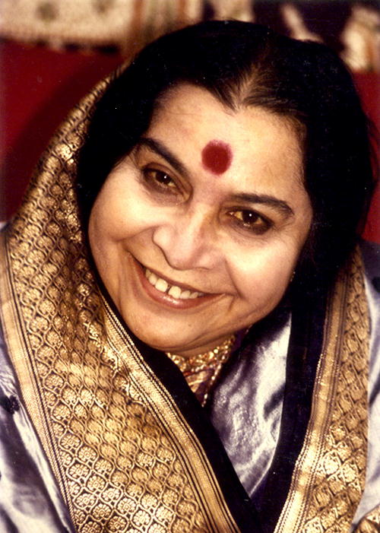

Slide 2
DEITIES, ARCHETYPES AND MANTRAS
Divine Sounds
© VND-Colombia

Slide 3
DEITIES & ARCHETYPES
MANIFESTATIONS OF THE DIVINE
Throughout the evolutionary process, several aspects and qualities of the Divine, Deities and Incarnations were awakened and are reflected in our chakra
Deities: Indian manifestation of the Universal Archetypes.
Archetypes can be found in the collective unconscious. Carl Jung’s life work provided a clear idea as to how archetypes work on human beings and how they repeat in different cultures.

Slide 4
DEITIES
Personify qualities of the chakras
Allow us to discover these qualities through myths, legends and biographies
The awakening of a chakra permits its qualities to be expressed in our lives.
Behaviours that corresponds with the quality represented by a Deity open the chakras more and leave more space for the Kundalini to pass through.

Slide 5
Shri Ganesha
Aspect of the Divine Child
Fearlesness
Innocence
Devotion
Wisdom
Spontaneity

Slide 6
Shri Brahmadeva and Shri Saraswati
Creator of everything
Pure knowledge
Creativity
Arts

Slide 7
Shri Adi Guru Dattatreya
The primordial master
Control over our senses.
Non-dependance of external circumstances for our well-being

Slide 8
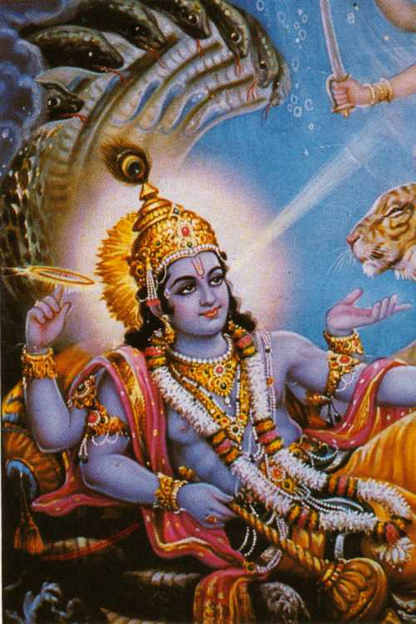
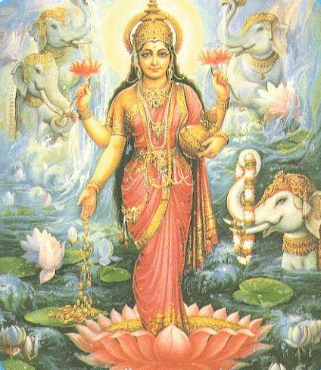
Shri Vishnu and Shri Lakshmi
Balance and maintenance
Re-establishes dharma:
- Manifests honest and pure behaviour
Vishnu is the protector of universal evolution
Feminine Aspect: Generosity wellbeing, satisfaction, thirst for evolution, spiritual seeking

Slide 9
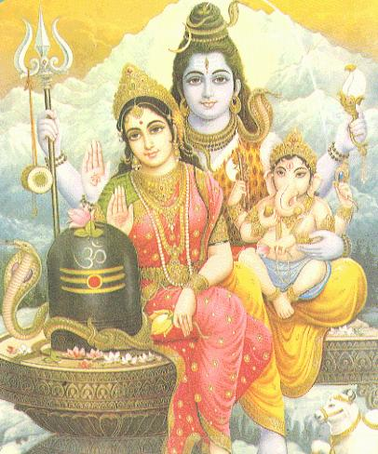
Shri Shiva and Shri Parvati
Represents the pure Cosmic Spirit.
Self, Truth, Joy
Love, compassion
Peace and silence
Permanent Bliss and Awareness

Slide 10
Shri Durga
The Mother of the universe which she protects.
Security
She destroys all our fears, gives us confidence
Creates antibodies

Slide 11
Shri Rama and Shri Sita
He lived 4000 years before Christ; He represents the perfect King, the hero of the Ramayana
He personifies the perfect behaviour in human relations
Sincerity
Righteousness
Love for the others
Ideal son, ideal brother, ideal father
Sita, the ideal wife

Slide 12
Shri Krishna
He lived 2000 years before Christ. He was the hero of Mahabharata and Bhagavad Gita
Collectivity
Brother-sister relationship
Sweetness and diplomacy
Witness state

Slide 13
Shri Jesus
The resurrection: The Spirit doesn’t die
Frees us from ego and karmas
Forgiveness
He is the door to the Kingdom of God (The Sahasrara)
Announces the second birth

Slide 14
THE MANTRAS
Sanskrit is a ‘divine language’ that, when used in mantras, clears, cleanses and opens the chakras

Slide 15
MANTRAS STRUCTURE
OM, (Sound of the Universe, Big-bang)
TWAMEVA (‘Thou art that’)
SAKSHAT (Verily)
,
NAMOH NAMAHA. (I bow unto you)
SHRI ……………

Slide 16
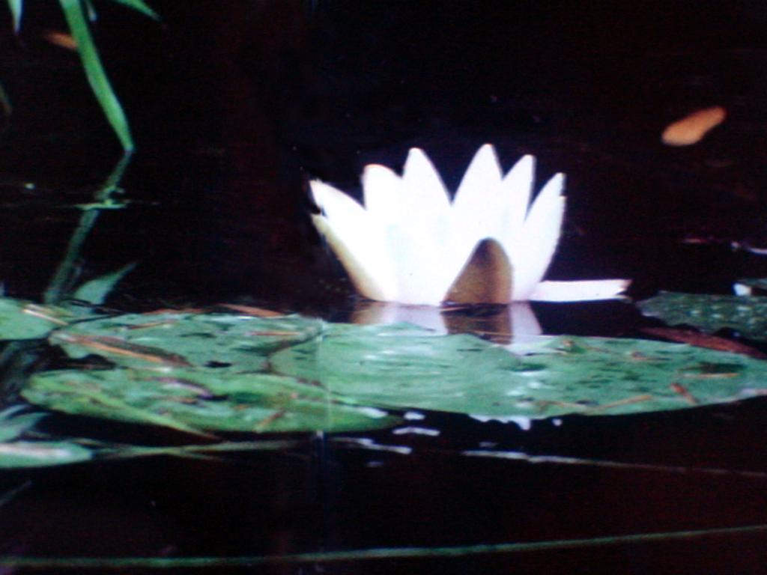
“Don’t go to the garden of flowers
Oh! Friend, don’t go there:
In your body resides the garden of flowers!
Take a seat in the thousand petals lotus and from there
Look at the infinite beauty”.
Kabir.

