Slide 1
Right Side
Our acting power: Prana Shakti
Notes:
Source: Talk Advice on the right side, 1982 minutes 25.30 - 57.30. Mana Shakti is left side power (the break). Prana Shakti is mental and physical power.

Slide 2
Right sided behaviour / mind
Future oriented, planning, organising
Time oriented, very precise, meticulous
Body oriented, outside
Thinking about the future, imaginary
Five hours of meditation or anything else
Very smart (thinking) mental power
Notes:
Overdoing things, too long and too speedy

Slide 3
Right sided nature
Straightforward (in nature nothing is so straight...)
Ego: so called ‘successful and dynamic’
“What is wrong attitude”
Stupidity: dancing when 90, horse riding when 85
Troubling others
Notes:
To the point / strict, without softness

Slide 4
Swadisthan Chakra
Converts fat cells, into brain cells
Too much thinking, overheats this chakra
Notes:
So being too right sided gives this chakra problems.

Slide 5
Right sided diseases
Liver: wobbly eyes, unsteady attention (right Nabhi)
Pancreas: diabetes
Spleen: high blood pressure, leukaemia (left Nabhi)
Heart: heartattack (Spirit retrieves)
Eat in peace (no hurry) and without looking on your phone etc.
Notes:
Liver: easily agitated / irritation. Heat has to leave the body through the water in blood, sometimes this doesn’t work.

Slide 6
Meditate, be in the present
Spirit (inside) oriented
Put attention on the Spirit
Patience with yourself
Giving nature, generous
Give something (back) to nature
Notes:
Spirit is Collective Being, don’t make fun of it, because you make fun of your Self and others. Have patience you will start to feel it. You can practice holding out your hands to flowers, your compassion / vibrations will flow and the flowers live a bit longer.

Slide 7
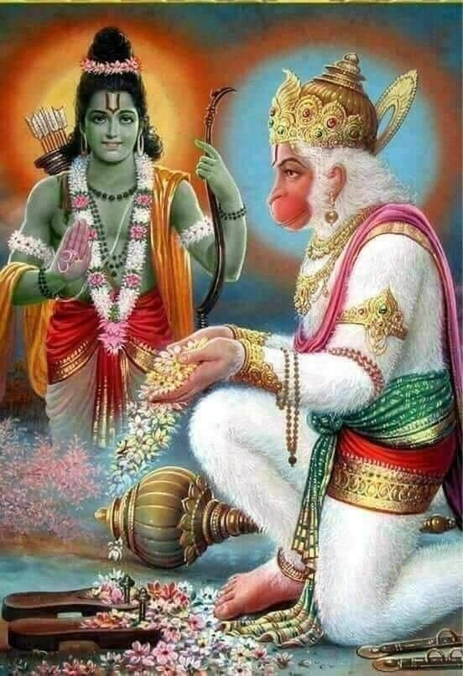
Shri Rama and Shri Hanuman
Personify qualities of right heart and right channel
Shri Rama lived 4000 years before Christ and represents
the perfect king, father, brother and son (right heart)
Shri Hanuman is the servant of Shri Rama, he protects our right
heart and controls our right channel
Shri Hanuman is the helper / actor / supporter of the Divine
Shri Hanuman shows the way to the abstract: to the Sahasrara
Notes:
Shri Hanuman his attention is on the Divine / Love. He wants to fulfil all pure desires and create goodness / friendship.

Slide 8
Shri Hanuman qualities
He helps to establish truth
He protects people who are in truth
He is very powerful, dynamic and fast (quicker than thought)
The lord of the ether, master of all networks (cause of communication)
He creates electromagnetic forces, creates movement in molecules and atoms
He guides people’s actions and makes them surrendered by spoiling their plans
Notes:
He does everything to prove the existence of the Divine, he creates all kinds of vibrations.
He is the messenger, he carries messages from one place to another. In Hinduism he is also called the wind God’s son, being as fast as the wind.

Slide 9
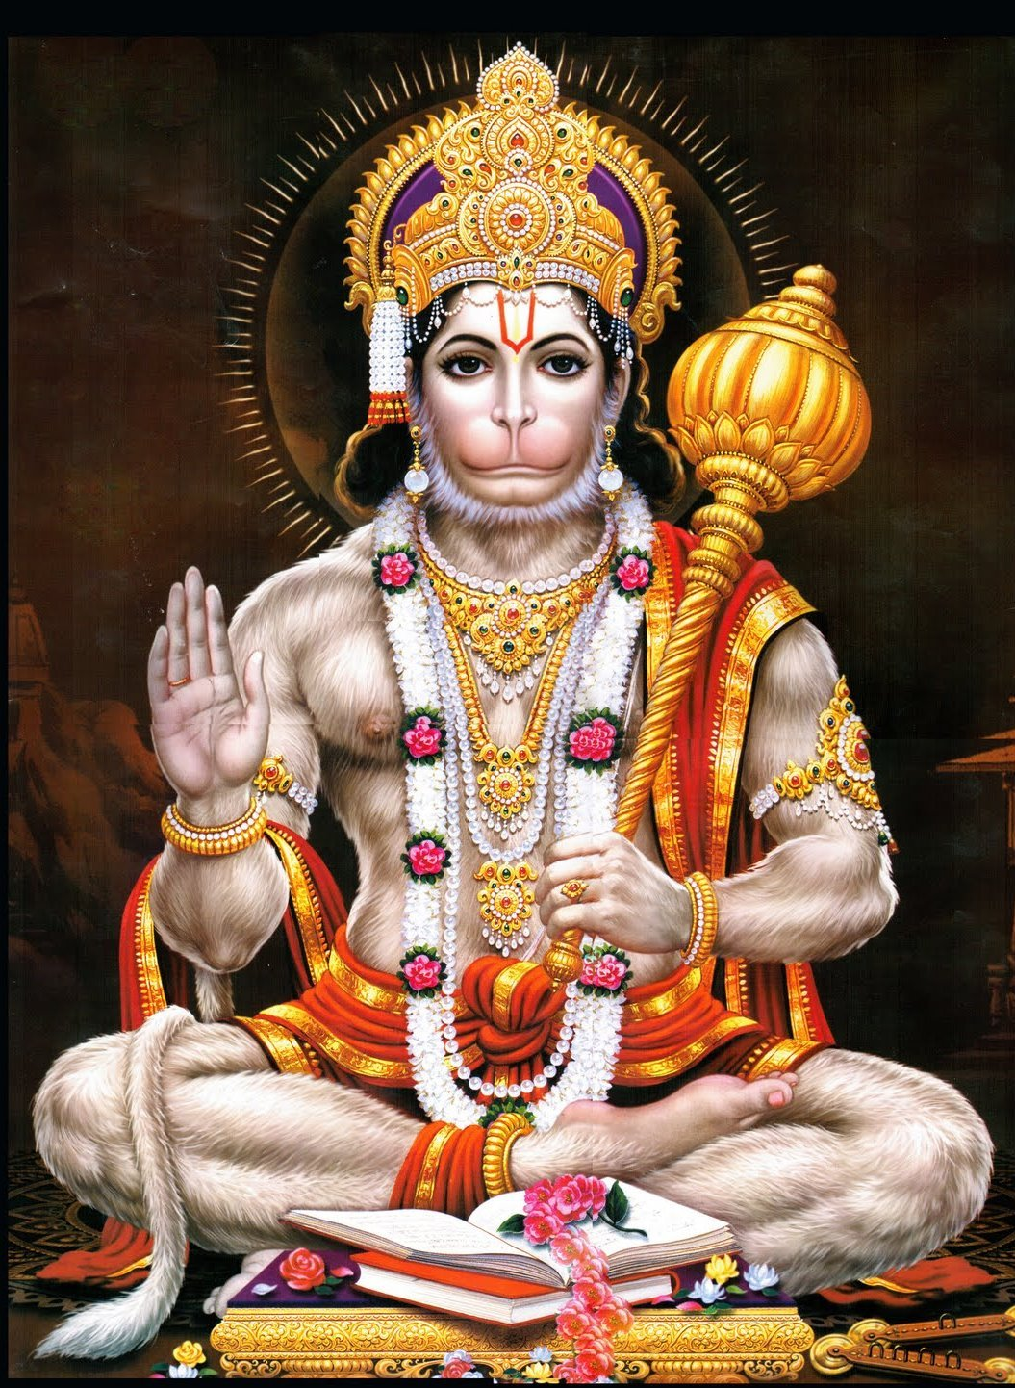
More qualities
He gives us discrimination
He shows us our ego
He makes us sweet and childlike
He gives people their conscience
He is the source of enthusiasm
He is an ocean of love (bhakti)
Notes:
He wants us to love each other.

Slide 10
Shri Hanuman Chalisa
Prayer/ Song in honour of Shri Hanumana (about 10 minutes)
Praising His qualities
We listen to this song in meditation to strengthen the right channel and to calm down any over activity. After it we remain in meditation for a while.
Notes:
So surrender all your inside thought activity… and just listen with your attention in Sahasrara.

