Slide 1
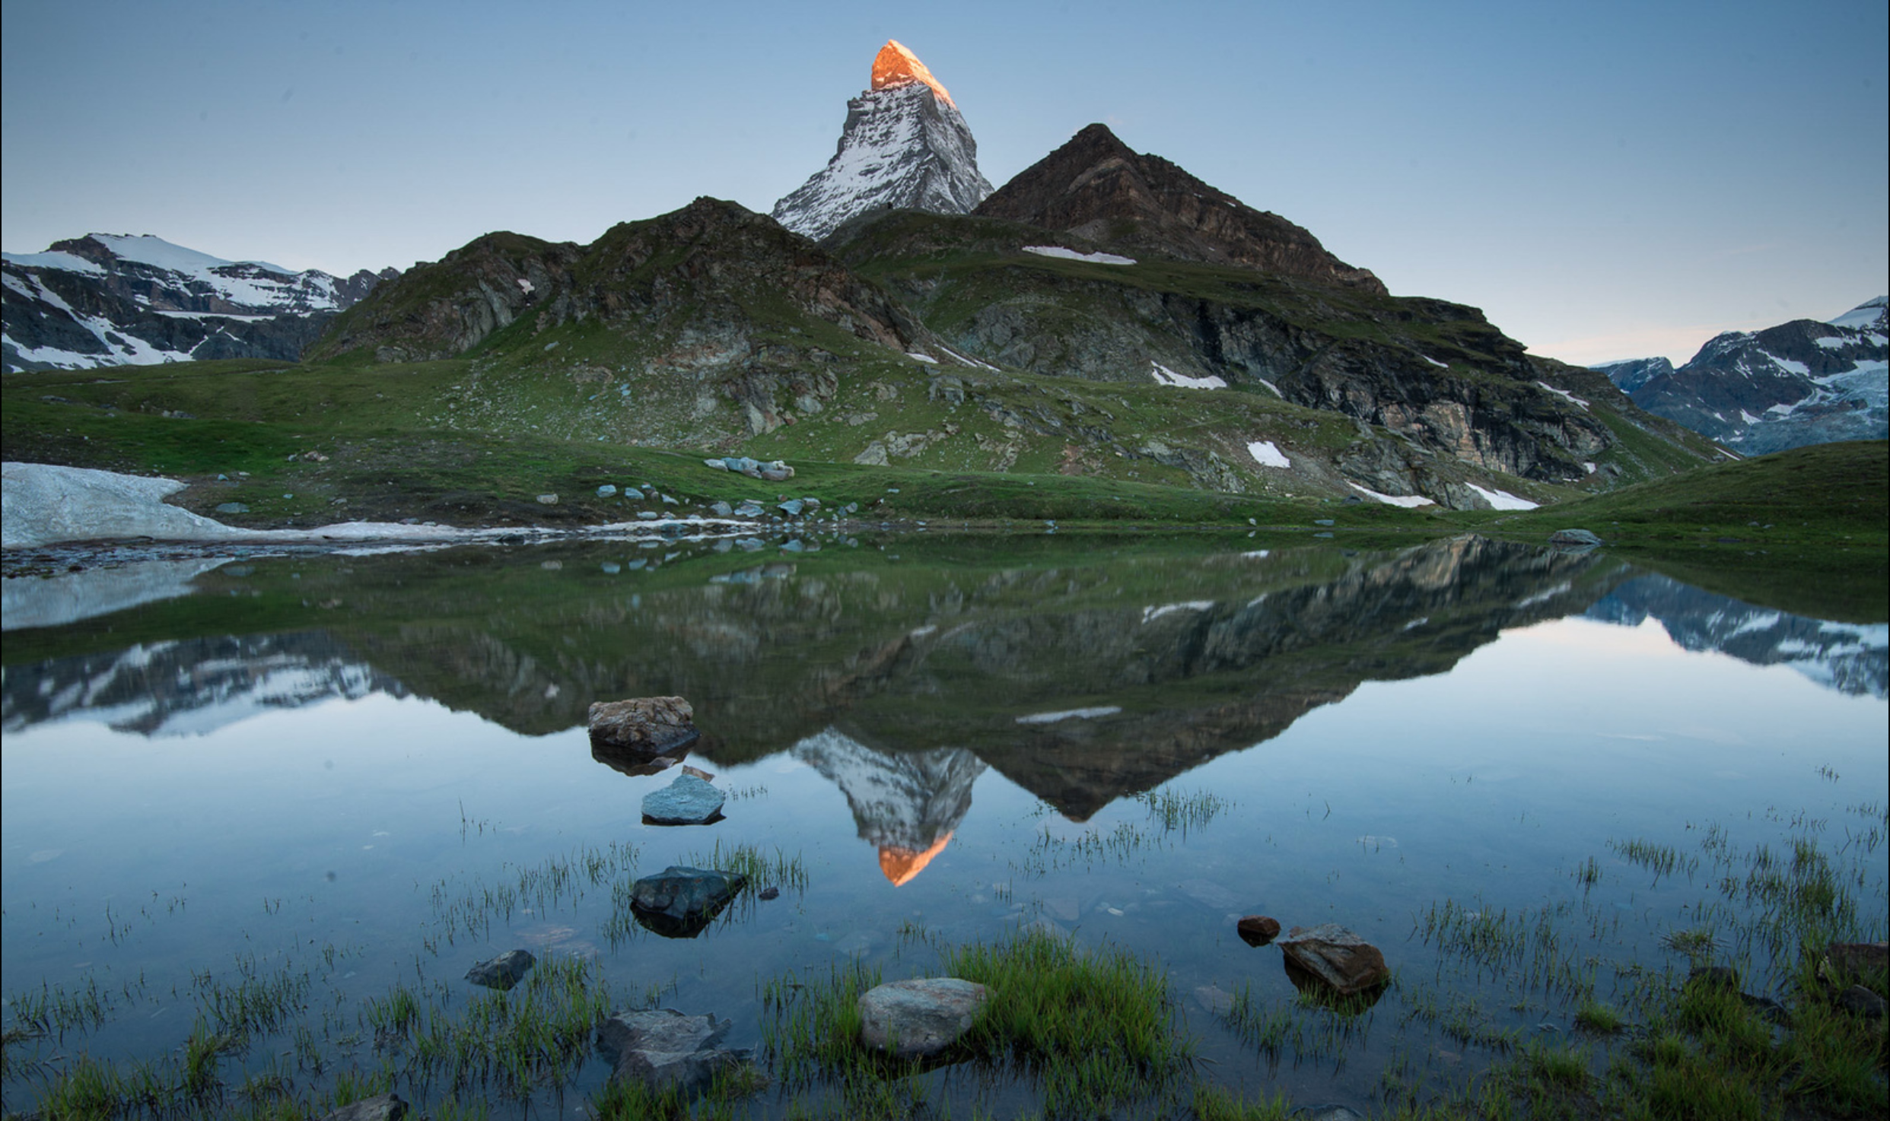
SPIRIT –––––––– SOUL
Notes:
Better understanding the distinction between the spirit and soul is another step in the gradual process of 'knowing thyself'. When introspection is merged with meditation, we work to unload ourselves of that which is transient from that which is true. We often talk about the spirit, but let's understand the spirit in relation to the soul, and how the two form together the indelible part and parcel of the whole.

Slide 2
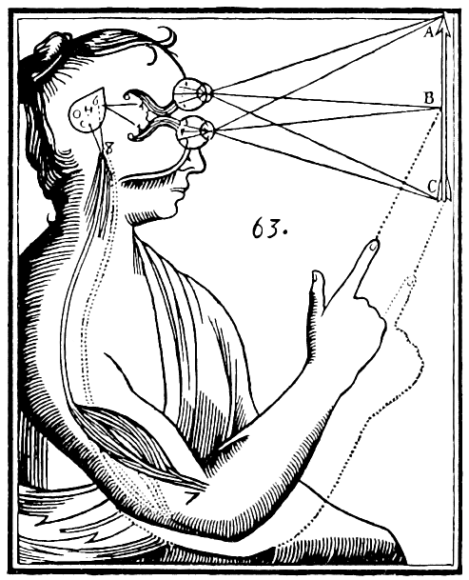
SPIRIT
SOUL
Notes:
The distinction between the spirit and soul is found throughout different cultures around the world. This list presents a generalized overview, each term has subtle disctinctions but can be categorised followingly.

Slide 3
SPIRIT
Rūḥ روح‎
SOUL
نَفْس Nafs

Slide 4
SPIRIT
Rūḥ روح‎
Hun 魂
SOUL
نَفْس Nafs
魄 Po

Slide 5
SPIRIT
Rūḥ روح‎
Hun 魂
Pneuma πνεῦμα
SOUL
نَفْس Nafs
魄 Po
Ψυχή Psyche

Slide 6
SPIRIT
Rūḥ روح‎
Hun 魂
Pneuma πνεῦμα Ātman आत्मा
SOUL
نَفْس Nafs
魄 Po
Ψυχή Psyche
जीव Jīva
Notes:
While it may seem like we present a dualistic approach to the spirit and soul, it must be mentioned that the two are inextricably interlinked; without the soul the spirit could not reflect and manifest, without the spirit the soul would be lifeless. The ability to discern between the two is an essential aspect of refining jiva to further define and foreground the atma in our daily life. Jiva is the aspect that changes and is transient, while the atma is changeless and eternal.

Slide 7
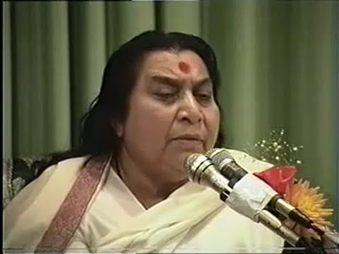
Public Program at Christchurch, New Zealand (1992)
"Spirit is the one which is enveloped by the subtle causals of elements which have made this body. That becomes the soul."
From 1:21:22 to 1:22:46

Slide 8
THE FIVE STATES OF MATTER
Pancha Bhuta
Ether Air Fire Water Earth
Smell
Taste
Sight
Touch
Sound
SUBTLE CAUSALS
Tanmatras
Ear Skin Eyes Tongue Nose
THE FIVE SENSE ORGANS
Jnānendriyas

Slide 9
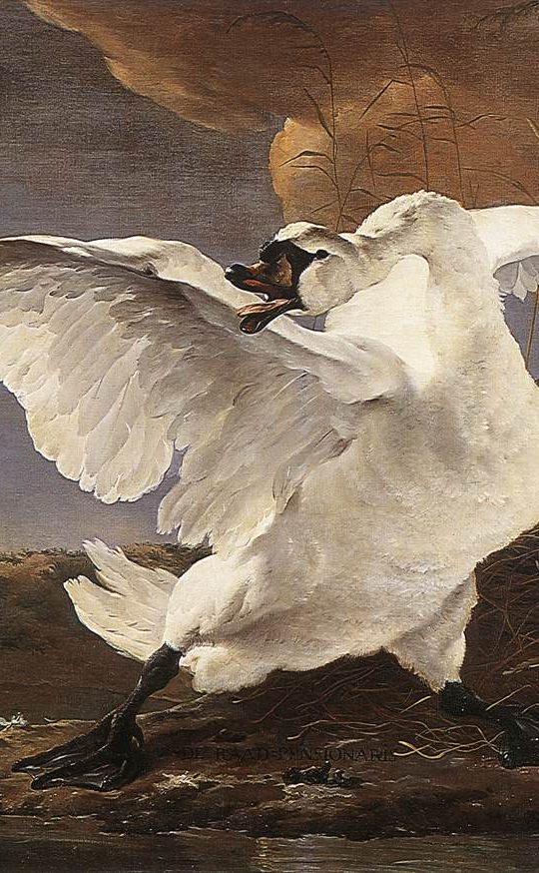
From a Soul to an Enlightened Soul: Jīva to Dvija
Dvija (द्विज) has two meanings in Sanskrit:
A Bird
A 'Realized' Soul (Twice-born)
The swan (Hamsa: हंस) is a common symbol in the Vedas and Upanishads to illustrate the soul and its development.​
The Hamsa is also an auxiliary chakra located between our eyebrows, i.e the base of our nose. Power of discretion.
Jan Asselijn (1650)
Notes:
We have heard from before that imagery in India is symbolically rich. The swan is a case in example. Hamsa Chakra governs our ability to discern between what's right and wrong. What is right is beneficial for our spiritual growth, what is wrong is spiritually detrimental. Terminus point of strands of both the Ida and Pingala Nadi. Also subtle distinctions. Consider swan also in relation to the vahana of the Swadhisthana Chakra.

Slide 10
Svetasvatara Upanishad Compiled during 1st-millenium BCE
"In this vast Wheel of creation wherein all things live and die, wanders round the human soul like a swan in restless flying, and she thinks that God is afar. But when the love of God comes down upon her, then she finds her own immortal life."
Dhyāna (ध्यान): Meditation, contemplation, introspection.
Jan Asselijn (1650)
Notes:
Through Yoga we refine the jiva to define the atma–it is a constant process of sublimation, more aware to the subtlety of the self. The Svetasvatara discusses many topics, but the relationship between the spirit and the soul is a constant undercurrent. The two find themselves submerged only through Yoga.
The wheel is described as 'made of one circle, three layers, sixteen parts or segments on the rim, fifty spokes, twenty counterspokes, six groups of eight, three paths, one rope of innumerable strands, and the great illusion.'

Slide 11
Mahalakshmi Puja, Brisbane, Australia, (1992)
"So, for any machinery, we have to fix it up properly before we start working it out. To fix up our Mahalakshmi Principle, you have to see that your physical being is all right, is normal, and has no problem."
From 16:51 to 25:24

Slide 12
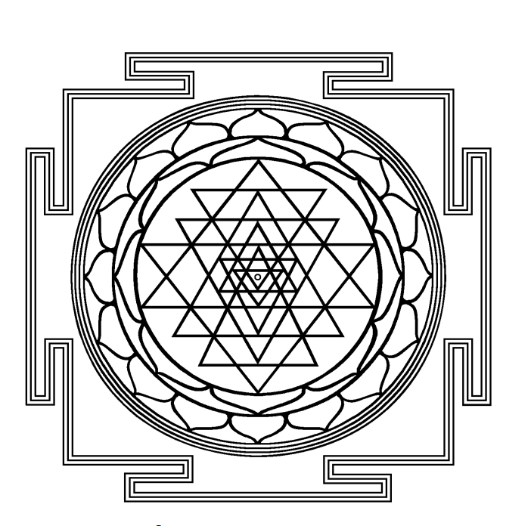
Four Steps to Stay in Balance
Cleanse
your physical and subtle body
Keep
your attention on nature
Sustain
your thoughtless awareness
Understand
the common strands in all religion
Notes:
The Shri Chakra is an ancient symbol found earlier forms already by 10,000 BCE. It is a sacred representation of creation and its nine-fold form. I can do it no justice in one presentation. In essence, the individual soul seeks to travel towards the epicentre of the Shri Chakra from which the creation originates from, passing through the obstacles of each layer by becoming more subtle so as to brave the maze and its progressively more intricate structure. For our purposes today we are only going to focus on one layer of the Shri Chakra, and look at the sixteen petals on the outer rim of the wheel, which make up the subtle causal elements of creation on a macro level and the body on the micro.

Slide 13
And by the soul and the One Who fashioned it,
then with the knowledge of right and wrong inspired it!
Successful indeed is the one who purifies their soul,
and doomed is the one who corrupts it! (91:7-10)
Surah Ash-Shams

Slide 14
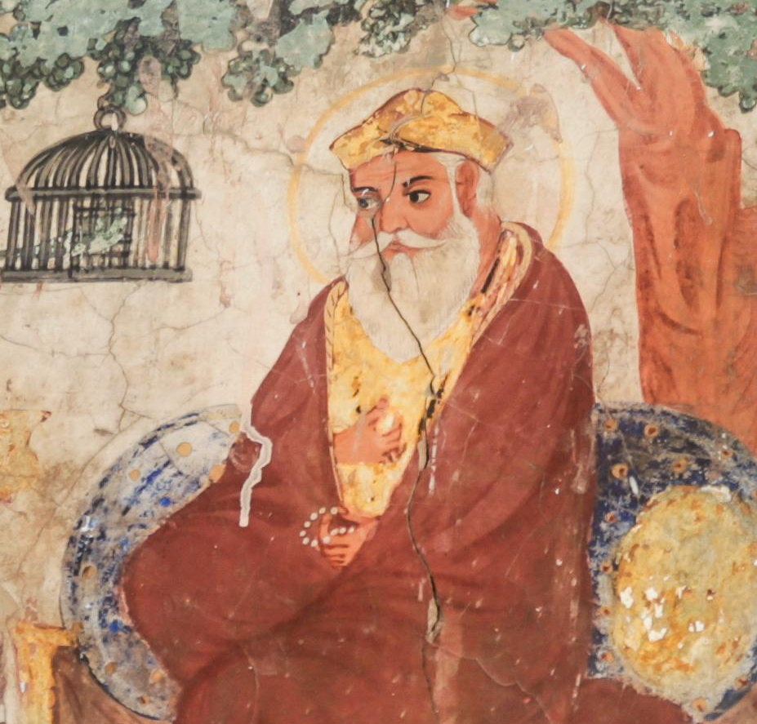
Aisaa naam niranjan ho-ay.
Such personality obtains purity.
Jay ko man jaanai man ko-ay.
If one understands mind is different than self.
Japji Sahib, refrain in Pauri 12-15

Slide 15
Mahashivaratri Puja, Delhi, India (1983)
"Shiva is the ultimate we have to achieve. Shiva is represented in our Spirit. So, to become Shiva is the ultimate aim of every creation."
From 00:00 to 10:15

Slide 16
'The One who is beyond time'

Slide 17
Constituents of Consciousness
Jnānendriyas
Pancha Bhuta

Slide 19
SPIRIT
––––––––
SOUL
Notes:
So let us dissolve the diverse and varied aspects, go beyond words and worlds, and see what is yet to unfold within our being with the power of introspection and meditation–the power of Dhyana.

Slide 20
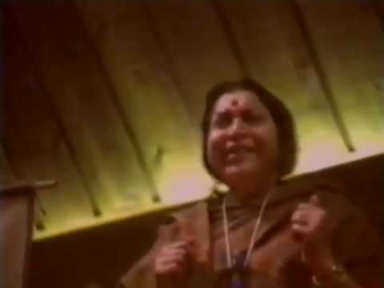
Public Program in Houston, Texas (1981)
"The Spirit is not in our conscious mind. It resides and watches the whole field. In the Bhagavad Gita he's called as Kshetrajna– the one who knows the field."

