Slide 1
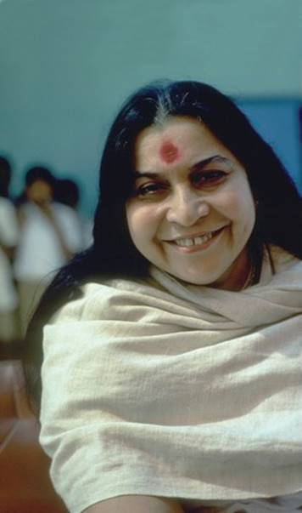
Shri Mataji Nirmala Devi
and the Opening of the Sahasrara

Slide 2
“I want to be smaller, Like a dust particle.
Which moves with the wind
It goes everywhere, can go, Sit on the head of a king
Or can go
And fall at the feet of someone.
And it can go
And sit everywhere.
But I want to be a particle of dust That is fragrant, That is nourishing
That is enlightening.”
Nirmala Salve, age 7

Slide 3
Shri Mataji Nirmala Devi

Slide 4
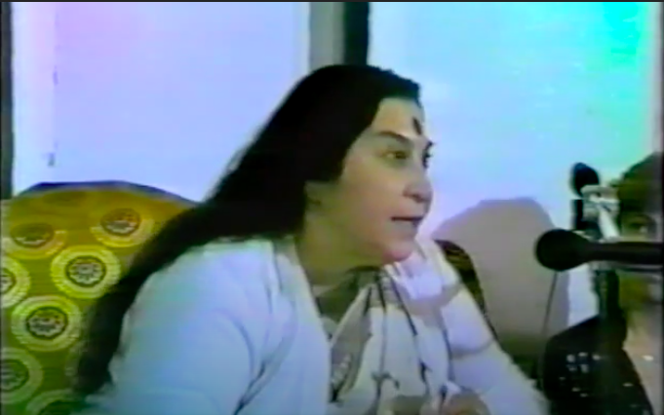
Interview Shri Mataji

Slide 5
The Pivotal Moment
“I felt at that moment whatever energy was there above suddenly entered within me like a cool breeze from every direction. I saw the whole thing open and a big torrential rain of breeze started flowing through my head all over. I felt I was lost now, I was no more. It is only the grace that was there. I saw it completely happening to me.“
Shri Mataji Nirmala Devi

Slide 7
Transformation is Her Legacy

Slide 8
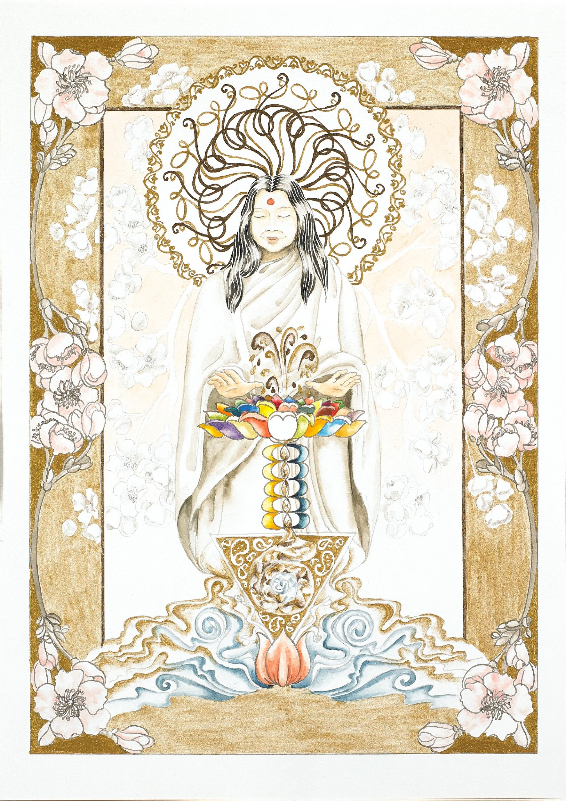
Transformation is Her Legacy
So this Kundalini that is your Mother, she is there to supply you, nourish you, to look after you, to make you grow... by giving you a higher personality - higher personality, wider personality, deeper personality.
11/08/91 Germany
Be kind to yourself. Be gracious to yourself and get your realisation. This is the simple thing as a Mother I would like to tell you. There is nothing to be done except getting your realisation... You are not being forced to do it, your freedom is completely respected. If your freedom is not respected, how are you going to enjoy it, the freedom of your spirit? So it is completely in your hands, be free and accept, whether you get realisation or not.
Australia Monday, April 6th, 1989

Slide 9
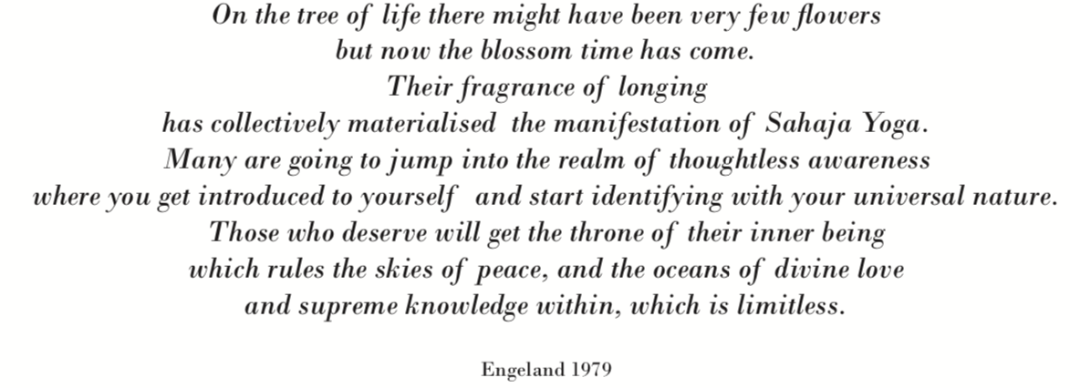

Slide 10
Summary
• Opening of the Sahasrara Chakra: (on 5th of May 1970, India)
- Complete integration and union with the divine
- A universal happening which has up to that point in history never happened before
- Directly linked to the collective (un)consciousness
• The Self-realization:
- A method to awaken the Kundalini in everybody who desires it
- Spontaneous, gentle and instant awakening of the Kundalini without any `sacrifices`
- In complete freedom and respecting the free will
• En masse realization:
- A way to give a large group of people their self-realization at the same time
- The power to pass it on to other people, once your Kundalini is awakened (`one sugar cane can make 10 sugar canes`)
-
• Shri Mataji
- name given by the people who's lives have been transformed through Sahaja Yoga meditation, meaning `respected holy mother`

