Slide 1
SAHAJA YOGA MEDITATION, FREE WILL & SCIENCE

Slide 2
Overview
Footsoak
Video: What the bleep
Presentation
Ekadesh Rudras meditation

Slide 3
The video: and a question
Do we have free will?
Notes:
The frontal lobe is important in decision-making, but we don’t use it.
We use our already wired circuits, taking place in the rest of the brain – the brain becomes hard-wired.
We don’t have free will – we choose what we already know – our accumulated chains of conditionings and habits.

Slide 4
Do we have free will?
Frontal lobe is in charge of firm intention, decision making, regulating behaviour and inspiration.
We use the already-wired circuits, brain becomes hard-wired.
We follow our conditionings and habits
Brain does not know the difference between what it sees and what it remembers.
Notes:
Pursuit of freedom needs to be with the guidance of innate wisdom
If we encounter smth new we approach it based on our pre-existing connections in the brain, our past experiences.
We think we have free will but we stick to what we know, our old ways of thinking and being.

Slide 5
The Kundalini and free will
The Kundalini respects a person’s free will and will only rise if you desire it.
“Through totalitarian regimes you are oppressed from outside, but this so-called freedom, this freedom of abandonment, destroys you from within… without Self-Realisation, one cannot understand the power of freedom.”
Shri Mataji
Notes:
Pursuit of freedom needs to be with the guidance of innate wisdom
On the one hand, we have complete freedom to do what we like to but on the other hand, we go to extremes and abandon our morals, the dharmic way of being in pursuit of physical desires, such as drinking, taking drugs etc.

Slide 6
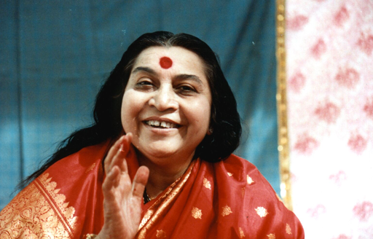
Shri Mataji on freedom
“Human beings should not take freedom as abandonment, but freedom to enjoy completely and fully. The freedom that takes you to destruction is not freedom. The right idea of freedom must be taken.
And, people should know that freedom, ultimate freedom, is when you become your own master, when there are no habits, when you cannot be dominated by anything. You are above everything. That’s the freedom you have to achieve.”

Slide 7
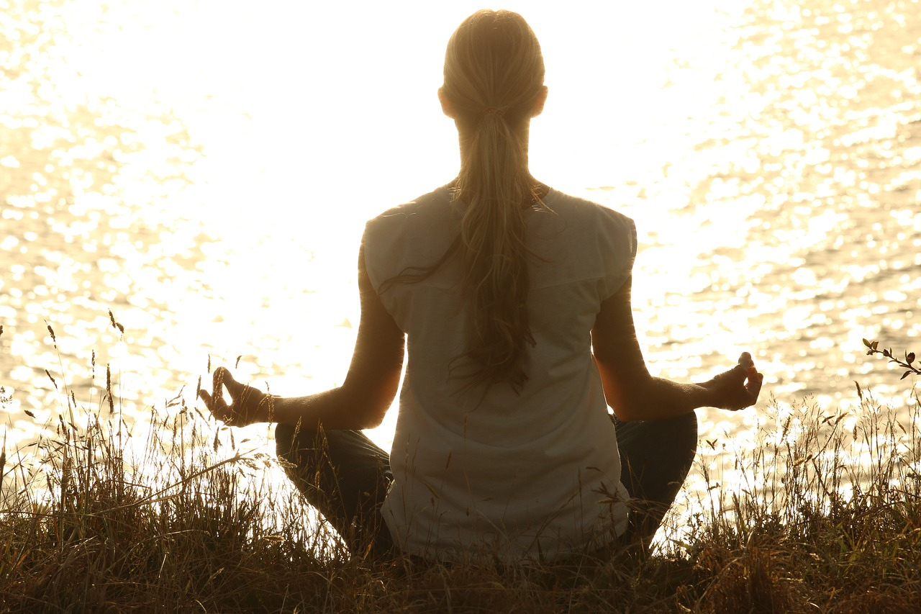
THE SCIENCE: What happens when we meditate?
Our metabolic activity is reduced (different from sleep)
We relax physically
We relax mentally
Notes:
Just a description of what happens when we meditate. It slows us down, making us more relaxed, peaceful.

Slide 8
West vs. East Source. (Hernandez et al., 2018)
Western psychology: 3 states of consciousness:
Deep sleep
Dreaming
Wakefulness
Eastern philosophy: recognises a 4th “superior” state
4. Mental silence or consciousness without thoughts: Nirvichara Samadhi
Notes:
In the west we have completely overlooked the fourth state of consciousness. What is the aim of meditation? To become thoughtless and experience the state of mental silence, which is completely lacking in the West.
SY mediation gives us tools to experience this state of thoughtlessness. Thanks to SY we can reach and enjoy this state collectively.
Other meditations do not provide tools for becoming thoughtless.
How is your meditation going? Do you experience mental silence? Do you manage to stay in a meditative mood throughout the day?

Slide 9
The effects of meditation
Improves our psychological balance
Improves our emotional stability
Reduces stress, depression & anxiety

Slide 10
THE SCIENCE & Sahaja Yoga Meditation
8-year study into the state of mental silence from the perspective of neuroscience and health at Kings College London, University of Leipzig, and Spanish universities in Castellon and Tenerife.
Findings presented in journal Neuroscience
Researchers recorded brain anatomy and functional connectivity in a state of mental silence during meditation in a magnetic resource scanner.
23 SY practitioners and 23 non-meditators.
Notes:
Functional connectivity = a neuroimaging technique which shows how different areas of the brain work together to perform different functions
23 volunteers experienced in Sahaja Yoga meditation and a group of 23 non-meditating volunteers participated. Both groups were very similar or equivalent in age, educational level, ethnicity, etc.
Their brain anatomy was compared.

Slide 11
Definitions
Gray matter. Contains most of the brains neuronal cell bodies. It serves to process information in the brain. Located throughout the CNS in both the spinal cord and brain.
High concentration of grey matter in various parts of the brain is positively linked to general intelligence.
Gray matter is highly heritable but also strongly influenced by environmental influence.

Slide 12
Examples
An increased volume of gray matter in Broca's area of professional musicians, reflecting, at least in part, the number of years devoted to musical training.
An increased volume of gray matter in the posterior hippocampus of experienced London taxi drivers (a brain region involved in spatial navigation), with volume correlated with length of taxi-driving experience.
An increase in the development of new brain cells in older adults who underwent an aerobic training program compared with those who did not.
Notes:
An increase in gray matter in different parts of the brain is positively linked to an activity related to the respective brain region.

Slide 13
THE SCIENCE and Sahaja Yoga meditation: Findings Part 1
A region in the brain called the rostral anterior cingulate cortex (rACC) is directly related to the ability to be in mental silence.
The meditators had an average of 7.5% more grey matter than the non-meditating group in this area.
The meditators who experienced a deeper mental silence in their meditation in the scanner had more grey matter in this area than those with a less lasting mental silence.
Notes:
What is grey matter? Grey matter serves to process information in the brain. Contains neuronal cell bodies. Is present on the outside of the brain, and inside of the spinal cord. Regions of the brain with a lot of grey matter are: Cerebrum or cerebral cortex – outer layer of the largest and uppermost part of the brain. Essential to many aspects of higher learning, including attention, memory and thought The cerebral cortex is responsible for integrating sensory impulses, directing motor activity, and controlling higher intellectual functions. Cerebellum – essential for movement and coordination - muscle control, coordination precision. Has the highest concentration of neurons in the brain.
Grey matter contains most of the brain's neuronal cell bodies. Regions of the brain with grey matter are those involved in muscle control, and sensory perception such as seeing and hearing, memory, emotions, speech, decision making, and self-control.
High alcohol consumption has been correlated with significant reductions in grey matter volume.

Slide 14
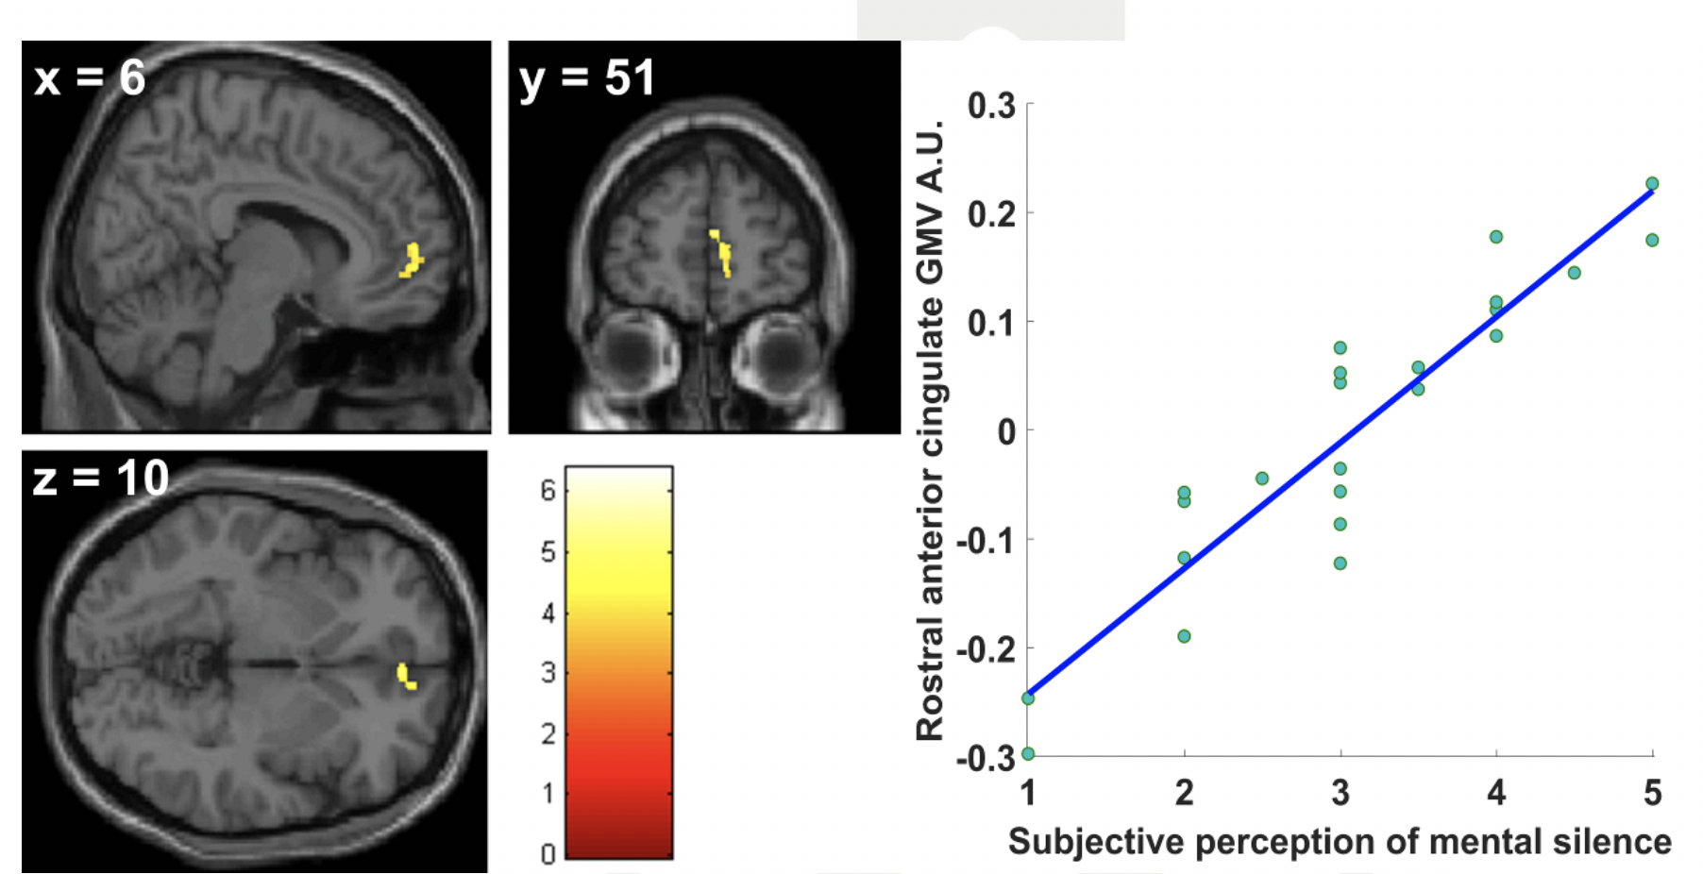
Notes:
Where in the brain is the yellow area?
Relate back to the frontal lobe.

Slide 15
THE SCIENCE and Sahaja Yoga meditation: Findings Part 1 cont.
According to recent scientific publications:
People with mental illnesses have less grey matter in the rACC.
People who are happier and have greater self-control over their emotions have more grey matter in this area.
Notes:
Mental illnesses characterised by the difficulty of stopping the torrents of thoughts (anxiety, depression, hyperactivity, attention deficit), as well as other more serious mental conditions (schizophrenia, autism)

Slide 16
THE SCIENCE and Sahaja Yoga meditation: Findings Part 2
Meditators experienced greater functional connectivity between rACC and areas in both hemispheres of the brain in charge of internalised attention and simple state of joy.
State of mental silence produced a disconnection of the rACC with the thalamus – less attention to the outside world in favour of greater internalised attention during meditation.

Slide 17
THE SCIENCE and Sahaja Yoga meditation: Conclusion
Mental silence experienced through Sahaja Yoga meditation is associated with the development of neural networks and areas in the brain that are crucial for the control of attention and emotions.
This may have a direct positive impact on mental health and indirect impact on physical health.

Slide 18
Other studies: Effect of Sahaja Yoga Meditation on Quality of Life, Anxiety and Blood Pressure Control
Study compared two groups receiving treatment from:
International Sahaja Yoga Research and Health Center
Mahatma Gandhi Mission Hospital (control group)
Measurements taken before and after treatment

Slide 19
Results
Meditators
Significant improvement in quality of life, anxiety and blood pressure
Non-meditators
Quality of life deteriorated
No improvement in blood pressure

Slide 20
Sahaja Yoga: An Ancient Path to Modern Mental Health?
Research thesis, University of Plymouth, by Adam Morgan
Conclusion:
Sahaja Yoga is a valuable and promising treatment for anxiety and depression

Slide 21
Sahaja Yoga Meditation as a Family Treatment Programme for Children with ADHD
Universities in Australia, King’s College London
Sahaja Yoga Meditation may offer families an effective management tool for family-oriented treatment of childhood ADHD.
Notes:
ADHD: Attention Deficit Hyperactivity Disorder

Slide 22
Results
Children
Benefits at home:
Better sleep patterns
Less anxiety
At school:
More able to concentrate
Less conflict
Parents
Felt happier
Less stressed
More able to manage their child’s behaviour

Slide 23
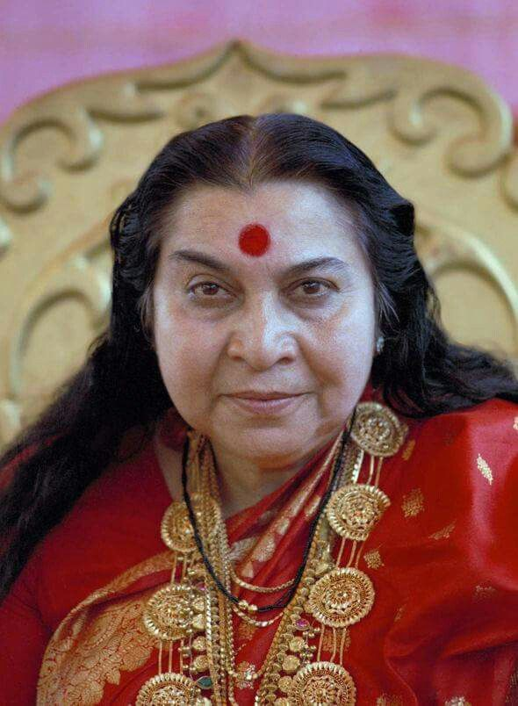
Meditation
EKADESHA RUDRAS
Notes:
In Hinduism and Buddhism, they are called the 11 destructive powers of Shiva that are in the frontal lob.
Destructive does not mean black magic, but the destruction of all inner negativities.
Each centre represents a different type of negativity.
We will have a special meditation to activate the powers to destroy negativity within us.

