Slide 1
Mooladhara Chakra Pelvic plexus
Week 7:
discover the roots of your true Self!
''Mool'' = Root ''Adhar'' = Support

Slide 2
Earth element
- Representing the beginning of life
- Foundation of Subtle system
- Situated below the abode of the Kundalini
- Support of Kundalini and entire subtle system within you

Slide 3
Within you there are roots which create a balance between your inner and outer existence
Mooladhara Chakra allows our Kundalini to Rise
Governs:
Excretory
and
reproductive
organs

Slide 4
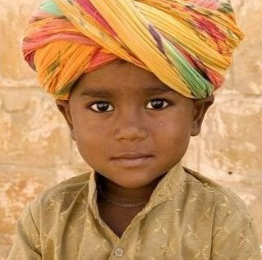

Slide 5
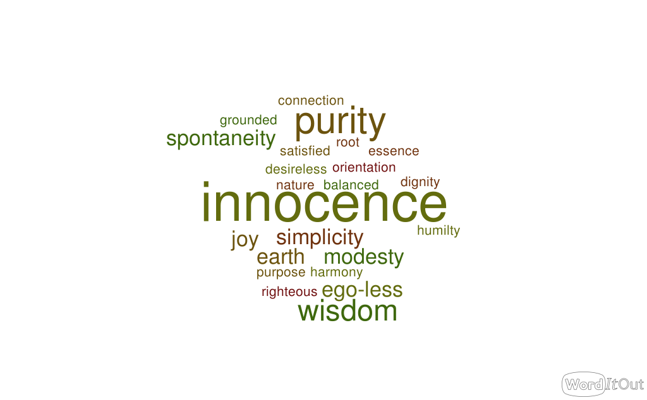

Slide 6
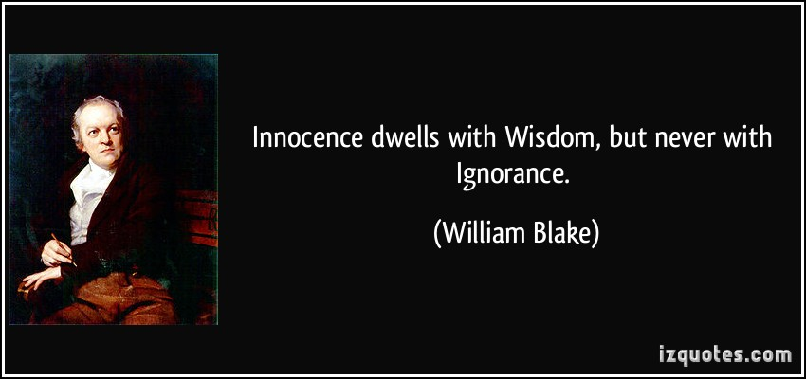
What is Innocence?

Slide 7
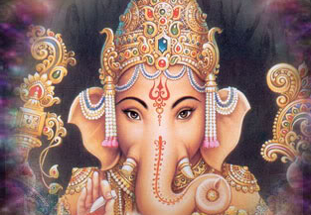
Symbolism
Shri Ganesha
Role model for Mooladhara
Embodiment of Innocence and Wisdom

Slide 8
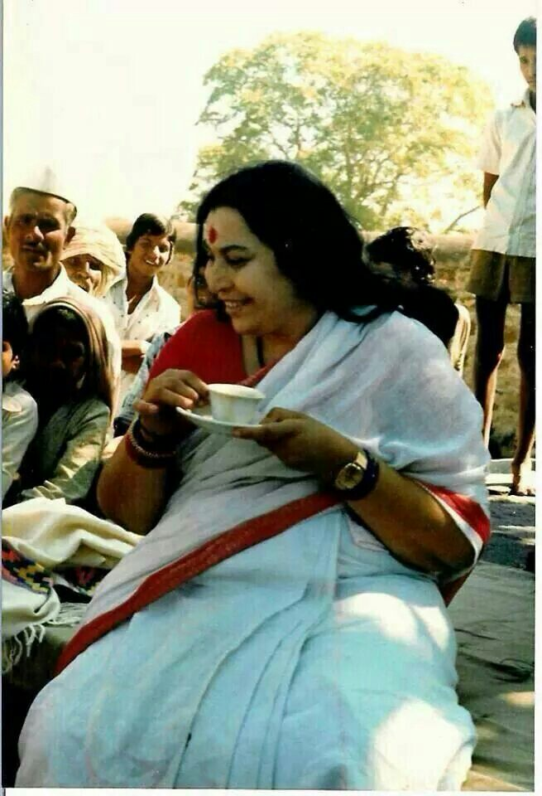
''Innocence is such a great thing that it cannot be destroyed. It is the quality of the Spirit. It has all the wisdom of the world, all the understanding of the world; and when anybody tries to harm the innocence, the world, the whole world – which may not have cared so much for innocence, might not have worshiped innocence so much – they all stand up against anybody who tries to harm the innocence. You can see in your own lives around you, when anybody tries to trouble children – all of them, whatever they are, whatever they are coming from, whatever maybe their nationality, they all jump, all jump to control and to safeguard that child. What is it? What is it within us that makes us so very conscious to protect the innocence? It’s really a shame, a great shame for us, when we find in this world that innocence is under attack. Anything else can be tolerated.''

Slide 9
What is Spontaneity?

Slide 10
Obstacles blocking the Mooladhara chakra:
- Letting lust and greed dominate
your life
- Overthinking too much
- Taking advantage of situations,
Cheating, misleading
- Letting your Ego guide you
- Overindulgence
- Perverted attention
- Disrespecting innocence
- Unauthorized attempt to raise Kundalini

Slide 11
Meditate on the quality of innocence to develop this power
Sitting/meditating on the Mother Earth
Maintain purity of eyes and thoughts
Meditation
every day
Footsoak
Be honest
with yourself
Watch your attention
and intentions

Slide 12
When our Mooladhara is balanced, it grants us:
- Help us keep emotional balance and mental balance
- Keeps us from getting into depressive or lethargic states
- Keeps us from over-planning and over-indulging
- Achieve thoughtless awareness faster due to less identification with ego and super-ego
- Strong sense of right and wrong
- Stable eyes
- Strong attention
- Keeps us to remain harmony
with nature
- Gives us the ability to raise our
Own and other's Kundalini
Soothes our attention and the subtle system by allowing the Kundalini to rise.

Slide 13
When your roots
are strong, you are a balanced, joyful,
satisfied and loving person who is
desireless and truly free.

Slide 14
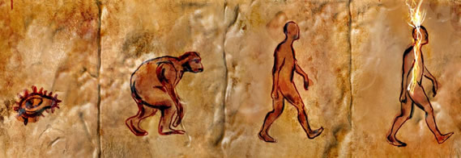
Inner knowledge / Outer knowledge
Light of Innocence
https://www.youtube.com/watch?v=N4Cb9Zn6MYE
Shri Mataji Nirmala Devi

