Slide 1
The Ego
Mechanisms, Tricks, Disguises & Identifications

Slide 2
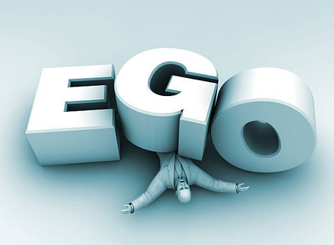
Why do we need to know
how the ego works?
Notes:
Unless we know the basic mechanics behind the workings of the ego, we won’t recognize it and it will trick you into identifying with it again and again.

Slide 3
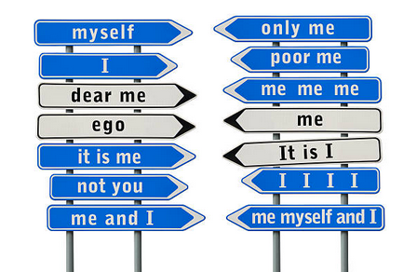
What is the ego?
Identification with forms
Content: what
Structure: compulsion to identify
Notes:
Primarily thought forms but also physical forms and emotional forms.
It consists of content and structure. What you identify with is the content. The unconscious compulsion to identify with something is the structure.

Slide 4
What is the ego?
Wanting is stronger than having
Results of unfulfilled wanting
Notes:
Wanting keeps the ego alive much more than having. Wanting is structural and not amount of content (having) can provide lasting fulfilment.
Unease, restlessness, boredom, anxiety, dissatisfaction, are the result of unfulfilled wanting.

Slide 5
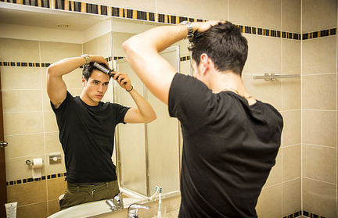
Levels of identification
Material things
Body and appearance
Thought forms
Emotional forms
Both create energy formations
Notes:
The ego satisfaction is short-lived and so you keep looking for more.
More fundamental than things and bodies is thought & emotional forms. They are energy formations.

Slide 6
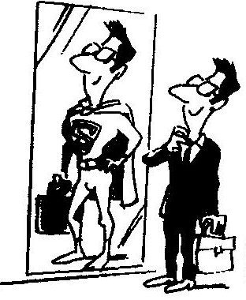
Other personal identifications
Possessions, opinions & external appearance
Long-standing resentments
Concepts of yourself
Notes:
Concepts of yourself as better or worse than others, of success or failure.
The content changes, but the same structure operates in every ego.

Slide 7
One way the ego feeds itself
Incessant stream of thoughts – thinking happens to you!
Notes:
Most people have an incessant stream of thought. Most people’s thinking is mostly involuntary, automatic, and repetitive. It fulfils no real purpose.

Slide 8
What is the ego - aspects
Thought and emotion.
A bundle of memories you identify as ‘me and my story’
Roles
Collective and personal identifications
Notes:
Examples of collective & personal identifications: nationality, race social class or position, profession etc.

Slide 9
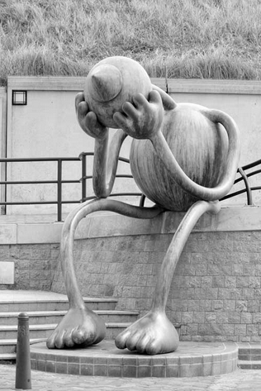
Role playing
We are unaware
Get attention (psychic energy)
Victim
Extravert
Shy person
Notes:
Usually people are completely unaware of the roles they play.
Some roles are designed to get attention from others. The ego thrives on others’ attention, (‘psychic energy’).
A shy person wants and fears attention from others. The fear is that the attention may take the form of disapproval or criticism.
Victim role: once identified with a story in which I assigned myself the role of victim, the ego does not want an end to its “problems” because they are part of its identity.

Slide 10
Ego delays happiness
To sometime in the future
Never, because of the past
How to be at peace?
Be in the present.
The ego is afraid you’ll find out, because that will be end of the ego.
Notes:
The ego says: Maybe at some point in the future, I can be at peace.
Or it says: I can never be at peace because of something that happened in the past.
The ego doesn’t know that your only opportunity for being at peace is now.
It is afraid that you may find this out. Peace, after all, is the end of the ego.
How to be at peace now? By making peace with the present moment

Slide 11
Beyond Ego: Your True Identity
How to become free of the ego? Be aware of it - awareness and ego are incompatible. Awareness is the power hidden in the present.
When we have our Spiritual Realisation we can clearly see that we are not what we see, experience, think or feel. These are only temporary.

Slide 12
Beyond Ego: Your True Identity
When we are conscious in the present, we can recognise the unconsciousness in us.
We cannot fight our ego and win. We just need the light of consciousness.
WE ARE THAT LIGHT

Slide 13
Beyond Ego: Your True Identity
Not reacting to the ego in others is one of the most effective ways of:
- going beyond our own ego
dissolving other people’s ego.
Forgive: others and ourselves

Slide 15
