Slide 1
Communication & Expression
The Vishuddhi Chakra

Slide 2
Overview evening
Chakra clearing meditation
Vishuddhi Chakra
Communication/ Connectivity
Experience being connected
And playfulness
Meditation

Slide 3
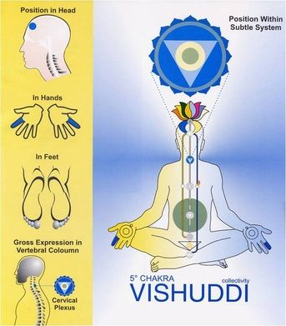
Vishuddhi Chakra
Physical: Cervical plexus/ Thyroid
- looks after, throat, arms, face
mouth, teeth
Number of petals /sub-plexuses: 16
Communication/ expression
Vibratory awareness

Slide 4
Notes:
Physical: Cervical plexus
Neck, throat
Thyroid
Face & expression
Mouth, tongue, teeth
Nose, sinuses
Ears
Skin
Arms

Slide 5
How Kindness generates connectivity
What is Kindness, what does it mean for you?
KIN - Relationship
Next of Kin means family,
people who are connected
What do scientists say:
Emotional bonds are as necessary to MANKIND as food and water.
Infants – connected – explores
deprived - disengage
- John Bowlby -
Notes:
Vishuddhi chakra plays a very important role, because connects you to the whole - Virat

Slide 6
THE CONNECTING CULTURE
We still need to feel safe, heard and seen.
Gallup: people who experience interpersonal connections in the workplace have a lower heart rate with a stronger immune system
Positive social interactions not only lead to health improvement but also improved productivity and creativity

Slide 7
Communication
Ingredients for good communication
Mastering anger
Humour/ playfulness
Sweetness
Diplomacy
Tact
Respect
Notes:
Diplomacy
Sweetness - dissolve people with sweetness, don’t get angry
Tactfulness
Respect for others
1. Humility - first quality of communication is to be extremely humble about yourself. You must always show that you are less intelligent than another person.
2. Master your own anger
3. Master (anger of) others
4. Humour: So, in communication with others, you have to be a very humorous person. NO SARCASM
But mostly I’ve seen, people have humour if somebody cannot walk straight, if a physical problem is there, they’ll laugh. If he has, say, not properly made his hair, then they will laugh. On some sort of very superficial thing, they laugh. This is not humorous. This is some sort of a criticism in laughter. Or some people have a humour like this, that they say sarcastic things. That’s no good. If you say one word to somebody sarcastic you think you are very brilliant, but you are lost forever for that person. That person will remember : “He said such-and-such things to me.”
So sarcasm is against you completely, against Sahaja Yoga. If you have to say something, say it in such a manner that it doesn’t hurt the person and the person enjoys that subtle humour and understands also that this is the problem with me.
Now, humorous way is, say, if I have to tell something to you, I need not tell you directly you are like this, you are that, but I say: “There was one, you see, crow which came to my house and like that I can transfer all your qualities to that crow and describe to you. I’ll say that: “this crow did like this and did that.” Immediately, you’ll start thinking : “Is it about me that Mother was saying or about the crow?”
So transfer it to somebody else. Transfer it somebody else. That’s the best way. Shri Krishna Puja, Yogeshwara – The Technique of the Play

Slide 8
Qualities
Communication
Left
Self-respect
Pure relationships
Center
The witness
Detachment
Collectivity
Right
Diplomacy
Tactfulness
Sweetness
Respect for others
Notes:
Through Vishudhi chakra you feel connected to the whole

Slide 9
Vishuddhi problems
Left
Feeling guilty
Low self-esteem
Not talking when needed, not expressing feelings
Center
Attachment
Individualism
Right
Reacting
Feeling superior to others
Being aggressive
Harshness
Talking too much
Notes:
Be kind to yourself and to others

Slide 10
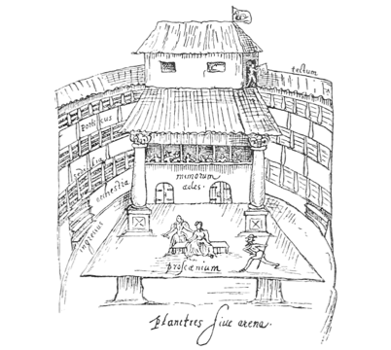
Witness: what does that mean for you?
“All the world’s a stage And all the men and women merely players; they have their exits and their entrances And one man in his time plays many parts...”
William Shakespeare
Notes:
All the world's a stage, And all the men and women merely players; They have their exits and their entrances, And one man in his time plays many parts.
Can become a great actor if Vishuddhi is working well.

Slide 11
WITNESSING
Without thinking
You have empathy
You do not need to react
It does not make you feel bad.
The power of Silence:
Thoughtless Awareness that connects you to the All Pervading Power and makes you see Reality/ the Play
Comparing with creative thinking/ theatre Improv

Slide 12
A good place to start:
Smile and the whole world smiles with you
Moods are contagious
You can influence with positivity.
The feel good neurotransmitters – dopamine, endorphines and serotonin are all released when you smile
Does wonders against stress

Slide 13
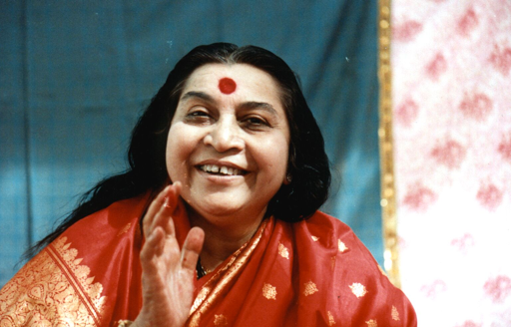
Expression
“Express the love! When you speak to someone, find out what they need, so you can help them. Speak in a way that you won’t hurt them.”
Shri Mataji

Slide 15
GAMES
To experience :
Self- respect/ bodylanguage
Being connected
Playfulness
Witness of the Game

