Slide 1
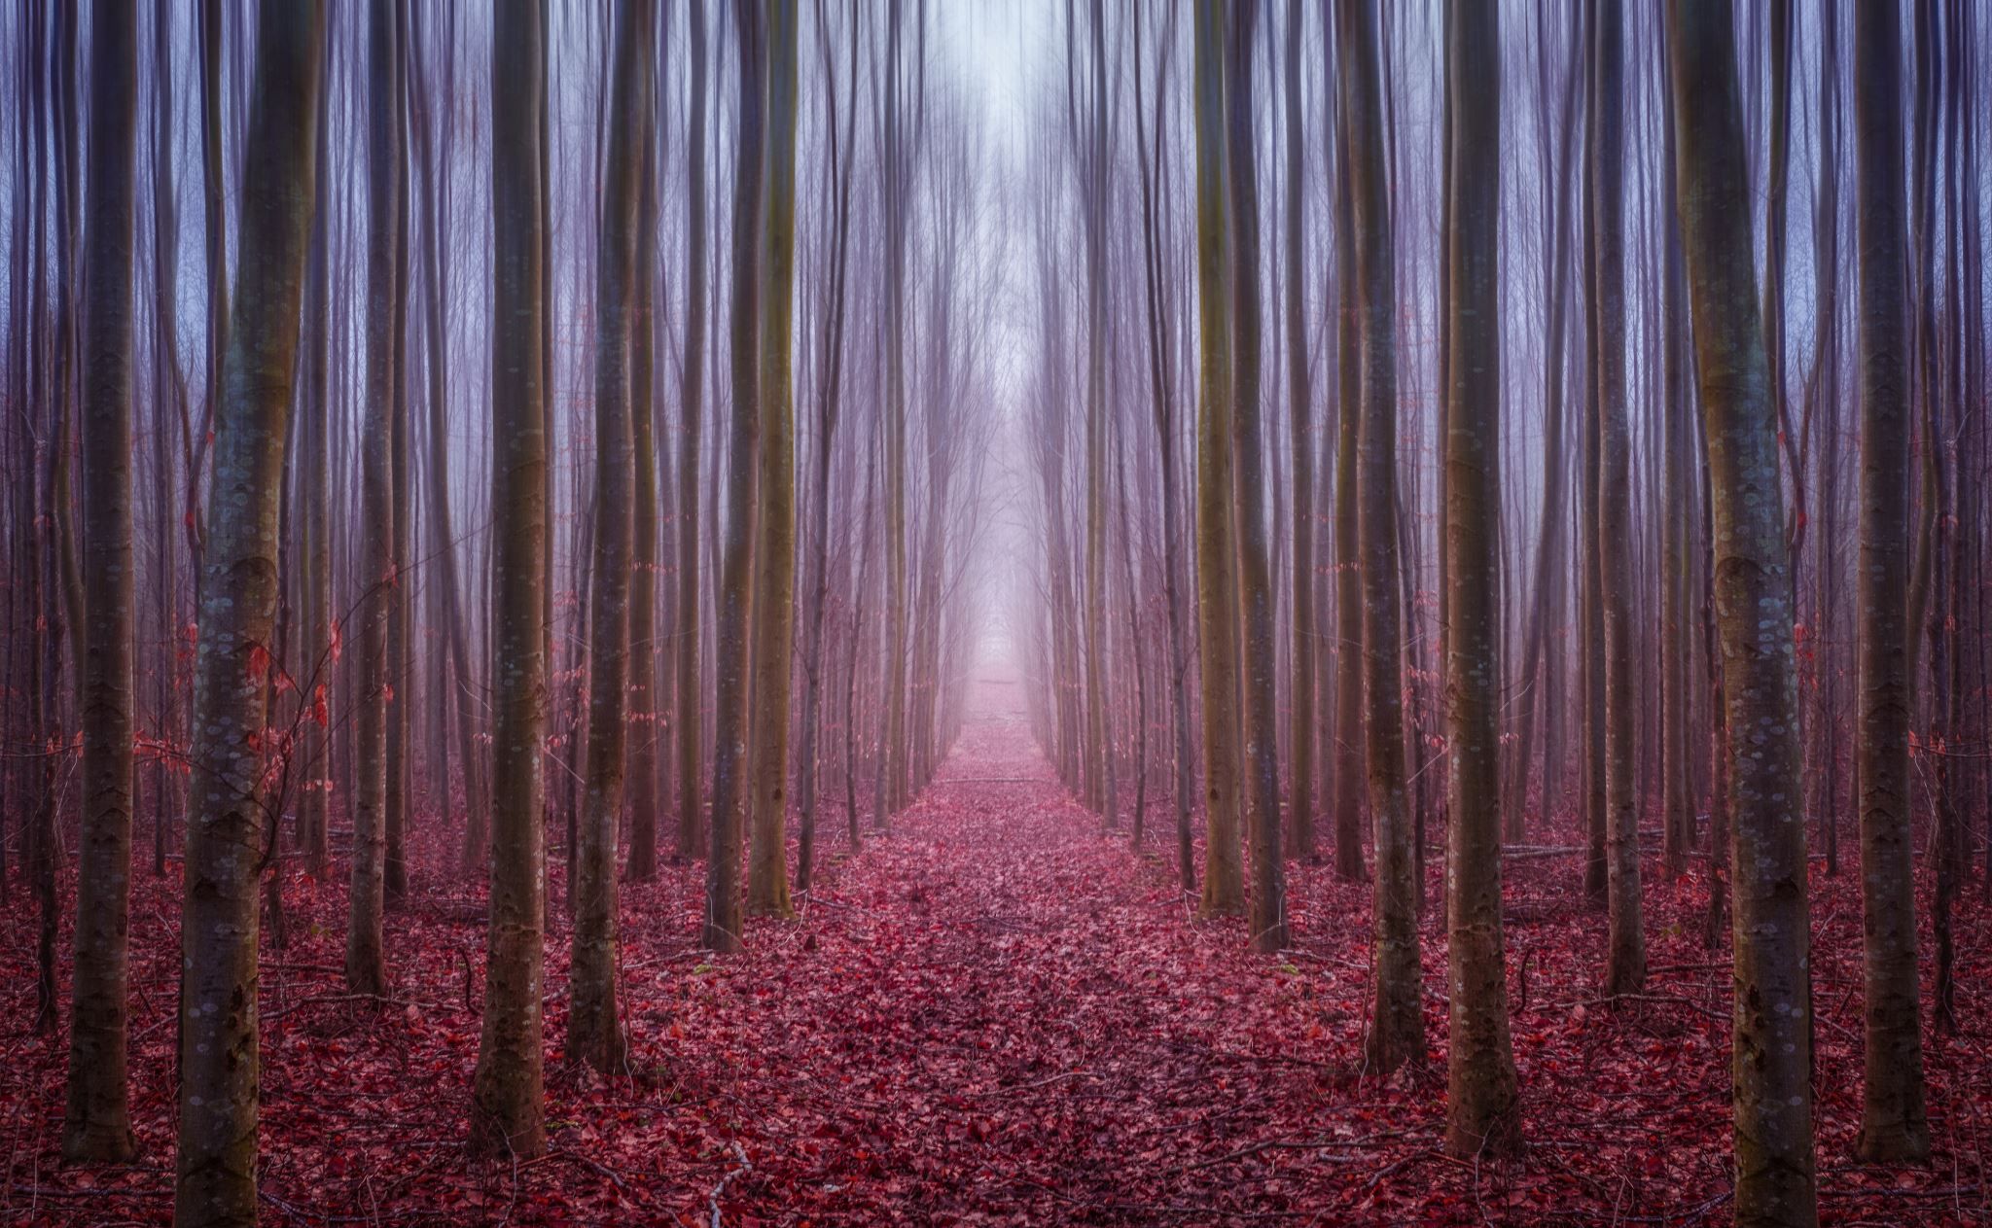
FEAR
& UNCERTAINTY
AND HOW TO OVERCOME IT

Slide 2
FEAR
WHERE DOES IT COME FROM?

Slide 3
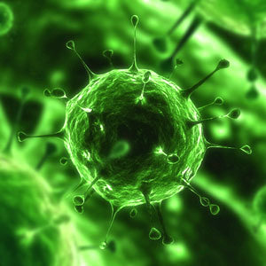
SOURCE: Where do our fears come from?
We are all unique
Past experiences
Personal & collective subconscious
Fear of the unknown
Uncertainty
Insecurity
This Photo by Unknown Author is licensed under CC BY-SA-NC

Slide 4
FEARS
HOW DO OUR FEARS AFFECT US? HOW DO WE COPE WITH THEM?

Slide 5
EFFECT:
WHAT DO OUR FEARS DO TO US?
This Photo by Unknown Author is licensed under CC BY-NC-ND
Notes:
Physical effects:
Causes stress
Higher heart rate
Sweating
Anxiety
“This is not pleasant and that’s why we try to reduce uncertainty in all sorts of ways, to take control of the situation.” Frenk van harreveld, Social psychology, UvA
From article in the NRC Handelsblad (major Dutch newspaper), Sat 21 March & Sun 22 March 2020: Omgaan met zekerheid. (Coping with uncertainty) Uncertainty has been less researched than fear as a psychological phenomenon.

Slide 6
UNCERTAINTY
“It helps to bring order and structure in your life,” van Harreveld
“This is not pleasant and that’s why we try to reduce uncertainty in all sorts of ways, to take control of the situation.”
“We try to create the appearance of certainty.”
This Photo by Unknown Author is licensed under CC BY-SA
Notes:
If we’re not in control we want to know that others are – government, scientists.
Currently many of us are experiencing unparalleled uncertainty in our lives. And for the future. “Ik begijp wel dat mensen veel wc-papier kopen.” van Harreveld. ”I understand why people are stocking up on toilet paper.”

Slide 7
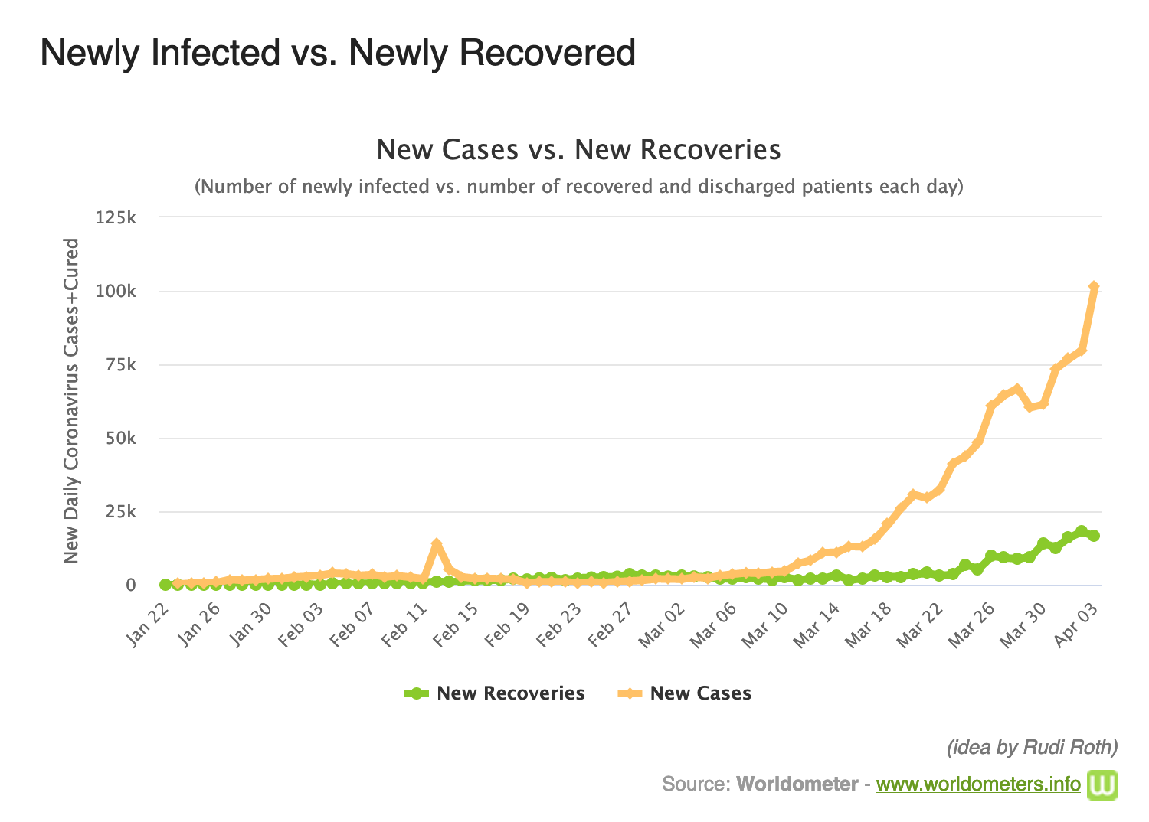
Notes:
“Various people who I had no idea knew how to do this sort of thing, suddenly started sending me graphics.”
van Harreveld

Slide 8
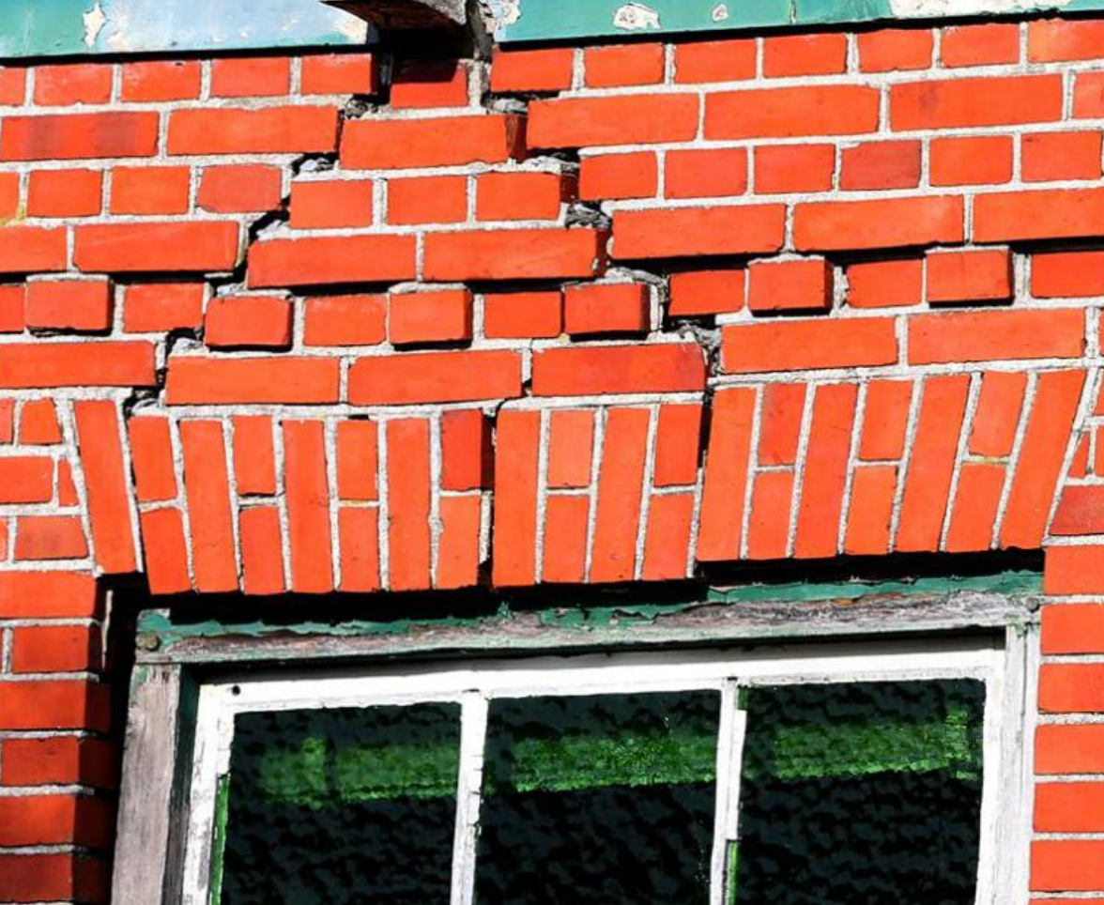
GRONINGEN EARTHQUAKES
Research into state of mind of inhabitants by Tom Postmes
Notes:
The article in the NRC about coping with uncertainty also referred to this research conducted into earthquakes in the northeast of the Netherlands around Groningen. The earthquakes are the result of drilling for gas, causing structural damages to thousands of homes and buildings – like cracks, and sagging external walls. Some houses are being torn down.

Slide 9
HOW WE REACT:
We are all unique, we all react differently
Character
Some people are more resilient
Others have more trouble coping
RESULTS OF RESEARCH INTO GRONINGEN EARTHQUAKES
Notes:
Also in the NRC was an article about a woman giving psychotherapy, who has now shifted her practice in Amsterdam to walks in the dunes with clients. She treats people with stress, burnout, traumas and anxiety. And she is seeing a worsening of people’s complaints particularly for anxiety and worries, as a result of the coronavirus.
“One patient has to go to her work but is terrified that she will catch the virus and give it to her elderly father.” This woman was panicking so much that she could no longer think rationally. And then you can no longer decide what you should or should not do to avoid catching the virus.
How do psychologists treat fear – usually by exposing someone to whatever it is that they fear, in order to experience that their fears are (largely) unfounded. But in this case, asking someone to regularly travel with the train or be exposed to the virus isn’t possible!

Slide 10
HOW WE COPE:
How people cope depends on:
The level of control they have over the situation
The extent to which problems dominate their lives
The hopeful people managed to
Put the situation into perspective
Concentrate on activities that gave them energy
RESULTS OF RESEARCH INTO GRONINGEN EARTHQUAKES

Slide 11
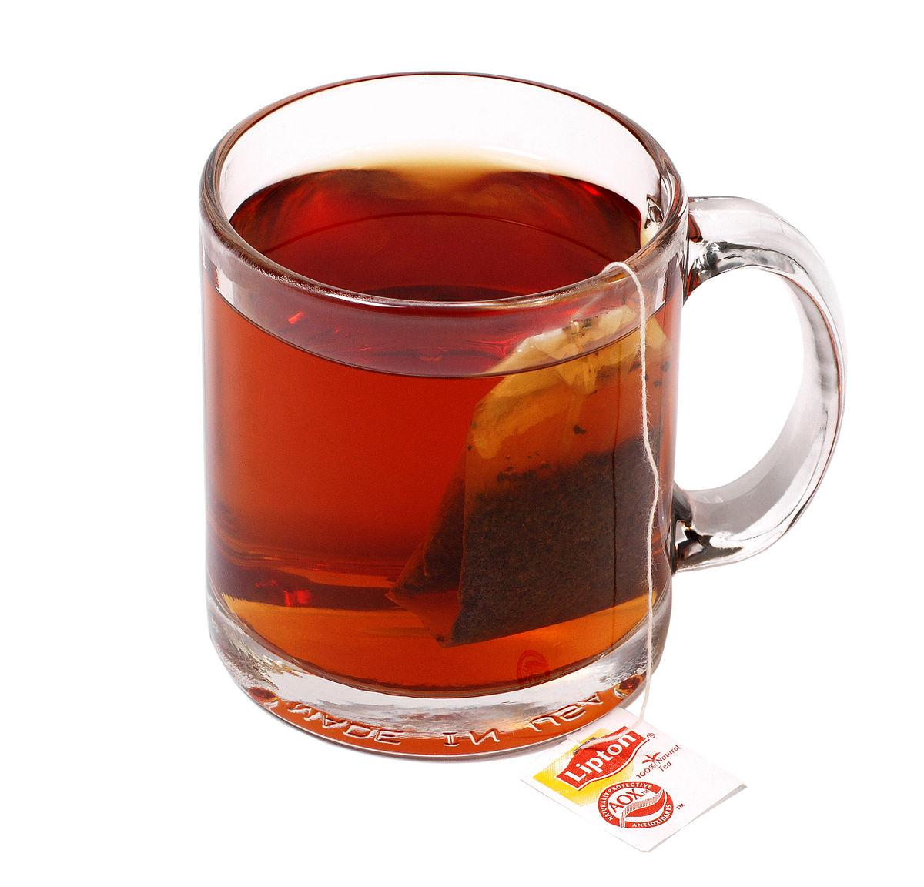
PRACTICAL TIPS
Plan your day with concrete aims
Take a daily tea break!
Don’t watch the news too much
Focus on what you can do for others
This Photo by Unknown Author is licensed under CC BY-SA
Notes:
Suggestions from scientists in NRC article

Slide 12
FEAR & UNCERTAINTY: THE EFFECT ON OUR SUBTLE SYSTEM
This Photo by Unknown Author is licensed under CC BY-SA

Slide 13
Heart chakra – why it’s particularly important to work on it right now
When we have a strong centre heart chakra:
It produces antibodies and gives us a strong immune system to ward off illness
Gives us a feeling of security
We can trust ourselves, others and that we will be fine
We have courage to face challenges
Notes:
Causes of catches:
Fears
Growing up in an unhappy family
Feelings of insecurity
Right now we have plenty of feelings on insecurity, uncertainty and even fears

Slide 14
How fear affects our heart chakra
Left heart
A cloud covering our Spirit
Cannot feel love, joy or compassion
Heart palpitations
Centre heart
Fears accumulate here
Centre most affected
Affects immune system
Right heart
Excessive responsibility and control
Notes:
We need to work on our heart chakra at the moment with all the fears and uncertainty resulting from the coronavirus. We are all affected in some way, some of us more than others. Some of us may know someone who has or has had the virus. Perhaps someone close to us. Perhaps someone who has been hospitalized. We may even have had it ourselves or be carrying it. We may have elderly relatives we do not want to infect, like a friend of mine in the UK. Her whose mother is living with her and her family and my friend had to go to hospital for an investigation. Someone dear to us may have passed away from it in another country and been unable to be there at the last moment, like the colleague I work closest with at the moment.

Slide 15
How to strengthen our centre heart
Stay positive, keep things in perspective
Breathe in and out deeply
Get outside, exercise
Know that we are continuously under the protection of a higher power
Give a bandhan

Slide 16
How to strengthen our centre heart
Affirmations:
Please take away my fears
Please give me courage and confidence

Slide 17
HOW TO OVERCOME OUR FEARS
Say Ma Jagadamba x 12
Say 9 names of Shri Durga
Candle treatment on centre heart
Ask someone to work on you & tap centre heart on your back
SAHAJA YOGA TREAMENTS FOR THE HEART
This Photo by Unknown Author is licensed under CC BY-SA

Slide 18
How fears in our nabhi chakra manifest
Left Nabhi
Lack of inner peace
Lack of satisfaction
Right Nabhi
Restlessness
Worries
Physical effects:
All organs governed by nabhi: - stomach, intestines, pancreas, liver, uterus, spleen
Notes:
Some of us might be struggling with the fear of losing their job or the uncertainty of having lost their job, had their contract reduced or suddenly no work at all as a result of the virus. Or are worried about losing their job. I had the good fortune after years of working freelance of being given a permanent contract at the beginning of the year. But other freelancers working in my department have had their contracts shortened by 2 months.

Slide 19
HOW TO OVERCOME OUR FEARS
Work on the nabhi and void
Footsoak
Say the mantra *Bhaya Nashini to destroy the fears in our nabhi (*without Shri)
Affirmations: I am peaceful and satisified
SAHAJA YOGA TREAMENTS FOR THE NABHI
This Photo by Unknown Author is licensed under CC BY-SA

Slide 20
Fears in our vishuddhi chakra
Vishuddhi
Fears result from our inability to be detached and to see what is happening as a play
Fear of confronting people, standing up for ourselves (left)
Notes:
(fear of losing job, prestige, social position, losing a certain standard of living)

Slide 21
HOW TO OVERCOME OUR FEARS
Work on the vishuddhi
Wear a scarf to protect this chakra
Gargle with vibrated salt water
Affirmations: Please make me a detached witness. Let me see the play of life.
SAHAJA YOGA TREAMENTS FOR THE VISHUDDHI
This Photo by Unknown Author is licensed under CC BY-SA

Slide 22
Fears in our superego
Source
Past events
Personal and collective subconscious
Effects
“Your body makes the same stress hormones when thinking about a trauma (past event) as by the thought of a future image of doom,” Carien Karsten, psychotherapist

Slide 23
HOW TO OVERCOME OUR FEARS
Work on the superego
Affirmations: Please take away all my conditionings. I am not my past. I am not any negative emotions. Please remove any negativity coming from the personal or collective subconscious.
SAHAJA YOGA TREAMENTS FOR THE SUPEREGO
This Photo by Unknown Author is licensed under CC BY-SA

Slide 24
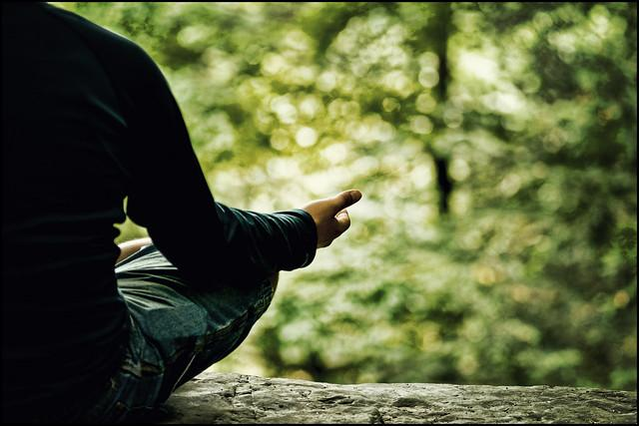
MEDITATE
Which chakra is affected?
Say affirmations or mantra for that chakra
Sahaja Yoga treatments
This Photo by Unknown Author is licensed under CC BY-NC

