Slide 1
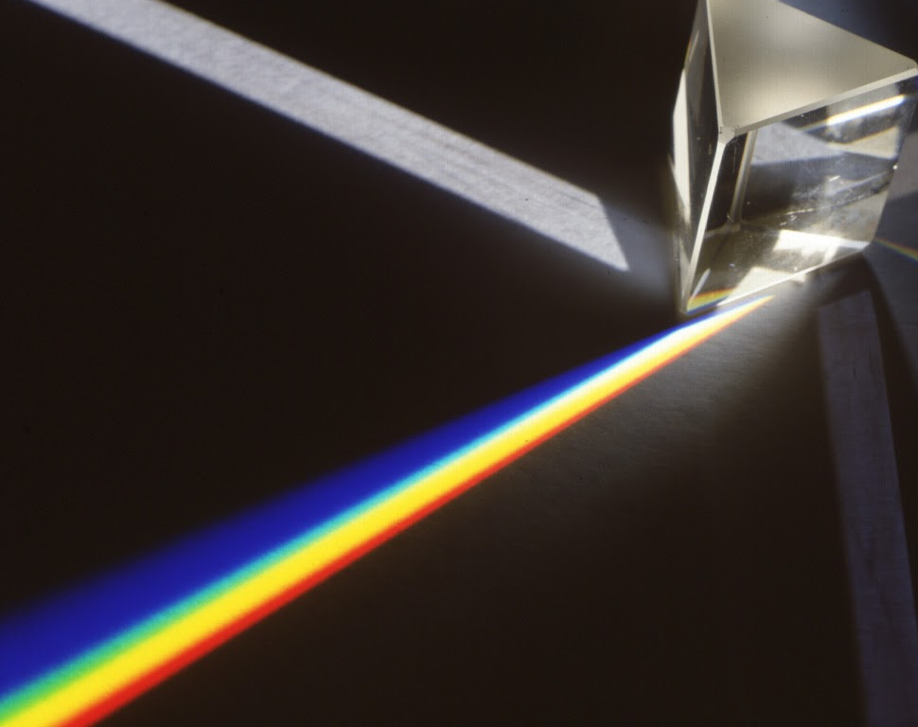
Sahasrara Chakra Silence & Stillness

Slide 2
Opening of the Sahasrara Chakra
In 1970 Shri Mataji opened the Sahasrara Chakra
Only a very few were able to attain their Self-realisation before this event
Kundalini was dormant or stuck at Agnya
Notes:
Only now the awakening of the Kundalini in us has taken place on a big scale. Before 1970 very few people were realised souls. In the whole world you could count the people who had their Sahasrara chakra open. For all others the Sahasrara chakra was closed!

Slide 3
What happens when the Sahasrara Chakra is opened?
ONLY after your Self-realisation:
you get connected with your Self / the Spirit : with pure detached Love
you can feel this Love as the Self or the Spirit inside your heart
you get connected with the All-Pervading Divine Power
Notes:
The Spirit is the reflection of the Divine Power inside your heart / body
The All Pervading Power = Love = Truth = God = Allah = Jehova = Jaweh = Sadashiva, however people wish to call it; this is inside and outside your body All Pervading Power is also inside us, in the form of vibrations. We can ‘carry’ and spread vibrations. Music, art and food / water can also carry vibrations if it is made with / in a state of love. We will tell you more about this in the intermediate course.

Slide 4
Awareness is the Key
ONLY after your Self-realisation you become AWARE
In all religions people talk about God, or Love, which is Truth. But the followers do not establish awareness
In all meditations people talk about silence. But the people cannot get into the state of thoughtless awareness, because their Sahasrara chakra is not open
Notes:
You can say these people are very close, but they miss the last step. Their Kundalini is not awakened, the enlightenment is not there.

Slide 5
Growth of Awareness
Thoughtless awareness
Vibratory awareness
Collective consciousness
Awareness of All Pervading Divine Power
Awareness of your own divinity
It will all come if…..
Notes:
Human awareness unites with the Divine/ Infinite: most subtle form of communication begins: vibratory awareness. You start to realise that there is collective awareness and that you are part of it.. If you don’t feel all this yet, it will all come if... you keep coming and meditating.

Slide 6
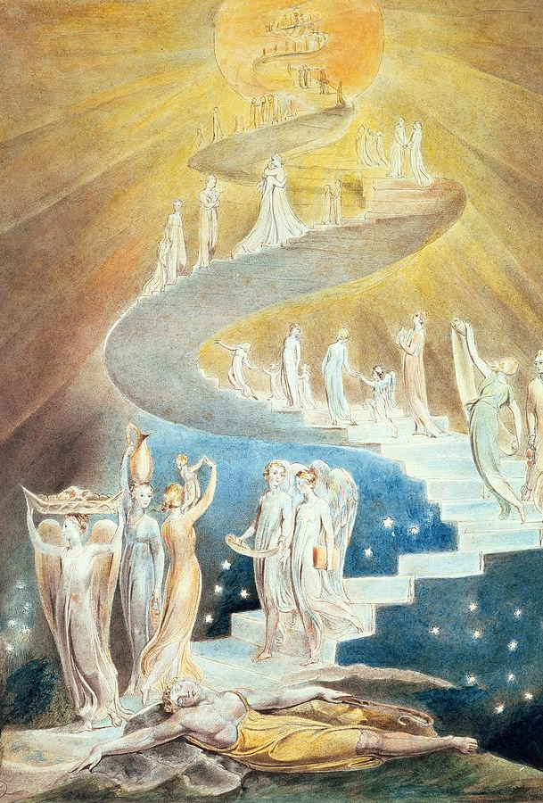
Integration of the subtle system
The Sahasrara is a space in which all the chakra’s have their representative place
The Kundalini enlightens them and connects them
The heart chakra is in the middle / centre. It is the highest seat of the Spirit.
Notes:
To keep the Sahasrara open, you need an open heart (chakra)!

Slide 7
Powers of the Sahasrara
Giving Self-realisation, if person allows
Giving vibrations
Silence and bliss
Detachment
Surrendering
Notes:
Detachment: you can now see your own ego and conditionings. You can see bad and good points in everybody, regardless if you are angry with them or you love them.
All the chakra’s: Powers of … Creativity, Peace, Love etc. Again it will all come if….

Slide 8
Causes of catches
Everything that closes the chakra’s
Ego and/or Superego close the way up
Materialism, the attention gets stuck
Notes:
Lust, anger, greed, attachment, jealousy, pride
Not taking your Self (realisation) serious: a ‘by the way’ attitude
Blocked chakra’s close the way for the Kundalini to rise. Ego can surround the heart and cut it off from the brain. So your Sahasrara does not stay open and you cannot feel the connection with your Self.

Slide 9
Clearing
Clear your heart chakra
Have faith in your Self, which is the essence of everything: pure Love
Attention on the Spirit / the Self
Notes:
- No (time to) meditate (because our attention gets dragged outside)
- Doubting (y)ourself / our own Divine powers, our Kundalini, the vibrations we feel etc.
Keep your attention on the Spirit in your heart or in Sahasrara, while you meditate. In this way you can open your heart.

Slide 10
From the Upanishads
TAT TVAM ASI
Notes:
Boy student sacred wisdom. Vedas. Fruit, Seed, break the seed, What do you see? Explain more to me, father’. Salt water, what do you see? Taste the water from all sides. How is it? Look for the salt again. What do you see?
Then his father spoke to him: ‘My son, from the very essence in the seed, which you cannot see comes in truth this vast banyan tree. Believe me, my son, an invisible and subtle essence is the Spirit of the whole universe. That is Reality. That is Atman. THOU ART THAT.’
His father then said: ‘In the same way, O my son, you cannot see the Spirit. But in truth he is here.
An invisible and subtle essence is the Spirit of the whole universe. That is Reality. That is Truth. THOU ART THAT.’

Slide 11
More Upanishads
Meditation is in truth higher than thought. The earth seems to rest in silent meditation; and the waters and the mountains and the sky and the heavens seem all to be in meditation. Whenever a man attains greatness on this earth, he has his reward according to his meditation.

