Slide 1
The Six Enemies of the Soul

Slide 2
Fighting your enemies

Slide 3
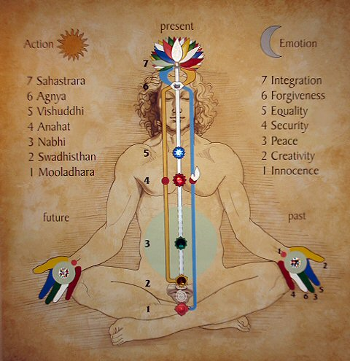
What could block the chakra’s and its qualities?
Each chakra is under attack.
The awakening of the chakras’ power by the Kundalini eliminates these defects
The enemies acts through our ego & superego
Achieve self-mastery

Slide 4
1. Kama - Lust
Affects: Moolhadara, whole left side, heart, superego, back agnya
Perversions, too much attachment to sex, running away from sex, thinking about sex all the time
Strengthen the qualities of innocence and purity

Slide 5
2. Krodha – Anger/Temper
Affects: swadhistana, whole right side, liver, ego, front agnya
Remedy:
Be angry at yourself without feeling guilty
Laugh about your reactions
Be compassionate towards others
Listen to the other person and try to understand their perspective.
“ Holding on to anger is like grasping a hot coal with the intent on throwing it at someone else; You are the one who gets burned” - Buddha

Slide 6
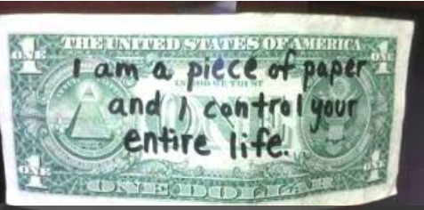
3. Lobha - Greed
Attachment to possessions and desire to own something
It destroys others and is destroying Earth
The energy of the being is diverted from inner growth into acquiring external possessions.
The manifestation of the qualities of the nabhi chakra include an innate feeling of well being and satisfaction, a condition that makes greed irrelevant.
Enjoy giving, generosity.
“Earth provides enough to satisfy every man’s needs, but not every man’s greed” – Mahatma Gandhi

Slide 7
4. Moha – Attachement
It obstructs the power of the heart to love in a generous and giving way. Attachment is a lower and selfish form of love – it takes instead of giving.
Always put global needs before any personal need
Use “We” instead of “I” when talking, and “our”
Use the third person to detach from your attachments and expectations

Slide 8
5. Matsara – Envy/Jealousy
Jealously prevents the establishment of common purpose and teamwork. It is destructive to the smooth functioning of any human collectivity. A person with an operative vishuddhi chakra is sensitive to the needs of the whole, the interest of the collectivity or the organization of which he is a part.
Competition in sweetness, depth, kindness. Who can share the most?
Count your blessings

Slide 9
6. Mada – Vanity/False pride
Affects: agnya, ego
Vanity comes from ego – artificiality (looks, posessions, positions)
Beauty with measurements – not spontaneous
Actually pride is nothing but the expression of self-esteem. Begging, borrowing, mimicry, all these things come from the less understanding of yourself. So vanity should be the pride, and the pride should be the expression of self-esteem. Self esteem is very different from ego. One is reality, another is complete artificiality. – 1983

Slide 10
When we try to use these enemies to harm others in return we are harmed. Also we harm others. We have to get rid of this humane flaw within us. But by telling people, “Don’t do, don’t do” it doesn’t work out. There has to be an ascent, there has to be a global transformation when one goes beyond all these enemies. These enemies work through our mind. And mind is a myth. We have created our mind by reactions. We have our mind created by conditionings or by our ego. But there’s nothing like mind which exists. We have become also slave of that mind. – Shri Mataji, 1996
DON’T IDENTIFY OR JUSTIFY!

