Slide 1
Swadistan Chakra
Creativity, Attention and Knowledge

Slide 2
Swadisthan Chakra
The center where the energy for our creativity and thinking is generated.
After Self-Realization, we discover that the true key to creativity is to create (dance, sing, paint, work) in thoughtless awareness.
The center that nourishes our pure attention, pure knowledge and pure desire.
What is pure attention/desire etc… ?

Slide 3
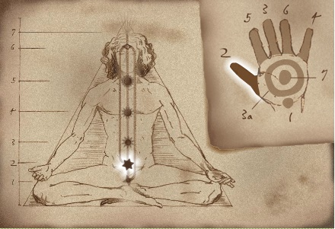
Swadisthan Chakra in the subtle system
Aortic plexus
Governs: Spleen, pancreas, liver and kidneys
Center: Creativity, appreciation of beauty
Right side: Undistracted Pure attention; inspired thoughts, ideas and actions
Left side: Pure desire and pure knowledge; being aware of vibrations

Slide 4
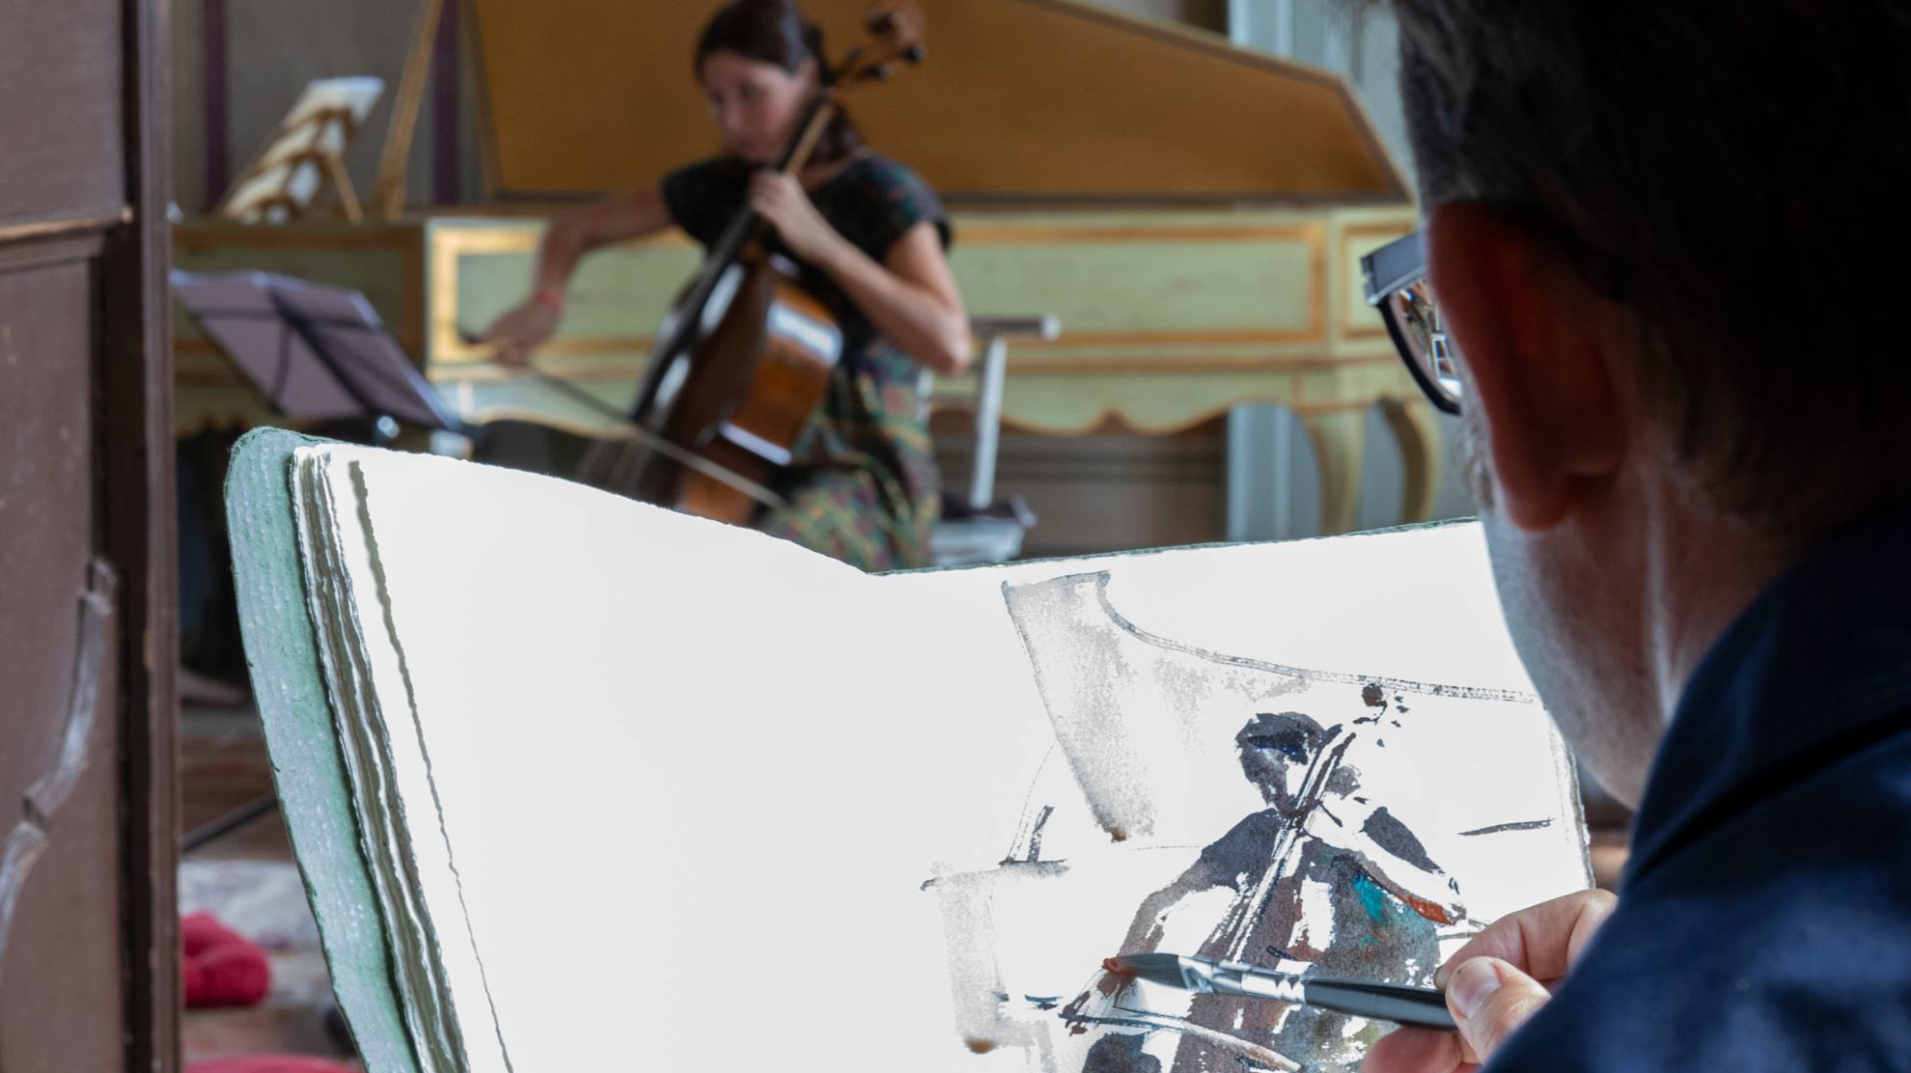
What is creativity? Are you?

Slide 5
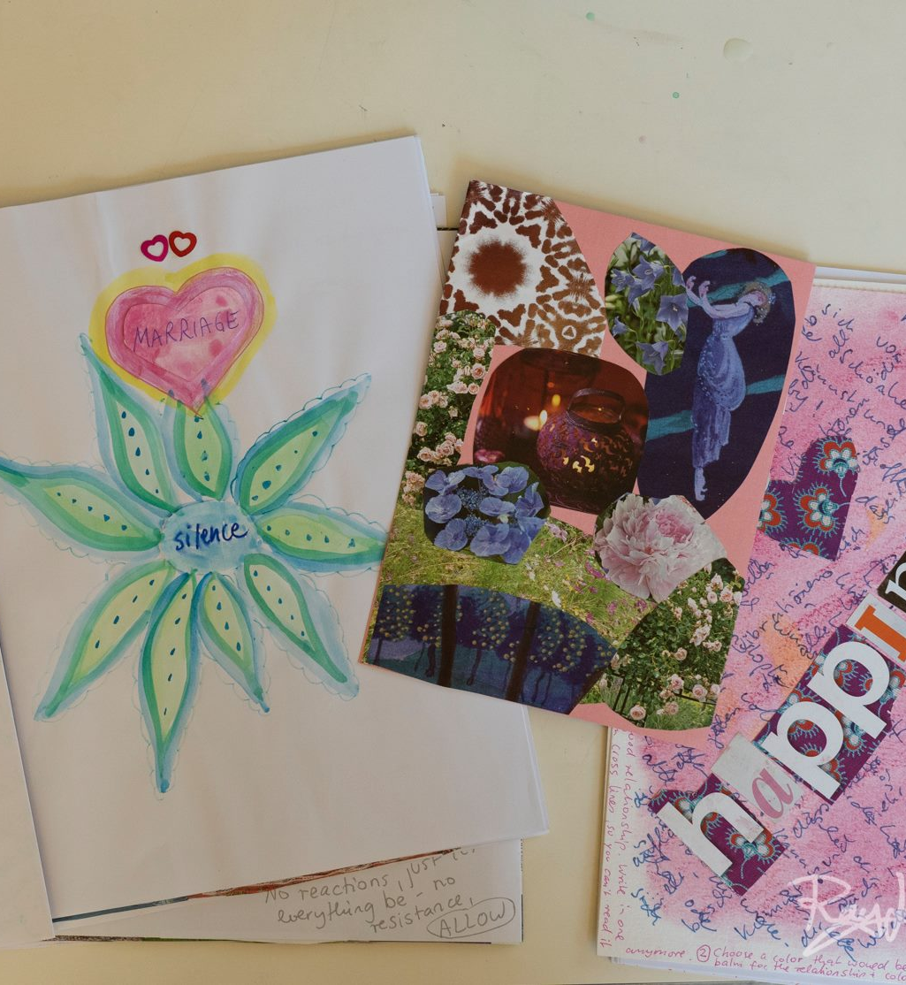
Enlightened Creativity
Enjoy creation in thoughtless awareness
Harmony of varieties that create a state of JOY
Recognizing the Spirit in art
The joy poured into nature by the mother earth is enjoyed by artists, and is revealed in the universal language of colours, lines and forms they use to express it. They fill human lives with exquisite creations of music, art, dance and other art forms.
Enlightened art emits vibrations

Slide 7
Quotes
‘’Mozart’s music is so pure and beautiful that I see it as a reflection of the inner beauty of the universe itself.’’ – Albert Einstein
‘’Where the Spirit does not work with the hand, there is no art.’’ – Leonardo Da Vinci
‘’Art arises when the secret vision of the artist and the manifestation of nature agree to find new shapes.’’ – Khalil Gibran

Slide 8
Mental blockages for creativity
Perfectionism from ego – relate?
Judgements and thoughts
Insecurities and lethargy (left-side)
Ego (I do it, instead of being the instrument for power of creativity)

Slide 9
Liver and Attention
Liver is the seat for pure Attention that gives stillness, no thoughts, just witnessing, observation
Breaks down fat particles within your abdomen to replace your brain’s gray and white matter, that creates the energy we use for thinking.
Too much thinking exhausts the liver also certain food is bad for the liver (e.g alcohol, fat fast food, meat)
When the liver needs to work too hard, you lose focus
Creativity can falter, joy and spontaneity can be lost

Slide 10
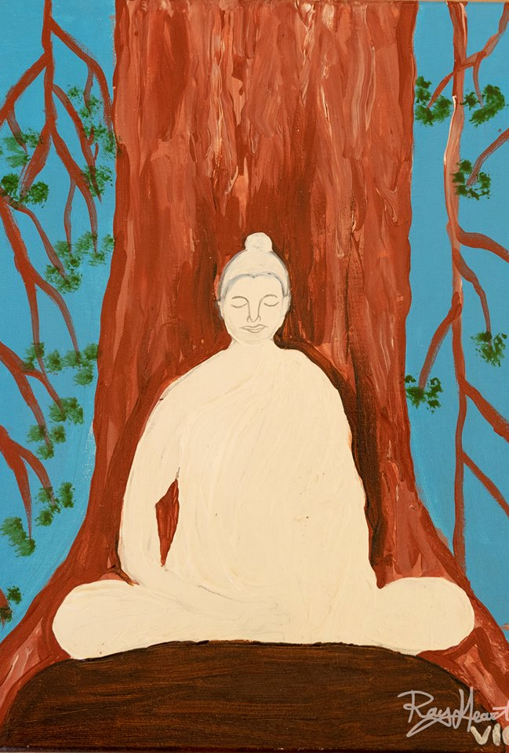
Balanced Liver and Attention
A balanced liver sustains and nourishes your ability to be attentive by filtering out toxins, impurities and external distractions. This purified attention gives peace and stillness, that is needed to meditate effectively.
When your Swadisthan chakra is balanced you will be able to maintain a peaceful mind free from worries, doubts, confusion and distraction. The creative work you do while in this balanced state will be spiritually enhanced. It comes from the heart and has pure love. It emits vibrations.

Slide 11
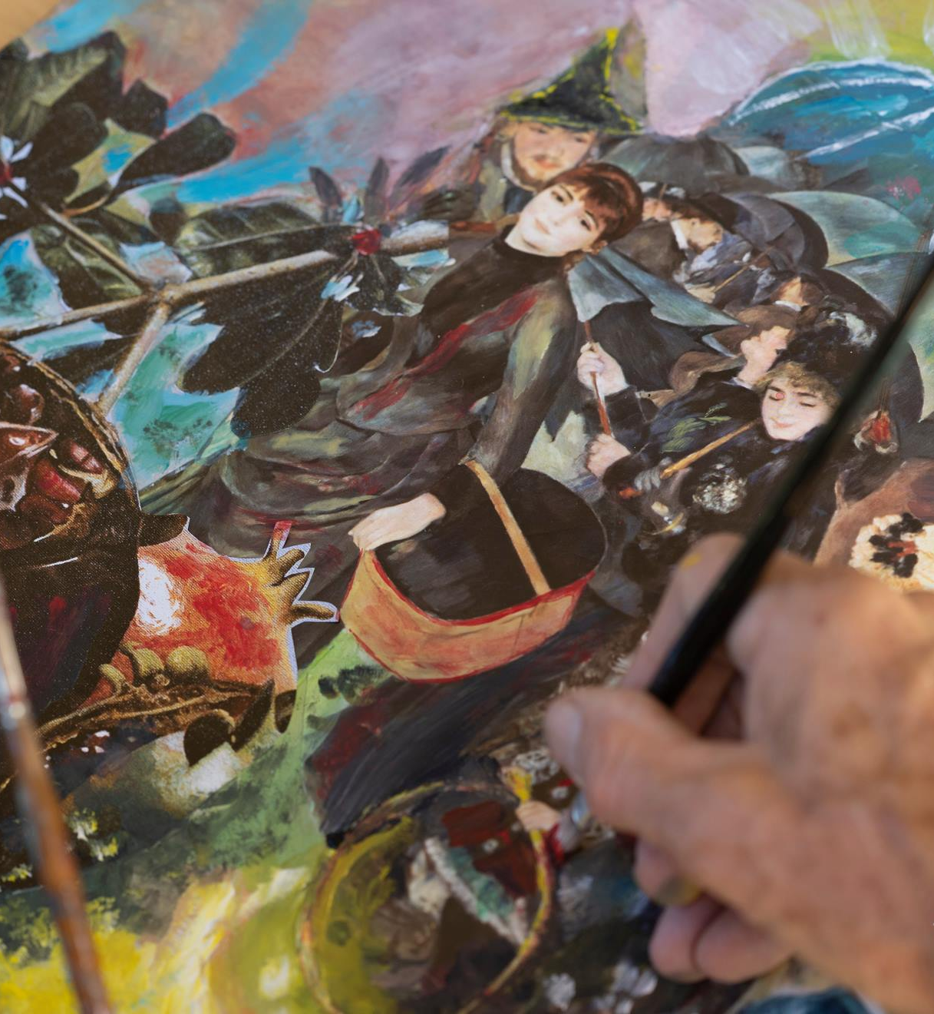
More blockages of Swadisthan
Right side:
Excess of mental and physical activity
Planning too much – futuristic behavior
Egocentrism
Left Side:
Misguided spiritual methods, black magic, drugs
Center:
Anger, fanatism, artificial behavior, unbalanced, too heavy food, alcohol

Slide 12
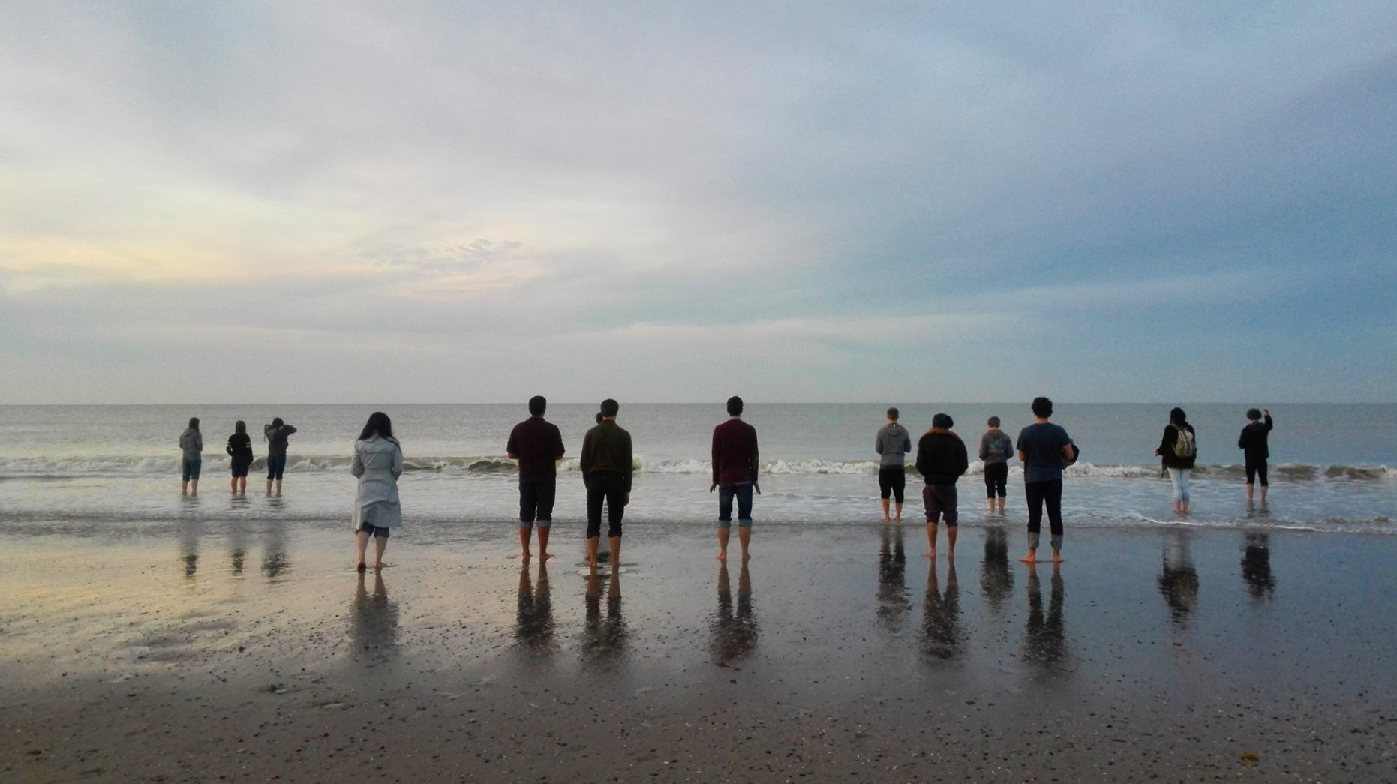
Clearing the Swadisthan Chakra
Bring attention to the chakra and trust Mother Kundalini to work it out
Affirmations:
Mother Kundalini, I am creative
Mother Kundalini, please give me pure knowledge
Mother Kundalini, please give me pure attention
Footsoak every day! Mostly cold (to cool down our right side)
Icepack for liver
Go for a walk in nature, for left and right side
Liver diet: yoghurt, cooked vegetables , fruits

Slide 13
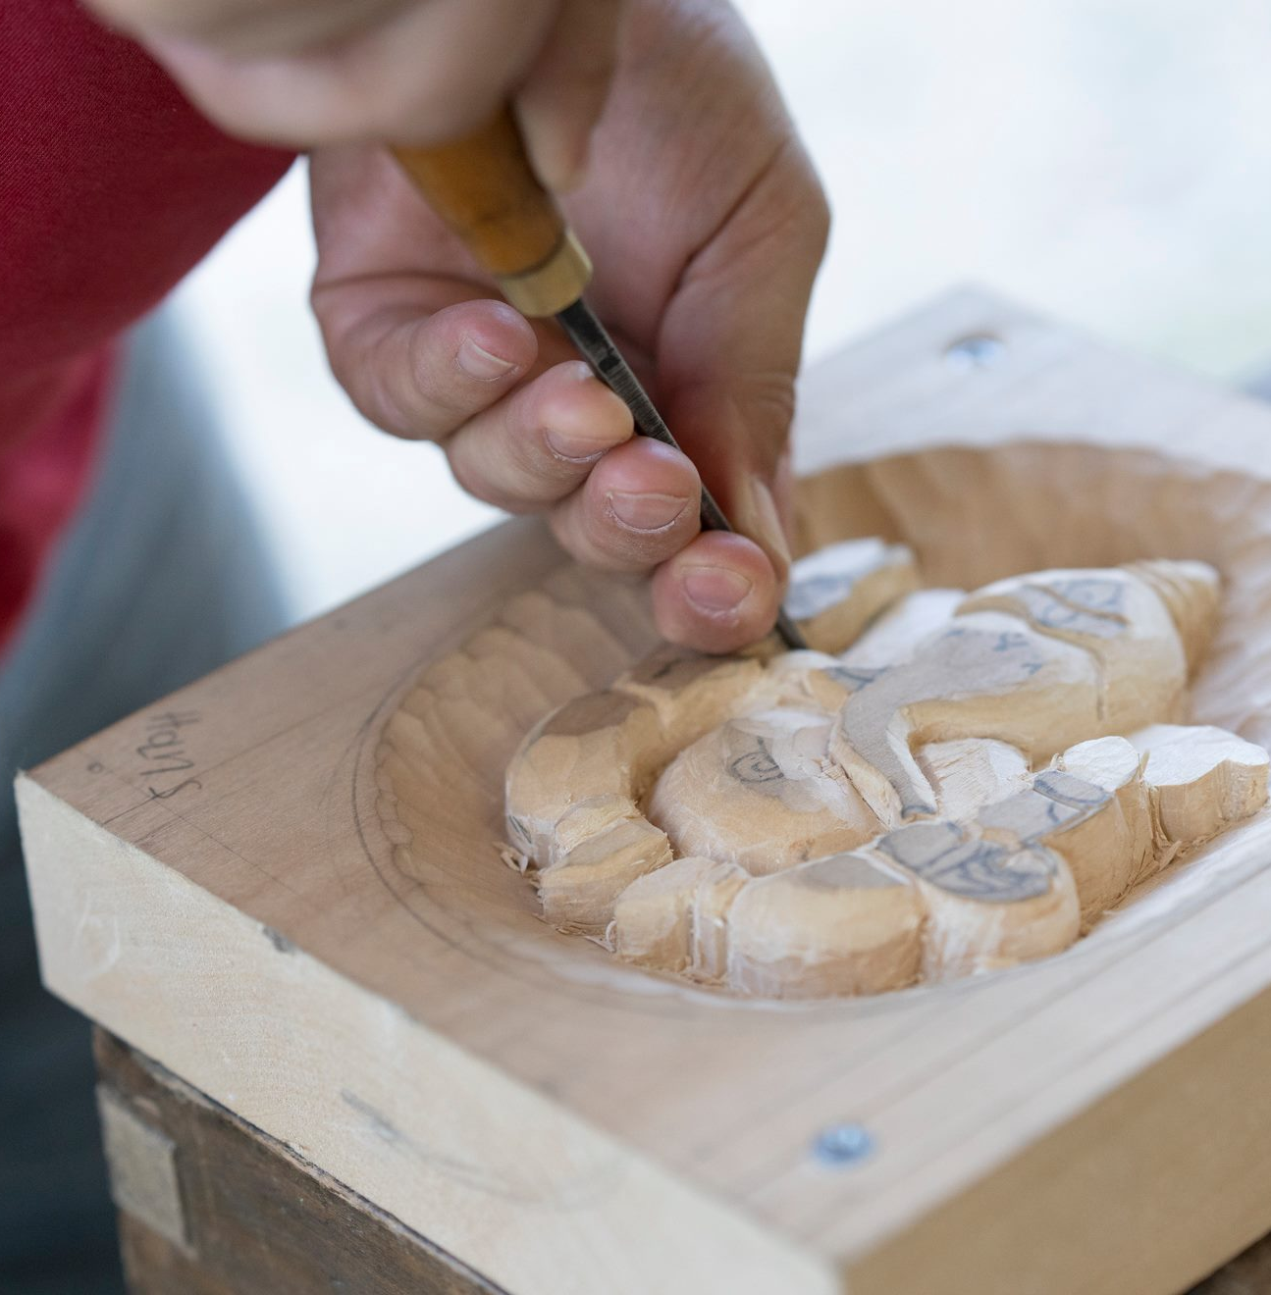
Are you ready to be creative?
Give yourself a creativity challenge
Expand your horizons
Try a new instrument
Learn new moves
Sing with gusto under the shower

Slide 14
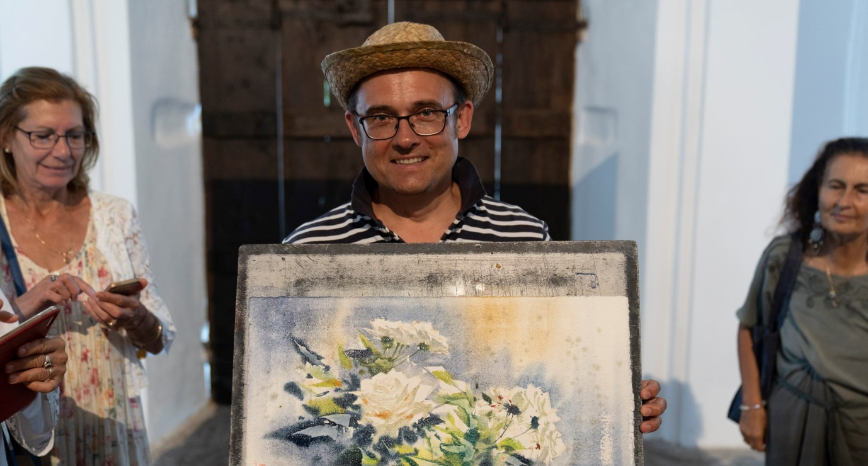
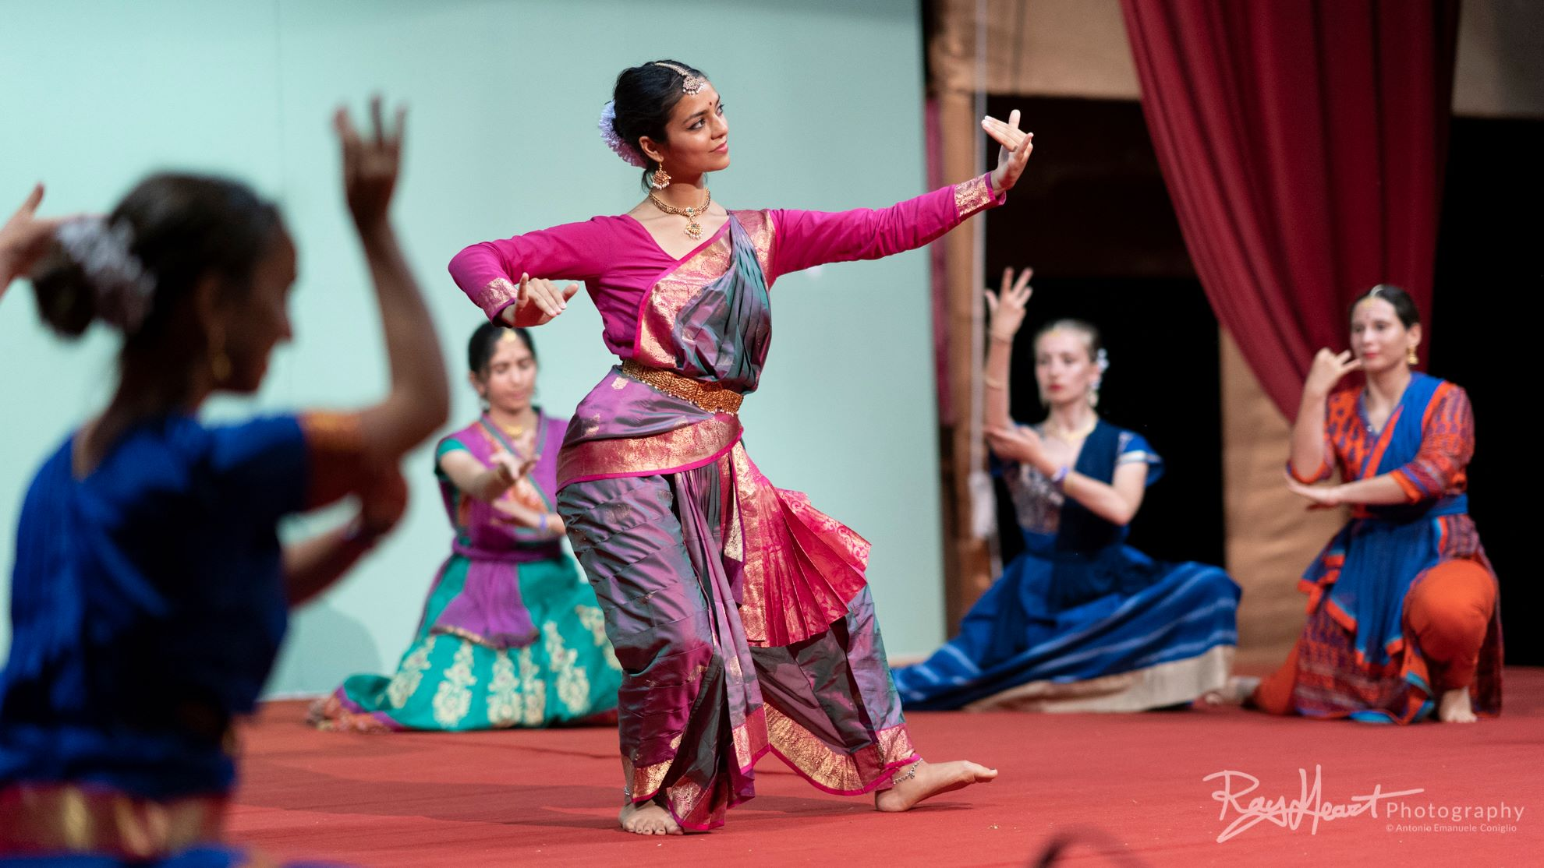

Slide 15
Speech

Slide 16
https://www.amruta.org/1983/10/12/public-program-boston-1983/?highlight=1983%20creativity
Boston, 1983, on creativity and thinking
19:10 – 27:35
Meditation:
https://www.youtube.com/watch?v=gNtfBj52MPo

