Slide 1
Bhagavad Gita
Detachment/Witness, Non-reaction, Delusion, Dharma

Slide 2
Bhagavad Gita
A part of the epic ‘Mahabharata’, where the forces of good and evil fight. Symbolism for the inner fight to improve ourselves.
Foundation of Hindu philosophy
It encompasses many issues

Slide 3
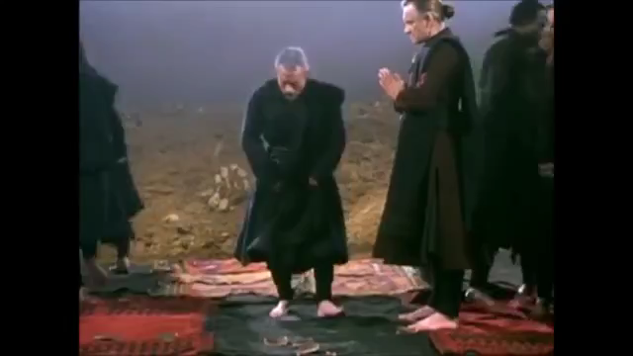
Notes:
§

Slide 4
Bhagavad Gita, ch 4, verses 5-8
Weapons cannot cut the spirit
Nor can fire burn it,
Water cannot wet it,
Nor can wind dry it.
Your right is to the work only,
But never the fruit thereof.
Be not attached to the fruit
Neither to inaction.
Whenever dharma declines,
O scion of Bharata,
And evil prevails,
I incarnate myself.
To protect the virtous,
To destroy the evil-doers
And to establish dharma in the heart of men,
I am born from age to age.

Slide 5
Detachment/witness state
Usually identified with carelessness, apathy, indifference, callousness, coldness, passiveness.
Distance between your mind/Self and your possessions, ‘positions’, opinions… everything you identify as ‘yourself’ (ego & superego)
Distance between your mind/Self and events that you can’t help to improve. One sees everything as in a movie.
Notes:
3 stories of detachment from ‘ A new earth’

Slide 6
Detachment/witness state
Refusal to judge what happens as ‘good’ or ‘bad’
Being aligned with ‘what happens’
It’s not being passive: If one feels that acting can make a difference, act without expectations and be a spectator of the situation while caring about it.
Notes:
3 stories of detachment from ‘ A new earth’

Slide 7
Detachment/witness state
What is acting? It can be subtle or ‘practical’
-Practical: What normally is understood as such
-Subtle: Through collective attention on an issue & Using Vibrations
-Another side to ‘practical’: Changing oneself
Notes:
Examples of Monsanto & Washington criminalty rate. Changing the chemical percentages of an object.

Slide 8
“If one wants to change the world, one has to first change himself inside” (Herman Hesse)
“One has to be inside the mirror of what he wants to see outside” (Mahatma Gandhi)
“The solution to political problems is not political but philosophical” (Robert Pirsig- ‘Zen and the Art of motorcycle maintenance’)
“Political problems cannot be solved, only the human problem must be solved from its roots” (Shri Mataji Nirmala Devi)
“Optimism is a strategy for making a better future. Because unless you believe that the future can be better, it’s unlikely you will step up and take responsibility for making it so. If you assume that there’s no hope, you guarantee that there will be no hope. If you assume that there are opportunities to change things, then there’s a chance you may contribute to making a better world. The choice is yours.” (Noam Chomsky)

Slide 9
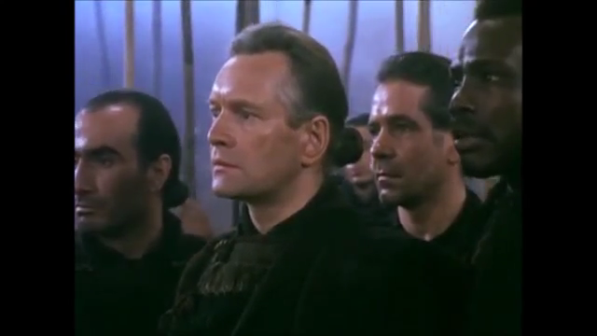

Slide 10
The Monkey catcher
Desire rising, senses burning hot cold, hungry monkey, searching for food,
scent of sweetmeats that entice, tempting
scent of spiced rice so saltly tempting, beckoning,
beckoning, alluring, beckoning, tempting, enticing wish.
Should the man, but should the man,
monkey be, monkey be? Be!
Curious monkey, sweet meat hungry, wooden stake driven deep, the trap is set.
Bold desire crosses the clearing fearing not for freedom, reaches squeezing a hand through the hole.
Won’t let go, doesn’t know, has only to let go a handful of desire for freedom.
Flee from senses fickle, they are illusory and with time perish, they come and go.
Be a-ware, seeker, the hands that hold you are the desire that drives you.
Do not be led blindly astray, you are not senses, passions,
No, so much more,
eternal.

Slide 11
Examples of detachment
-Mental labels of ’Good’ & ‘Bad’ are illusory, relative and transitory: Story of the Wise Man and his ‘Maybe’
answer:
A wise man won a car in the lottery. Everyone congratulated him.‘Aren’t you lucky?’ He smiled and said ‘Maybe’.
A few weeks later a car crushed into his new car; multiple injuries and ended up in hospital. Everyone said
‘that is really unfortunate’. He again smiled and said’ Maybe’.
While in the hospital there was a landslide and his house fell into the sea. All his friends told him ‘Weren’t you
lucky to be here while it happened?’ He then again smiled and said ‘Maybe’.
The wise man’s ‘Maybe’ signifies a refusal to judge anything that happens. Instead, he accepts it and enters into conscious alignment with the higher order. He knows that it is impossible for the mind to understand
what place or purpose a seemingly random event has in the tapestry of the whole.

Slide 12
Non-reaction
One of the outcomes of complete detachment.
We spend most of our time reacting to things, people, judging without being conscious of it
Disarms the ego in others:
-Ghandi’s passive resistance is the perfect example of action without reaction.
-Mandela’s forgiveness

Slide 13
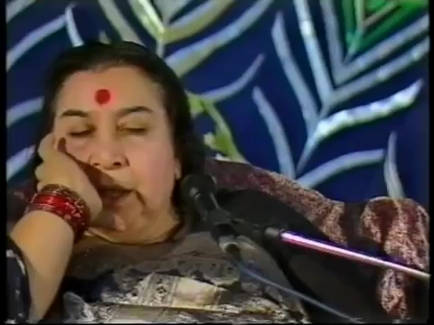

Slide 14
Dharma
According to linguists: The fulfilment of one’s duties
Spiritual level: Innate moral code that transcends cultures.
Combination of both

Slide 15
Delusion
State of Arjuna at the beginning of Bhavagad Gita.
It’s one of the results of not fulfilling one of the aspects of Dharma
Deception, disappointment
Feeling after expectations fail (back to attachment)

Slide 16
Key to not fall in Delusion
Krishna: Action without expectations and without being attached to the fruits of our doing.
To have goals and be active without expectations: key to complete fulfillment.

Slide 17
Running Deer
There where the rarified air whips white-capped peaks and gasping rushes from the Roof of the World,
the timid, tortured deer chases from dusk to dawn, a phantom ever-present scent,
Tossing its head to trace the source, captive of its own keen scent, the musk deer will run blindly,
forever.
There where the conditioned air of grasping office blocks fans discussions of profit and loss
the deer races with the pace of demand and supply.
Through markets designed to generate and satisfy a procession of artificial needs,
Man chases from dawn to dusk, elusive happiness,
not dreaming that the answer
to the question lies
inside.
Notes:
The ego says: Maybe at some point in the future, I can be at peace.
Or it says: I can never be at peace because of something that happened in the past.
The ego doesn’t know that your only opportunity for being at peace is now.
It is afraid that you may find this out. Peace, after all, is the end of the ego.
How to be at peace now? By making peace with the present moment

Slide 18
https://www.amruta.org/1998/05/10/sahastrara-puja-1998/
From minute 21,49-37,13

