Slide 1
Karma and Reincarnation

Slide 2
God
In the West
God Outside
Yourself
Creation
Revenging God
Abstract, mental
In the East
God Within
Creation
Yourself
Can be perceived, experienced
Notes:
In the West people are used to seek God outside themselves. This might be the revenging God of the Bible (the Old Testament), existing somewhere outside the creation (the universe); or the God of a rationalistic theology, very mental, derived by abstract thinking from abstract knowledge, tributary to the western belief in abstract philosophy.
In the East people will find God within themselves. The creation is seen as being essential to God! God is an all-pervading energy, that can be perceived as divine vibrations. In this way God is not only in the cosmos, in the universe, in the earth, in creatures, but also in US.

Slide 3
“Dying is only one moment. Just a transitory moment. You go, you change and you come back.’
Shri Mataji: Diwali Puja 1991
Notes:
Shri Mataji presents here the notion of death, which is traditionally the way death is consider in the East.

Slide 4
Death and Birth
“When the physical body becomes unsuitable for further evolution by disease or old age, He (Shiva) destroys this body and enables it for the Jiva (the individual Spirit) to acquire a new body for his further ascent.”
“The real cause of the coming into existence of the body is avidya or ignorance. If the ignorance is destroyed, you will be freed from the wheel of birth and death.”
Adi Shankaracharya (788 - 820)
Notes:
Shri Mataji presents here the notion of death, which is traditionally the way death is consider in the East.

Slide 5
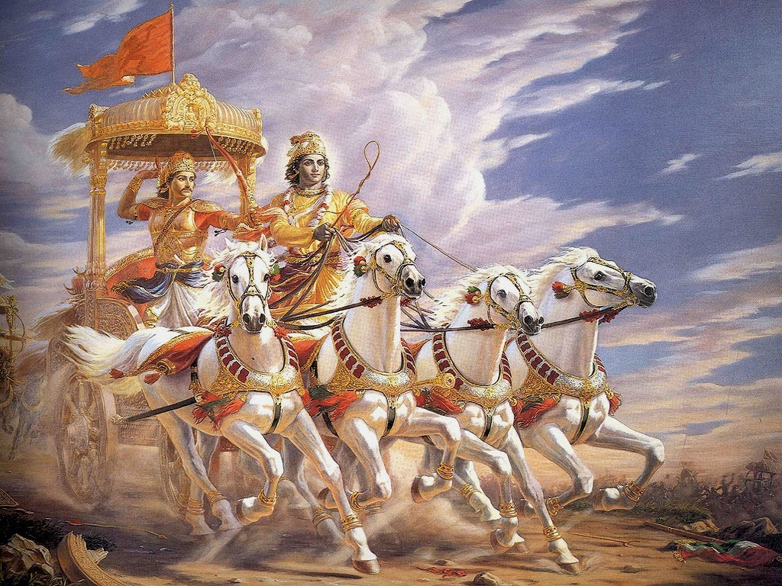
In the Gita , The Pandava prince Arjuna, faces his duty as a warrior to fight the righteous war between Pandavas and Kauravas (two branches of the same family).
Arjuna is counselled by Lord Krishna to fulfil his duty as a warrior (Kshatriya) and establish liberation (moksha) from samsara (the chain of reincarnations).
Notes:
This belief can be traced back to more than 10,000
years old oral Indian traditions, that later on have been recorded in the Vedas, and still later on in the Puranas and Upanishads.
One of the most important sources is the “Bhagavad Gita”.
The Bhagavad Gita, "Song of the Lord”, is a Hindu scripture in Sanskrit ( भगवद्गीता) that is part of the epic Mahabharata.
The Gita is a dialogue between Pandava prince Arjuna and his guide and charioteer Lord Krishna. Facing his duty as a warrior to fight the righteous war between Pandavas and Kauravas [Pandavas and Kauravas are two branches of the same family], Arjuna is counselled by Lord Krishna to fulfil his duty as a warrior (Kshatriya) and establish liberation (moksha) from samsara (the chain of reincarnations).
“But, the Yogi who strives with assiduity, purified of sins and perfected gradually through many births, reaches the highest goal.”
Bhagavad Gita
The Bhagavad Gita is a synthesis of the concept of Dharma and the yoga- ideals of moksha (liberation) through bhakti, karma, and raja yoga and Samkhya philosophy.
Scholars have tried to find out the time when Krishna was the ruler of Shuraseni and Vrishni tribes on the now-submerged island of Dwaraka (off coast Gujarat) sometime between 3200-3100 BC (in de Dwapara Yuga).
When I read the Bhagavad Gita, I ask myself how God created the Universe. Everything else appears to be superfluous” – Albert Einstein
Nice transition from the East to the West

Slide 6
Ignorance
But also in the West:
“Ignorance is the mother of all evil. Ignorance is the originator of death.”
“There is rebirth and an image of rebirth. It is really necessary that we are reborn by means of the image.”
The Gospel of Philip, in the Nag Hammadi Library, Qumran
Notes:
The Gospel of Philip is one of the Gnostic Gospels, a text of New Testament apocrypha, dated to around the 3rd century but lost in medieval times until rediscovered by accident, buried with other texts near Nag Hammadi in Egypt,. The text was bound in the same codex that contained the better-known Gospel of Thomas. in 1945
Rebirth as when we come back in a new body
Image of rebirth, when Jesus said we need to be reborn again, this image of getting our realization.

Slide 7
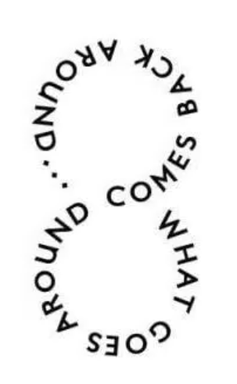
Karma
A product of ignorance
Positive actions, thoughts, emotions bring us closer to our Source/goal and they reduce the chain of karma.
Negative actions, thoughts, emotions make the chain of karma longer.
Notes:
Karma is a chain produced by ignorance that binds us to the wheel of birth and death.

Slide 8
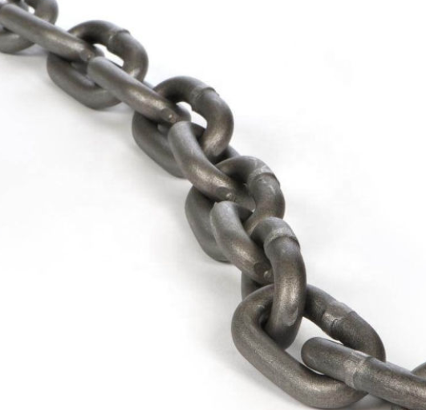
THE CHAIN OF MUTUAL DEPENDENT CAUSES AND RESULTS

Slide 9
CONSCIOUSNESS
IGNORANCE OF REALITY
New Embryo
Name
Form
Contact Outside
Experience
Impure Desires
Material
Power
Feelings
Senses
D
E
A
T
H
&
R
E
B
I
R
T
H
L
I
F
E
TRUTH – LIBERATION - ENLIGHTENMENT
Fulfilment
Pursuit
Thoughts
Dukha
(Attach)
Misery
Pain
Dying Person
ideas
impulses
Sorrow
Despair
Choices
Emotions
Actions
KARMA
Notes:
The last IDEAS and IMPULSES of a DYING PERSON – determined by the karmic chain of his life, are the germ of a ne NAME AND FORM in the womb of a mother.
The NEW EMBRYO develops SENSE ORGANS and when he is born these organs make contact with the world outside. That leads to experiences and feelings, developping consciousness, ego and superego.
These in turn originate DESIRES pure (spiritual growth and evolution) or impure (material desires, power desire, etc with the different negative qualities representing them (lust, greediness, jealousies, etc)
In pursuit of fulfilling our desires we make choices and take actions positive or negative that reduce or increase the karmic chain
Eventually we create attachments in ourselves to some of our desires, achievements, actions and emotions. And those attachements are the cause of Misery, Sorrow, Despair, Sickness and Pain.
Those attachements are present in our dying bed in the form of ideas and impulses product of all our actions, emotions and thoughts. This karmic chain becomes the Germ of a new existance. And we take a new birth, learning and growing towards reality, the TRUTH, or not learning the lesson, dwelving in old attachments and Karma, or creating new attachments adding to our Karma
↓

Slide 10
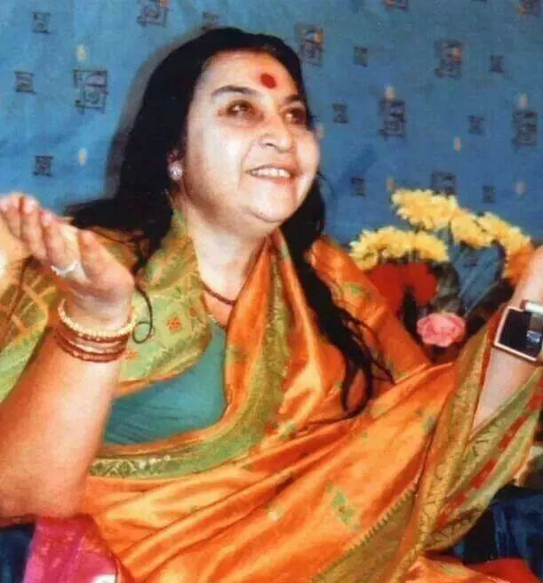
Shri Mataji and Sahaja Yoga
Self-realisation
Meditation
Introspection
Brings detachment & surrendering
Resulting in YOUTH, JOY, FUN, HOPE, LIFE
Notes:
So this is where Shri Mataji Nirmala Devi and Sahaja Yoga come in.
Self realization connects us with Truth and Reality
As we meditate our subtle system attention and desires become pure, of a higher nature, and we become increasingly dettached from the outcomes of our actions. We become increasingly capable of surrendering to God’s protection, help and support while staying dynamic.
With introspection we become aware of any negative thoughts or emotions that create negative behaviors and we see where reality truly lies. This awareness allows us to change and make better choices, breaking the karmic chain.
And so pain, sorrow, despair, misery, pain and sickness, weariness that makes you feel old are spontaneously replaced with Joy, fun hope life and a feeling of being and staying young

Slide 11
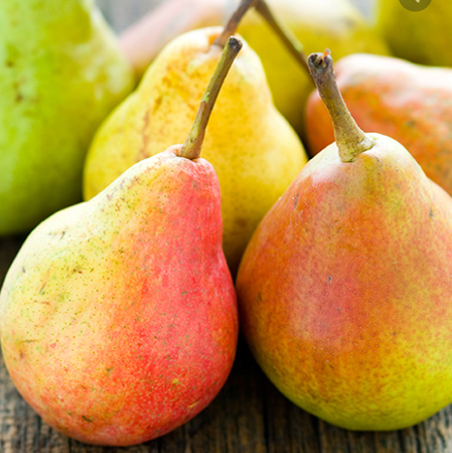
“So, this Krita Yuga has started and it is doing many things which were never done in any incarnation. The first thing is, during this time everybody will get their “karma phalas” (fruits of their actions), means whatever they have done wrong they will have to pay for it. Phala means the fruit. Only through self-realization the karma phalas can be completely finished.”
Mahalakshmi Puja, Barcelona, Spain, 01.10.1992
Notes:
Transition to next slide: how does self realization finishes our karma?
There are four periods/ages or yugas – Until recently we were in the Kali Yuga. Shri Mataji says about the yugas: “The whole Kali Yuga means the absolutely the worst and worst possible time for our destruction. That was over. Then comes Kruta Yuga, I mean, overlapping. Now, in Kruta Yuga, this all-pervading power, they call it Paramchaitanya, becomes active. It starts helping people to come along. That also has been going on some days. After this, is Satya Yuga. It’s the age of truth. But it’s a last judgement. If you take to truth, alright, well and good. But if you don’t take to truth you are judged. It’s like this." (Press conference, London, 8/7/99)
Satya yuga (truth) exposes all a-satya (false)
Krita yuga is a period of transition from Kali yuga to satya yuga
In Indian philosophy, there is a view as to why humankind finds itself in its present chaotic situation. The belief is that humankind passes through different ages, or Yugas. There are four main Yugas, and much like the different seasons, each has its own character. According to the Puranas, which are ancient Indian texts, the Yugas last for thousands of years. With each Yuga, the collective unconscious shifts, and gradually humankind finds itself adopting different principles and beliefs. For instance, there is a Golden Age, or Satya Yuga. This is a divine time; an age of spirituality. During this time, there is harmony between people; the world is a place of benevolence. People are said to be in a state of constant meditation. It is a time where there is no disease or sickness. Conflict is a thing of the past.
The second Age or Yuga is the Treta Yuga. This is an age characterized by mental abilities. This age is seen as a step down from the Golden Age of Satya Yuga. Man now has a sense of self. He develops the desire for power. A belief in man’s own mental abilities steadily rises.
The third age is Dvapara Yuga. In this age the sciences flourish. Inventions are abundant, especially inventions that seem to make distances between people and places disappear.
The fourth age, which is the one we currently find ourselves in, is Kali Yuga. This is the age of Darkness, where humankind has lost its inner connection with Divinity. It is, unfortunately, the world as we see it today.

Slide 12
“As soon as you become the Spirit, you get powers. One of the powers you get, is that of collective consciousness. (…) Your ego and superego are sucked in and you get rid of your karma.”
Krishna Puja, Chelsham Road Ashram, London, UK, 15.08.1982
Notes:
In her speach of May 13th 1982, Shri Mataji says “If Ego is gone, there is no Karma”

Slide 13
Karma and Freedom
Karma:
Builds up across different lifetimes.
Limited space of freedom, determined by self-constructed karma.
Offers a considerable margin of free choices
Choice between positive or negative thoughts, actions, emotions
“Whatever connection I had with this body, was the result of previous karmas – to be enjoyed or to be paid for, (...).”
Shrimad Devi Bhagavat Purana
Notes:
Karma is the result of one or more – many more – former lives. Within a reincarnation man has a limited space of freedom that is determined by his self-constructed karma. Each karma offers limits in which we have to live, but also a considerable margin of free choices. We can always choose for positive thoughts, actions, emotions or for negative ones.

Slide 14
Reincarnation in the West
6th -7th century reincarnation concept present in Western religions
Gnostic scriptures
Non canonical gospels found in Nag Hammadi (1957)
Banned in early Christianity
Exert power over people
Prescription on what to believe
Notes:
Reincarnation is not a typically Eastern or Indian concept. Until the 6th – 7th century the western religions believed also in reincarnation. Proof can be found in scriptures of the Gnostics or/and in the non-canonical gospels that were found in Nag Hammadi (1957). But ‘reincarnation’ was banned already very early out of Christianity, because it attributes power/influence and authority to people, whereas the clergy wanted to prescribe what people had to believe ... which is still the case.

Slide 15
Reincarnation vs Possessions
Reincarnation as the ordinary path:
In-Between-World or Limbo
Choice of a new place & parents for growth
New life : problems stemming from former lives
When reincarnation is not possible:
Very strong desires or very negative actions
Possession of a person in distress or despair
Paedophilia, homicide, strong aggression, hyper-sexuality
Reward: black magic, seeing the future, mesmerizing powers of false gurus
Notes:
It occurs rather often that people experience problems that stem from former lives, without being conscious of these former lives.
► When the Spirit/soul leaves the body, it proceeds to an in-between-world, the ‘limbo’, to find a new place and suitable parents to be born again, supposing that these can influence his karma in a positive way.
► But if that Spirit carries (very) strong desires or very negative actions into that in-between-world, it can in many cases not reincarnate, and it will as yet try to fulfil these desires. It will try to find a man or woman in distress/despair (in Sahaja Yoga we say: with an open left channel). It will try in this way to realize its desires. When it results in paedophilia, homicide, strong aggression, hyper-sexuality, supra-conscious powers ... it is called ‘possession’. As a reward the person might receive certain ‘powers’, such as: black magic, the powers of false gurus, being able to tell the future ... anyway to perform tasks that normal people can’t do.

Slide 16
The Punishing God vs The Source of Love
In past lives we had the right to make positive or negative choices, to rebel against our Creator, or to proceed in the line of His/Her loving desire.
We have “moulded” ourself into the specific individual form we have in this life
We are responsible for our own present identity, for what we have and are today.
There is no punishing God or blind fate. We punish ourselves.
In every life time we have a new start with new chances… if we are prepared to “grasp” them and reconnect to our Source
Notes:
Through hundreds, or even thousands of lives, we have been preparing the life (the reincarnation) through which we are living now. We have, so to say, ‘moulded’ ourselves into this specific, individual form.
We had the right – in all those lives - to make positive or negative choices, even to rebel against our Creator, or to proceed in the line of His/Her loving desire. In doing so, we became responsible for our own present identity. That implies that we are fully responsible for what we have and are today.
There is no punishing God (see Koran and Bible) or blind fate. We punish ourselves!
Each time we are allowed to make an new start, with a new capital, with new possibilities, with new chances ... if we are prepared to “grasp” them and get re-connected to our Source.

Slide 18
→

Slide 19
Additional Resources
- https://www.amruta.org/
→ top: right – type “karma” or “reincarnation” or both → you will be directed to talks of Shri Mataji in which She speaks about karma/reincarnation.
- https://www.independent.academia.edu/josboven
→ in an article with title “Karma and Reincarnation”.

