Slide 1
Bhagavad Gita, part 2
Gunas, Action, Joy, Discretion, Virata

Slide 2
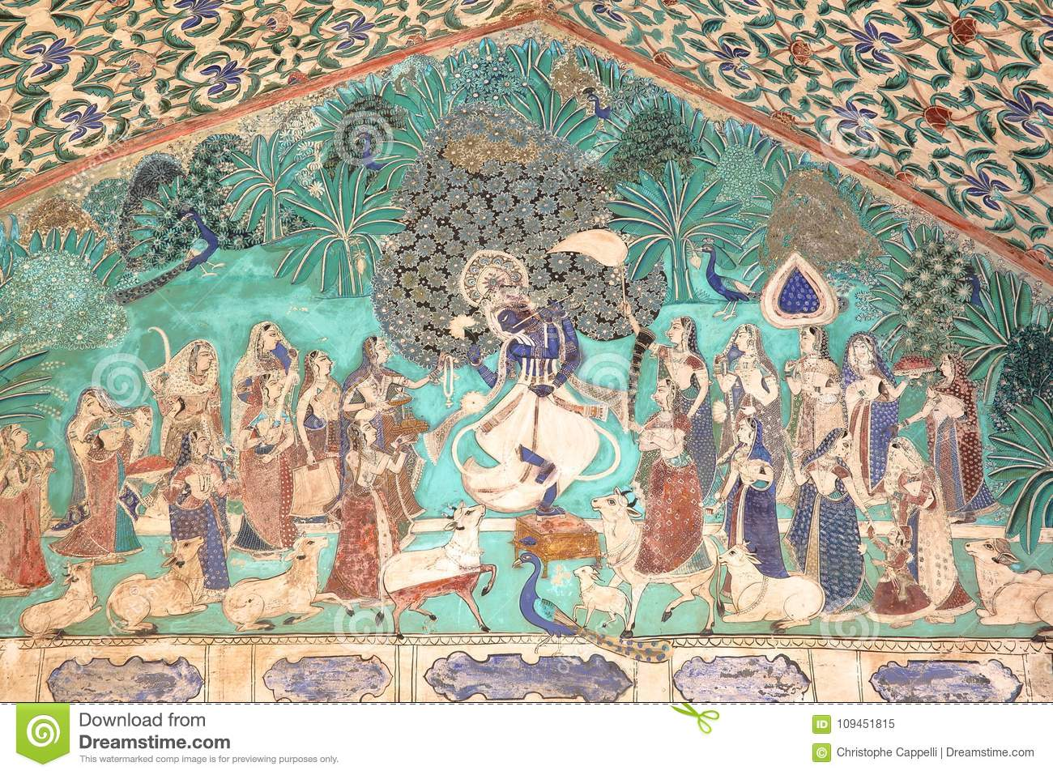

Slide 3
Krishna: State of Asia at his birth
Buddha preached non-desire, because disappointment and suffering leads to lethargy and prevailing left side.
Rama’s implementation of Maryadas (boundaries of good conduct) had led to much religious ritualism and severity.
Since childhood, Krishna tried to reverse the lethargy. He did this through enlightened action and by being playful. In this way he hoped to break the ritualism and severity. And to bring pure Joy.

Slide 4
Gunas (Energies feeding each channel)
The perennial philosophy in the Hindu tradition interprets the cosmos in terms of three gunas – sattwa, rajas, and tamas. Sattva means ‘law’, rajas means ‘energy’, and tamas means ‘inertia’.
Human beings are considered to be varying combinations of sattwa, rajas and tamas. Evolution is from tamas to rajas to sattva.
The lowest guna is tamas, the state of inertia, lethargy: When duties call for us to act, we feel inclined to say, “What does it matter? Why not drop out of society?”

Slide 5
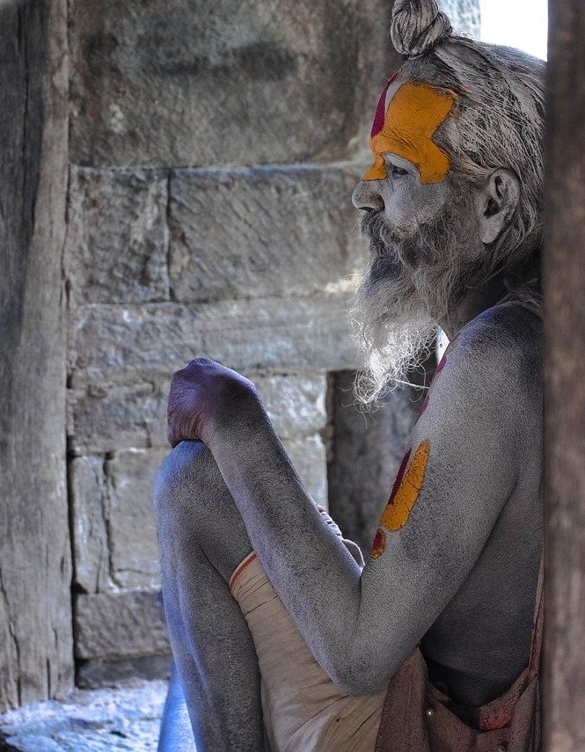
Gunas (Energies feeding each channel)
“It is all right for a rock not to act, it is all right for a stone just to sit, but you and I as human beings have to respond to the challenges of the day and make a contribution in our own way to the solution of its problems”.
Naishkarmya: Self-knowledge through meditation. Shri Krishna points out that this state is not reached by the path of inaction. It is not by abstaining from action, by refraining from work, by dropping out of society, by quitting school, that the state of naishkarmya is achieved.

Slide 6
Gunas (Energies feeding each channel)
Whenever there is a tendency to postpone, it is good to get down to work immediately. When there is something not very pleasant to be done, do it immediately. The pleasant things can wait a little, but the unpleasant things should be done immediately.
The way to transform tamas into rajas is through activity. But we must develop muktasangah samacara, ’’the capacity not to get caught in any of our actions’. When we get caught in our own job, our own interests, we lose our discrimination and forget the real purpose of life.

Slide 7
Gunas (Energies feeding each channel)
We must begin to direct all of our energies to the selfless service of those around us. We can harness our energy and restlessness and direct it to a higher goal.
It is not in the nature of a job or activity to be interesting or not; it is in the nature of the attention we give to it. Anything, when we can give it our full attention, becomes interesting. And anything, when we do not give it full attention, becomes uninteresting.

Slide 8
Gunas (Energies feeding each channel)
Verse 15. ‘Arjuna, understand that every selfless act is born from Brahman, the eternal, infinite Godhead, and that he is present in every act of service. All life turns on this law; whoever violates it, indulging his senses for his own pleasure and ignoring the needs of others, has wasted his life’.
Verse 16. ‘Strive constantly to serve the welfare of the world; by devotion to selfless work a man attains the supreme goal of life. Understand that those who violate these laws, criticising and complaining about fate, are utterly deluded, and are the cause of their own suffering’.

Slide 9
Gunas (Energies feeding each channel)
In this way we make raja yoga, (the path of meditation), and karma yoga, (the path of selfless action), go together. By throwing ourselves into energetic, selfless action, we shall be deepening our meditation as well as serving the Lord.
This concept of karma is personified in Sanskrit as Chitragupta, the “hidden auditor” in every cell of the human system: the moment one thinks a selfish thought, every cell in our biological system has received a minus, and the moment one thinks a selfless thought about as to how I can contribute to the welfare of others, every cell of our being has received a plus sign.

Slide 10
Gunas (Energies feeding each channel)
Then we have to transform rajas into sattwa: selflessness, forgiveness and putting the right attention are three important elements to transform rajas into sattwa. As tamas becomes transformed into rajas, there is more and more energy available to us. We must harness this newly released energy in order to transform it into sattwa.
The characteristics of the man established in sattwa are calmness, compassion, and complete fearlessness.

Slide 11
Gunas (Energies feeding each channel)
In sattwa we work arduously but not for our own personal gain. But, even in sattwa, we still believe that we are the doer, therefore we are still involved in the fruits of action. It is not enough if we attain the sattwic level, because the supreme purpose of life is to realize the Lord of Love who is present in everyone. The person who becomes aware of the Lord is said to have gone beyond the three gunas. He has realised the unchanging reality, the indivisible unity.
Applying the categories of the gunas to human evolution, the Gita says that the least evolved are the apathetic who do not act at all. Higher are those who act, even though part selfishly. Higher than they are those who act selflessly, but the highest are those who have realised the indivisible unity of all life, who have seen the Lord within all.

Slide 12
Video on Action

Slide 13
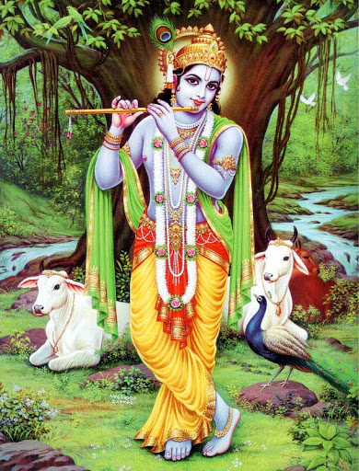
Joy
One of Shri Krishna’s missions was to remove the strictness and ritualistic attitude towards religion and spirituality in which much of the society had fallen.
He was known for being naughty since childhood, playing tricks (both as a child and in adulthood, always with the end of removing negativity in clever ways) and being always very playful and joyful.

Slide 14
Joy
He ‘invented’ many festivals (Holi is the most known) to create a sense of collectiveness and joy

Slide 15
Video on Joy

Slide 16
Discretion & Diplomacy
Hamsa sub-chakra
This is a centre, part of the Visuddhi, located between the eye-brows, that is in charge of discrimination and discretion. When awakened, we know what is good and bad, without any ‘mental labelling’ or pre-conceived ideas. And it helps us in knowing how to address issues with other people, together with…
Divine diplomacy & sweetness
These two qualities are placed in the right Visuddhi (together with non-reaction). When we are sarcastic, offensive, or talk with harshness or too directly, our right Visuddhi catches (and it, ultimately, affects the whole chakra).
Non-reaction and being sweet in words and manners go hand-in-hand. Divine diplomacy has nothing to do with artificial diplomacy

Slide 17
Video on Discretion & Diplomacy

Slide 18
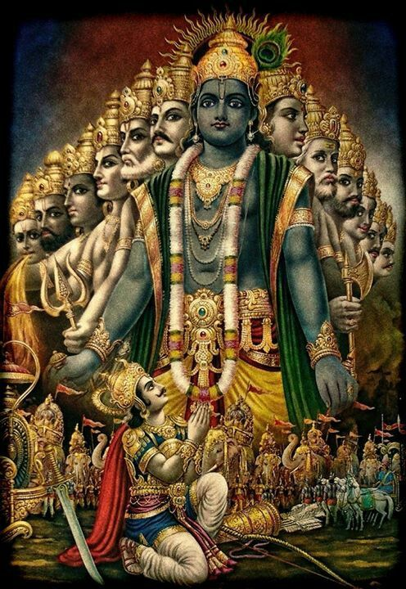
Virata

Slide 19
Father, Son, Holy Ghost?
God Almighty Jesus Christ Mother Mary
Sadashiva Ganesha Adishakti
Virata (Krishna) Maha Vishnu Rhada
Spirit Ganesha principle Kundalini

Slide 21
Virata
“Shri Krishna has become the Virata, the Great Primordial, Universal, Cosmic Being”.
“Virata is the brain of the Being which can be called as God Almighty, so the whole central nervous system is worked through by Shri Krishna. When your Spirit comes into your brain you become part and parcel of Virata itself”.

Slide 22
Virata
“So, this Virata Shakti gives us the sense of collective consciousness. First, we understand it through our brain power. But the whole brain power is to be guided by the heart, is to be watered. In Sanskrit there is a very beautiful word “Sinchan” - like dewdrops, sprayed with the love of God. So, the integration of this brain has to take place with your heart and with your liver”.

Slide 23
Virata
“Shri Krishna has sixteen petals on His domain of Vishuddhi chakra and these sixteen petals, multiplied by the one thousand petals of the Sahasrara become sixteen thousand. So, these are sixteen thousand powers, which are available to us also. These sixteen thousand powers are working in the brain. As soon as you get your realization these sixteen thousand powers start manifesting when your Sahasrara is enlightened with the Kundalini. So, all the nerves in the body get enlightenment. Your attention becomes enlightened. With these one thousand dimensions you become collectively conscious”.

Slide 24
“So all the energies suddenly start getting into motion. So, this power where the one thousand energies of the brain are suddenly awakened, is the power called as Viratangana. She is the power of the Virat. She is the power which makes Shri Krishna as Virat. So the sixteen thousand powers is done through the power of Viratangana. And at this modern time you know who that is! So, the Adi Shakti takes the form of Viratangana. With that enlightenment you achieve your Realisation”.

Slide 25
Virata
“So, when you forget, don’t think that you have forgotten something, or something has gone wrong with you. No, it has gone to your subtle understanding, which works out in a reflex manner, but into sixteen thousand dimensions. Can you imagine an instrument with sixteen thousand wires connected with another sixteen thousand wires with another sixteen thousand wires, and all the time working so efficiently? This is the work of Virata and this is the work of this enlightened mind”.

Slide 26
Virata
“The Virata expresses itself to us through the language of vibrations. That’s why everything in nature makes itself known by that language: flowers, trees, plants, animals, even stones … and humans”.

Slide 27
Virata
“So this is what it is today. As it is, the situation is that you have become part and parcel of the Virat already. You have not seen the Virata, but you are part and parcel of it. You're not watching it. You're inside it”.
“When your attention is focused on the Kundalini, and it pierces your Brahmarandhra, and therefore, merges with Virata, it is at this stage that ego is absorbed (...). In this way, you simply become an instrument of God Almighty”.
“The Virata has made you, so let the power of Virata flow through you and understand the meaning of Self”.

Slide 28
Video on Virata

Slide 29
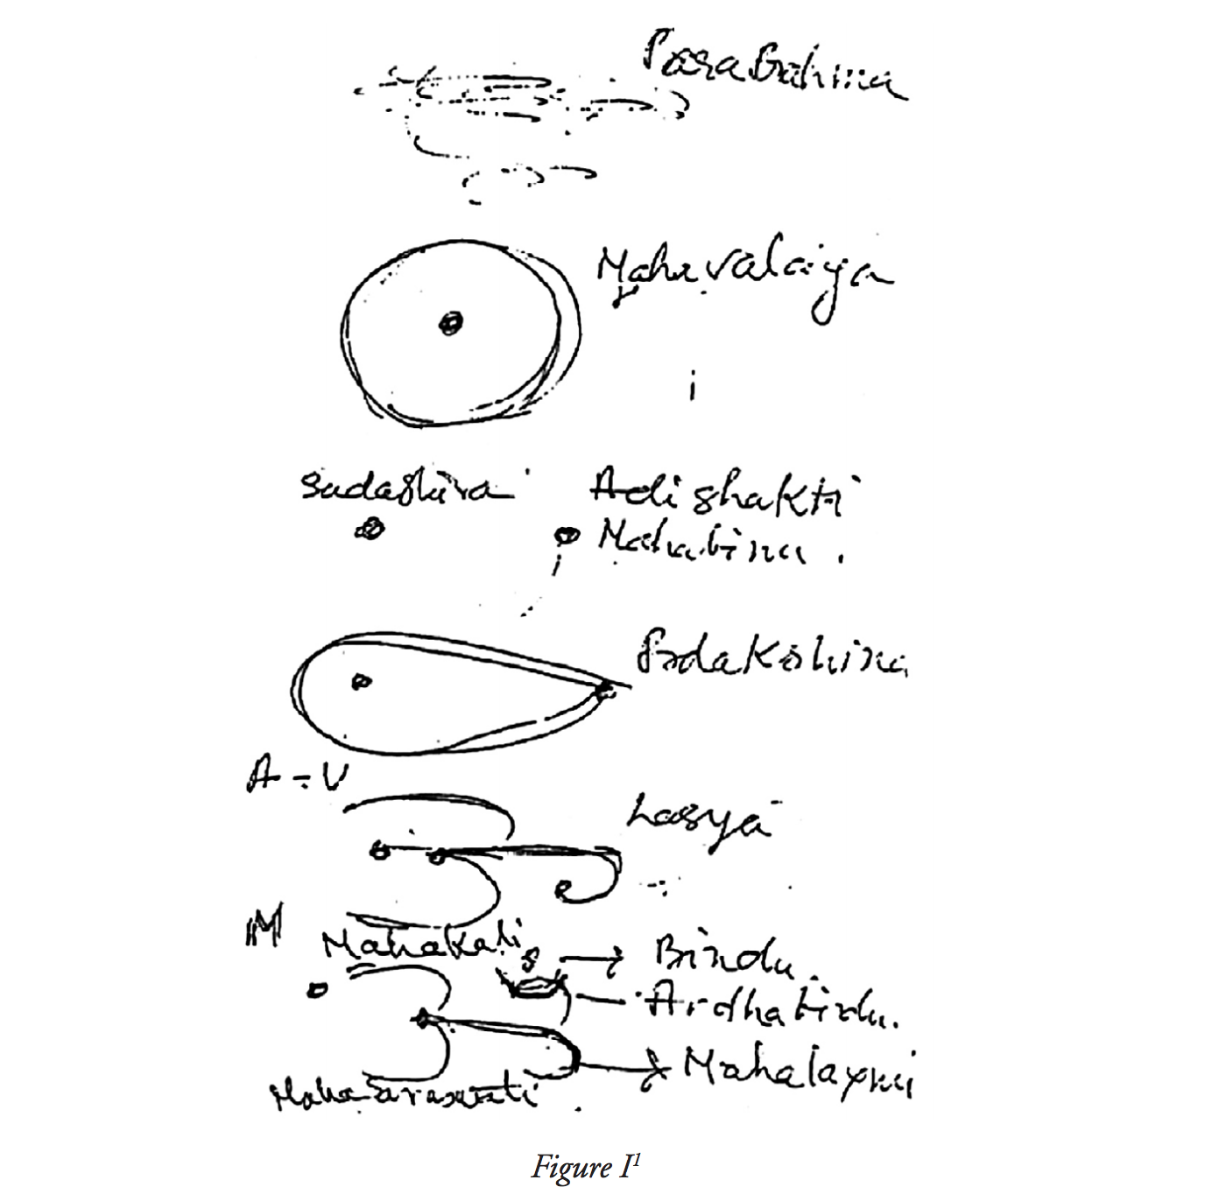

Slide 30
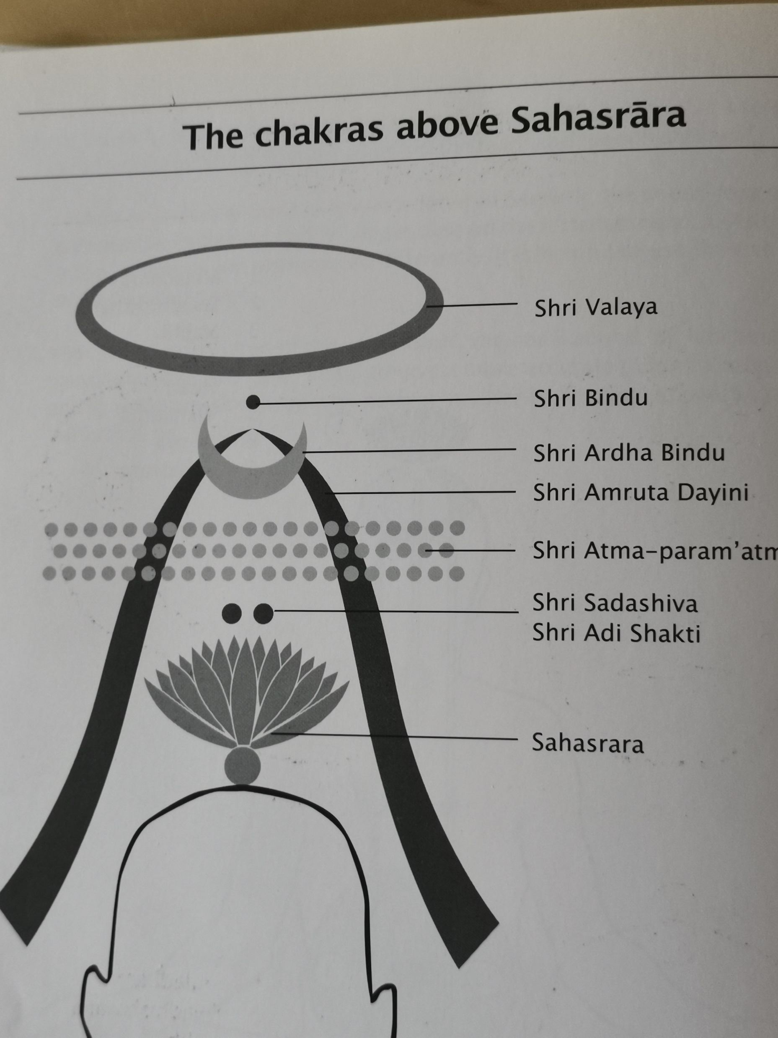

Slide 31
