Slide 1
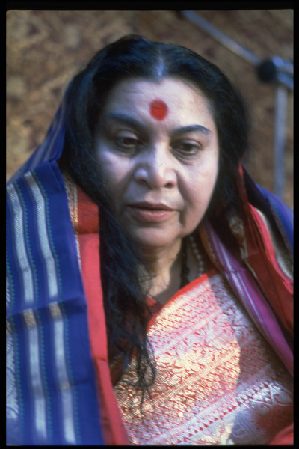
Kundalini
The awakened power inside you
some ‘history’
Notes:
Only now since 1970, when Shri Mataji started Sahaja Yoga, the awakening of the Kundalini in us has taken place on a big scale. Before 1970 very few people were realised souls. In the whole world you could count the people who had their Kundalini awakened. For all others the Kundalini was dormant!

Slide 2
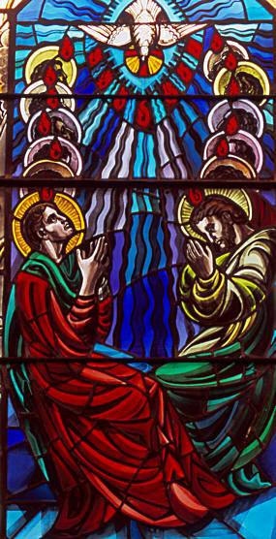
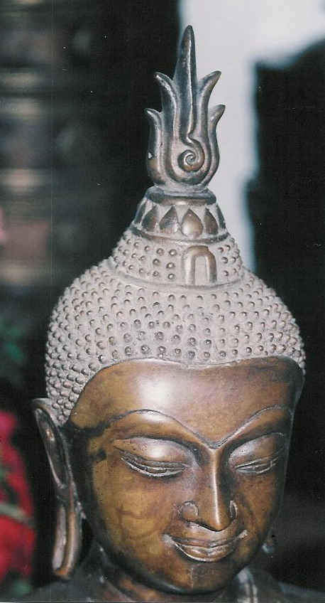
Kundalini in different religions
Tao Taoism China
Adi Shakti Hinduism India
Holy Spirit Christianity Europe
Rouh Islam Arabic countries
Shekina Judaism Israël
Cosmic energy Science
Notes:
The fact that the Kundalini has so many names means that in different religions some people knew about it. Therefore it could become an integrating and connecting / binding power. It is also shown in different art. However, not many people know about it. Most likely because it was always dormant in most people.

Slide 3
What is the Kundalini?
Energy existing out of many strands of energy (like a rope)
Every human being has 3 x 7 = 21 raised to power 108 strands
The more strands rise, the stronger your Kundalini is
In the beginning just one or two strands rise!
Notes:
So our Kundalinis are of different qualities, depending on the amount of strands that rise.The quality of the Kundalini is different in each one of us,
depending on the amount of strands that rise

Slide 4
Living energy
Energy of knowledge, attention, love and compassion
She knows what to do, where to go, how to clean your chakras
Powers: absolute purity, auspiciousness, holiness, chastity,
self-respect, pure love, detachment, concern and enlightened attention
She gives peace, wisdom, security and joy
Notes:
She acts by Herself, if you desire Her powers it ‘helps’

Slide 5
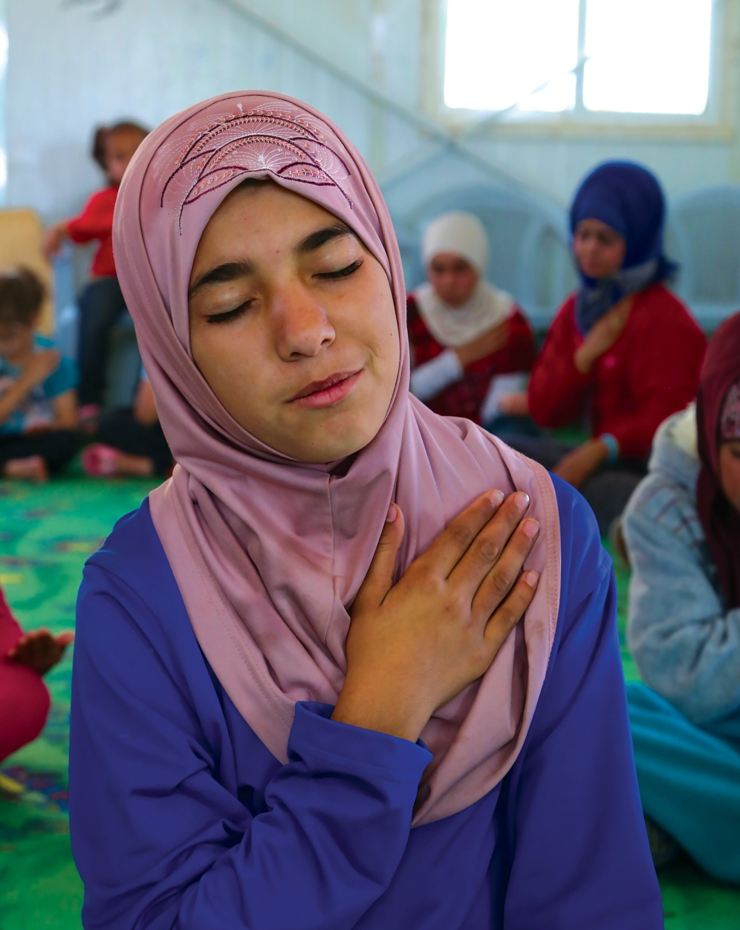
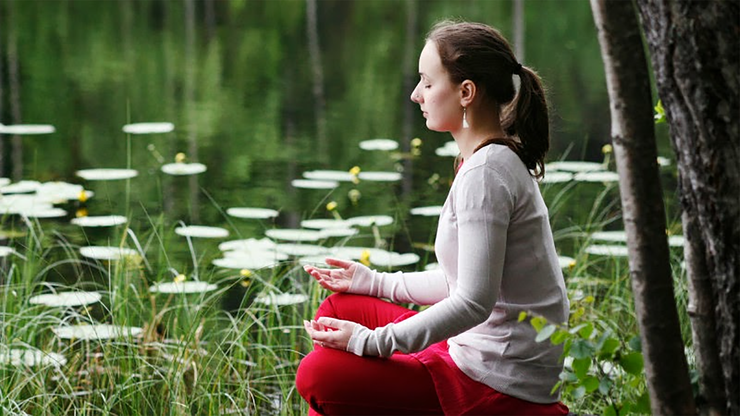
When does the Kundalini rise?
If you have a pure desire
If you have your Self-realisation
If you meditate regularly
Notes:
What do you think is / means pure desire? The more pure desire you have, the more the Kundalini will rise. What we should ask for is that beautiful, soft, compassionate nature, then the Kundalini will supply, because She only has that.

Slide 6
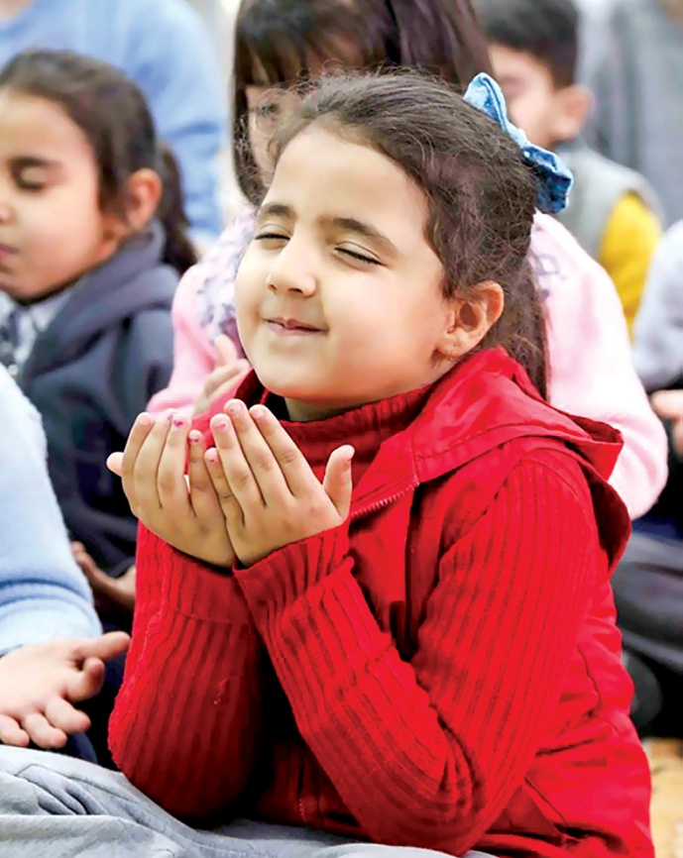
She cures, solves all problems
She takes away blockages on chakras
Give the Kundalini time to act: meditate
Live relaxed and peaceful
She reduces worries, fears, stress etc.
Notes:
So if we wish to live peacefully... we need to meditate regularly. It is a growing process. The Kundalini relaxes, when people just get their Self-realisation you can see it. The Agnya chakra relaxes and the pupils of the eyes relax. That is why they get bigger.

Slide 7
The Kundalini can get stuck
Swadisthan: if you do things against pure knowledge (hot or no vibrations)
Nabhi: materialistic attention
Heart: fears
Vishuddhi: feeling guilty
Agnya: thinking too much
In short, if you let your Ego and Superego rule (over) you
Notes:
Some spiritual courses can make your left Swadisthan catch.
Catholic church confessing, guilt. By feeling guilty we block our left Vishuddhi, the Kundalini cannot reach there because we fill it with guilt. So never feel guilty because you catch, or because you put time in meditating. Living in the present is a good way not to feel guilty; forget about the past and don’t think about the future.

Slide 8
Without an awakened Kundalini...
No thoughtless awareness
No vibrations, nor using or giving vibrations
No Divine Love in your heart
Not becoming your own guru
Sahasrara chakra does not open
Notes:
Examples of Divine Love outside, are easy to find in nature, music, art etc. Just look at it or listen to it without thinking and if it emits vibrations there is Divine Love in what you see / hear..
In the intermediate there will be presentations about vibrations and being your own guru and the sahasrara chakra. What we mean with become your own guru: you start to live from your heart, instead of from your mind (Ego and Superego)

Slide 9
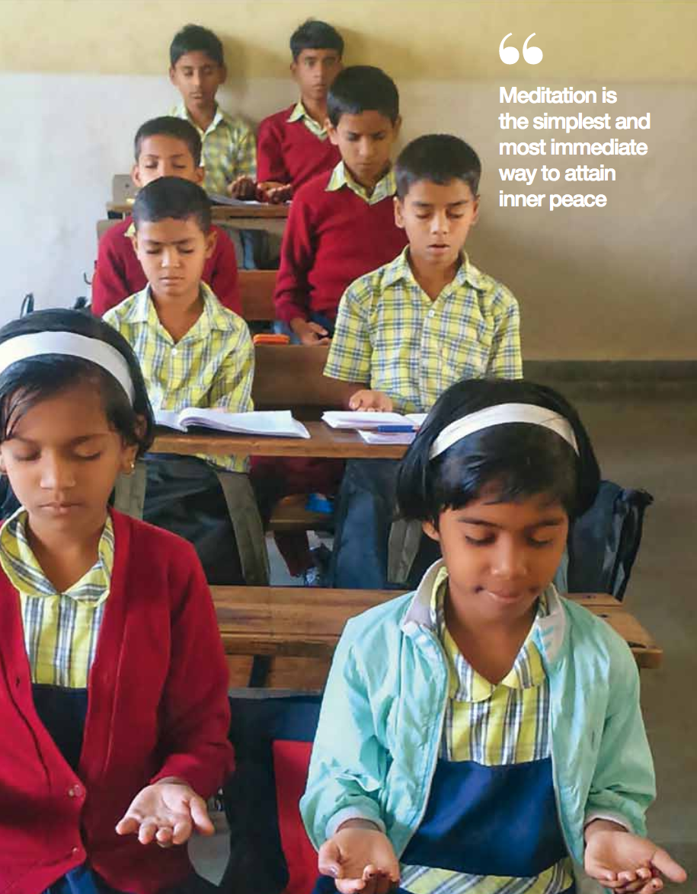
The Kundalini gives you enlightenment
Very special power inside you
She brings you into meditation
Without meditation, you lose Her power
Collective meditation, condition to keep growing
Notes:
When you stop meditating the Kundalini will go back into your sacrum bone and wait till you start your sahaj meditations again. The more regularly and collectively you meditate, the better it is for yourself and for the group. You will notice the most effect. We all have different qualities and we help each other and ourselves if we combine these in a collective meditation.

Slide 10
Beeja mantras and the Kundalini
Mantras based on the sound of the Kundalini in each chakra
Sound (music) has vibrations and every sound has a different effect on our chakras
We will sing beeja mantras to strengthen our chakras and our Kundalini
Notes:
Sound / music can have a positive (and negative) effect on our chakras and our Kundalini. For example Mozart his music activates the center channel. Bach activates the right channel. Handel activates the left side. Indian ragas, bhajans and qawalis are often good for our chakras, because they have good vibrations. You can find this music on internet. Of course there is much more music that balances us. Common sense very loud music with lots of heavy beats is often too rightsided. Very soft and sleepy music is often too leftsided.

Slide 11
Song to enjoy
You can check for yourself if the song has vibrations
Music with cool vibrations is music the Kundalini enjoys

Slide 12
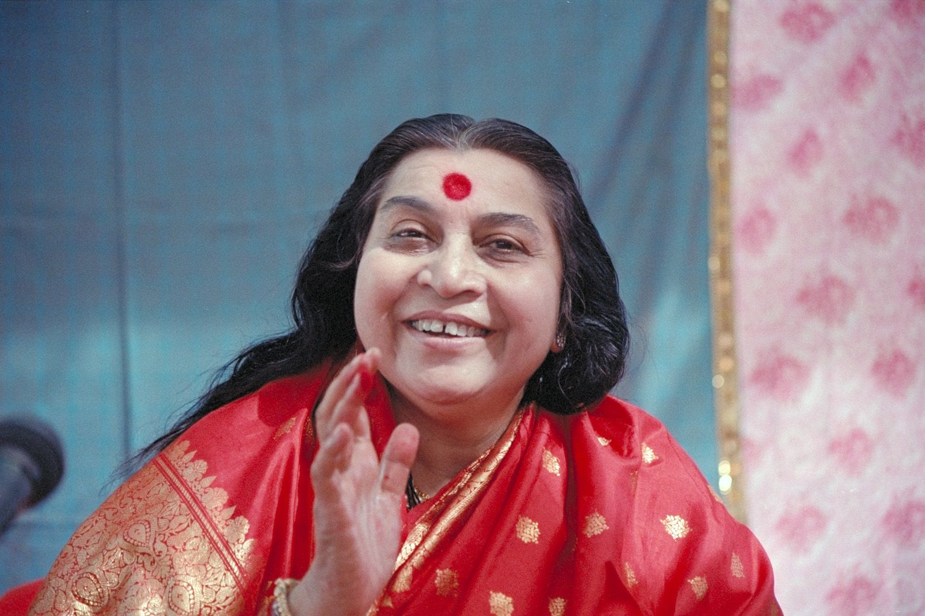
Speech of Shri Mataji
Adi Kundalini Puja
“The power of desire”
Germany 1991
Minutes 16.55 to 25.10
(or 24.00)

