Slide 1
Overview
Meditation
Why, what, how…
Talk by Shri Mataji
Hand massage, short example
Meditation
Notes:
Most of the images in this powerpoint emit vibrations, see if you can feel it…
Innocence usually opens our heart in a split of a second (without thinking), you get a smile on your face…
Images as well as music can enter your heart easily. It is a nice way to be more aware of vibrations.

Slide 2
Vibrations Why, what, how…
Love and innocence
Notes:
So this image emits motherly love and innocence…

Slide 3
Selfrealisation, how ?
When the Kundalini rises with a few strands, She opens the chakras a little bit, because She gives vibrations to the chakras. Also the Kundalini starts emitting vibrations on the sides, so all the 1000 nerves can get enlightened, gradually opening the Sahasrara more and more.
Sahasrara has to be open, so the Kundalini emerges out (you feel the cool breeze) and it enters into the subtle energy, which is all pervading. Then the Chaitanya (divine vibrations), which is part and parcel of this energy, starts entering in the limbic area. The limbic area is connected to the brain and all the nerves. So these vibrations start flowing onto (nourishing) the nerves, giving you the new awareness and opening your chakras more. So new strands of Kundalini can rise. (Vicious circle)
Notes:
Vicious circle: Chaitanya should enter to nourish your nerves by which the left and right side open out, so more Chaitanya can flow down all these centers. But if Sahastara is not open properly, this process doesn’t happen. As a result chakras don’t open and then new strands of Kundalini cannot rise, because the chakras are not open. So important to keep your Sahastrara open. Keep your attention steadily above your head and be in thoughtless awareness.
And becoming the Self: Uniting with the Spirit is only possible after Selfrealisation, before if you would put your hand on your heart, your attention is not enlightened.

Slide 4
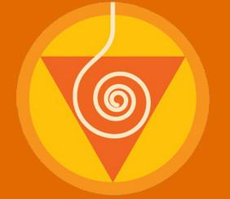
What is enlightenment?
Enlightened means vibrations start flowing, this is a very big thing
You become subtle like an antenna, receiving the vibrations
Without connection, you are not enlightened: you can’t feel vibrations
Kundalini gives you enlightenment
Notes:
The Kundalini has to rise and open your Sahasrara, without that your attention is not enlightened, your awareness is not enlightened, because you cannot feel the vibrations.
The Kundalini gives you your Self realisation, your becoming one with your Self the Spirit.
So getting your Selfrealisation is a must to be able to feel / receive vibrations. Is a must to get your enlightenment!
Picture: All mountains emit vibrations, but some more then others. Uluru or Ayers Rock emits vibrations which are good for the Muladhara Chakra. The aboriginals recognize / feel its holiness.

Slide 5
Why are vibrations so important?
Vibratory awareness
Sixth sense
Pure knowledge
Life guide, discrimination
Decision makers
Balance, cure
Collective awareness
Joy
Notes:
Life guide: they can organize us, let them organize you.
Balance: Vibrations bring us back into balance on all levels, they make us physically, emotionally, mentally and spiritually healthy
Collective: enlightened attention: our awareness becomes enlightened, so we start feeling other people their chakra’s on our hands / in our body.

Slide 6
Why are vibrations so important?
They detach you from your mental activity
Take you out of the illusions (ego and superego)
Show you reality
Only way to ascend
Notes:
Hopefully no more fake news for us, when we check vibrations, we are able to discriminate
Picture: Mount Everest emits vibrations which are good for the Sahasrara

Slide 7
Vibrations and science
Scientists have measured the rhythm of the heartbeat and the effect of our emotions on that. They also found that a regular natural heartbeat is the best for our body. Their conclusion: positive emotions are better for our heart. Their advice: be in joy / love…
Meditations / vibrations, bring us in a peaceful state. In short, improving our vibrations is physically and emotionally good for us.
Notes:
We all know that fear makes our heartbeat go faster, to be able to run.
Our mind / emotions react on how we feel physically, we all know that when we have pain, we get tense.
Breathing regularly gives us a regular heartbeat, that is why some breathing exercises can help us to get into a peaceful state.
Advice: be love, be in joy, heal your wounds, get rid of your fears, your anger and free yourself from negative emotions.
In short improve your vibrations!

Slide 8
Vibrations and science
Research has been done between 1726-1926 about sun cycles and major happenings like wars and revolutions. Conclusion: there is a correlation. This shows that somehow we are connected to what happens in the planetary system.
Scientists have discovered the positive effect of grounding (walking bare feet) on inflammation / pains in the body.
We feel the connection between the vibrations around us, and that this effects us. We also feel that the earth can absorb negative vibrations.
Notes:
A Russian scientist has looked into major happenings from 1726 till 1926 and he found a correlation between them.
In many tribes people knew they had to do important things on certain ‘solar moments’ which were good for that occasion.
They have discovered that walking bare feet on the earth reduces inflammation. (Stephen Sinatra is cardiologist M.D.), because the earth has electrons which are absorbed through your feet.

Slide 9
Vibrations of planet
Planet base frequency: 7.8 Hz, Schumann resonance. Spikes?
Gamma brainwaves are 32 – 100 Hz and are correlated to higher awareness as well as high amounts of love.
Notes:
Schumann resonance: lightning creating electro magnetic waves circle around the earth. Some of these waves create a repeating atmospheric heartbeat known as Schumann resonance
In 2014 they measured spikes from higher Schumann resonances up to 8.5 Hz, but also on days they measured 16.5 Hz. Other scientists say there always have been 8 different Schumann resonance frequency levels and the base frequency is always the same (gemiddeld): 7.8!
Human beings have different brainwaves frequency: For example: delta wave 0.1 – 3 Hz, theta wave 4 - 7 Hz, Alpha wave 8 - 15 Hz, Beta wave 16 – 31 Hz Gamma wave 32-100 Hz. Scientists know that these frequencies have different effect on us, the lower ones are like gear 1+2 in a car. More day dream state. The higher ones give us the capability to think and plan. The one around 8 Hz is the neutral position of the car, we can switch from one task to another. It is the relaxed state.
Some scientists say: Gamma brainwaves are correlated with a kind of super consciousness and awareness as well as higher amounts of love and compassion. It could upgrade our nervous system and expand our perception and awareness of reality.
Perhaps we are on the verge of a great evolutionary jump. Another way to say it is, we are going through an initiation after all we go from one phase to another. Perhaps the earth is assisting us in lifting the veil initiating us to a quickening in energy and enabling us to see our true nature. Maybe when we see, remember and awaken to who we truly are, human beings can finally move as a collective consciousness from a state of surviving to a state of thriving. From Dr. Joe Spenza.
Schumann frequencies tend to be in tune with the human brainwaves. These brain waves are said to be linked to human consciousness. The higher the wave the higher the consciousness (?).
Some scientists are talking about a (coming) shift in consciousness, to more collective consciousness. They say the earth’s electromagnetic field can influence our nervous system. Others say that we cannot measure these very high brainwave frequencies in Hz yet.

Slide 10
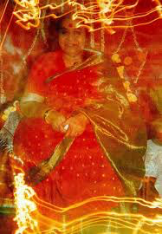
Four types of vibrations
Electromagnetic: like universal telecommunication (as phone), over the whole world and there is sound, you can record them
Emotional: there is joy in them
Love: vibrations go where needed for the whole, out of compassion
Light: quantum energy. You can see it on photo’s
Notes:
Vibrations are love, they raise the Kundalini. Energy of love: quantum energy. They understand what is needed and act / do what is good for the whole.
You get the knowledge, the light, the love.

Slide 11
Power of love
Vibrations are love
Love works through vibrations
The Spirit works through vibrations
It emits light so you can see in a subtle way
Notes:
Joy is the quality of the Spirit.

Slide 12
Pure knowledge and action
You can only feel vibrations, when you are thoughtless; then the vibrations give you pure knowledge (beyond the mind)
Vibrations act, report and think! They guide us, talk to us, help us, report to us. Tell us what is right and wrong
Pure actions: doing things which are good for your ascent. So all techniques like candling, footsoaks, camphering, shoebeating, stringburning etc. are pure actions. Slowly you will learn all in the (advanced) course and the seminars.
Notes:
Pure knowledge = energy like electricity. The way you feel it, you understand it, that is love.
Cool vibrations tell you the truth; the Spirit is happy. Hot or absence of vibrations, tell you something is against your ascend and against the benevolence of the whole; the Spirit is not happy.
Pure actions = working on ourselves with all the techniques.

Slide 13
Work on yourself
Give bandhans = giving vibrations without thinking; so attention is not in thinking process
With a bandhan you put Chaitanya (vibrations) into action
Vibrations exist in everything: in all atoms and molecules; they are all pervading
Notes:
Paramchaitanya is nothing but vibrations, it contains everything inside: knowledge, truth, light, love.

Slide 14
Improving vibratory awareness
Massage with vibrated oil your head, neck, shoulders, back and hands
Vibrations sit on fat, nerves is made of fat, your brain is also made of fat. Oil soothes the nerves.
Hold your hands on the level of your heart and use your hands
Sing mantras for the Vishuddhi
Notes:
Massage your hair (headrub) is very soothing for the nerves.
Rub (the back of) your hands, before you start feeling vibrations
Trust that it works by itself, take a surrendered attitude. Things work out automatically, because the vibrations are in charge, they are the doers and enjoyers.
Have patience with yourself. It is given to you… Take a relaxed witness attitude. Enjoy the birds, the flowers and try again next day… It has to grow.
Have faith whatever you do with your hands creates vibrations within yourself, so work on yourself. And later also on others.
When you don’t feel vibrations it can be a Vishuddhi catch, but as long as you feel peace inside everything is fine.
Experiment with it in a respectful way. The more you use your vibrations the more you will get it.

Slide 15
Improving vibratory awareness
Protect your neck / head with a shawl / hood
Right hand in ice, left hand in fire (shortly!)
Watch everything, witness with open hands
Use your vibrations, flow is always there, direct it; ‘online’
Notes:
We emit vibrations when we are thoughtless, the Divine takes charge. You could say we are ‘online’ when we are thoughtless…
Picture: Mount Kailash, Himalaya, this mountain has good vibrations for the left heart.

Slide 16
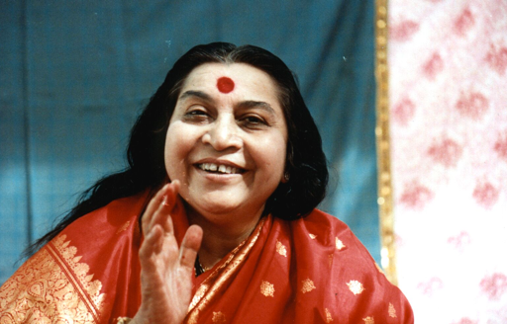
Improving vibratory awareness
Watch / listen to Shri Mataji’s talks
Listen without thinking
Her voice works on our Sahasrara and on our Kundalini
When Shri Mataji speaks vibrations flow
Notes:
Her voice, Her picture has vibrations, that is why we sit with our hands open to receive the vibrations.

Slide 17
Cooking / Art with love = vibrations
Food: Eat it, cook it and give it with (detached) love; eat with your hands
Eternal art / music has vibrations and is loved by many: Mozart, Rembrandt, Blake, Vermeer, M. Angelo
Notes:
Personal anecdote: When I eat food cooked by yogis I can digest it better! So our body reacts physically on it as well.
The more detached and unconditional your love is the better it is. So when you put this love in your food / art / music, the people who receive it get lots of vibrations!
Some art works are admired by almost everyone, this art is eternal because it has good vibrations (not fashionable). Examples: Mozart, Michel Angelo, Rembrandt, Vermeer, William Blake

Slide 18
What affects our vibrations?
Notes:
Everything that is bad for our attention also is bad for our vibrations, because we need to be thoughtless to be able to feel them. So our attention needs to be in a silent mode.
Attention needs to be looked after. Whenever it goes too much into any thought say: ‘Oh forget it’ or ”Not this, not now”.

Slide 19
What ‘stops’ vibrations?
Guilt: you cannot feel vibrations of the left side properly because the guilt is sitting on the nerve.
Not recognizing the Divine, doubts, thinking (mind)
Respect yourself, your body emits vibrations. You are the instrument through which the vibrations flow.
Notes:
Vibrations are always there, only we don’t always feel it. The question is what stops us feeling the vibrations.
We are like the microphone through which the sound comes.
After Realisation you can be aware that your Spirit emits vibrations of peace, joy and love. So you can give peace, joy and love to others. The Spirit always emits vibrations, but people don’t feel it ‘normally’.
Doubts means thinking, it comes from the mind. So you need to be thoughtless….

Slide 20
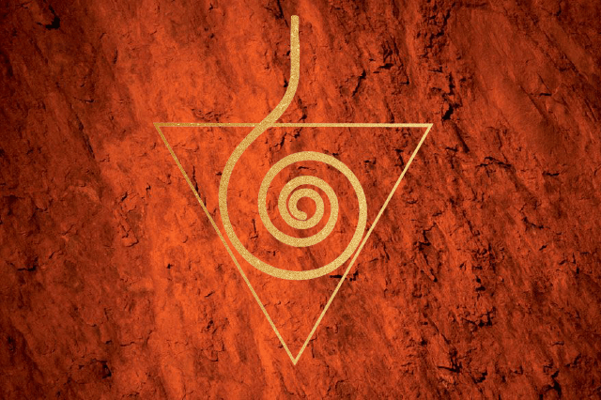
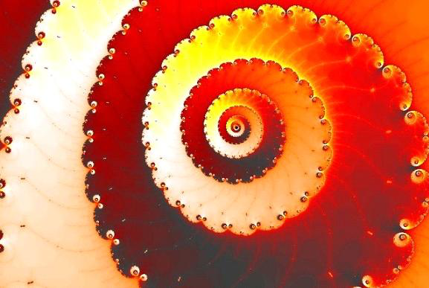
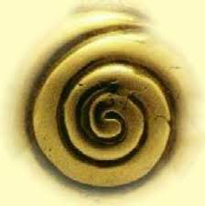
Singing with love
Song about the Kundalini

Slide 21
We will listen to…
Sahasrara Puja, Realise your own Divinity, 5 May 1991, Italy first 5 minutes
What are vibrations? 12 September 1978 first 8 minutes
Notes:
“What are vibrations” is 9 minutes, we listen to the first 5 minutes.
Sahasrara Puja we listen to the first 8 minutes about vibrations. After that it is not suitable.

Slide 22
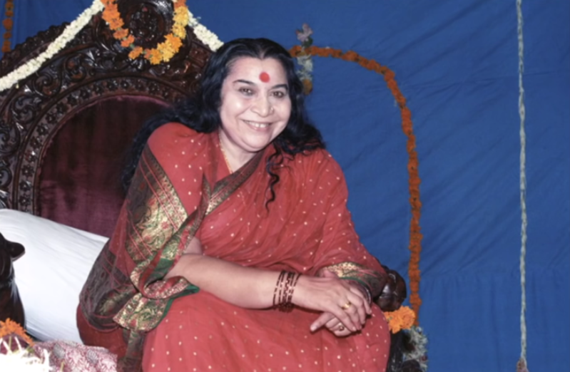
Meditation
Clearing chakras

