Slide 1
Enlightened
awareness

Slide 2
What is
thoughtless
awareness?
It is a state of higher awareness, where we go beyond the ego and superego
We are in the PRESENT MOMENT
This state is manifested by the Kundalini rising and making you feel the cool breeze

Slide 3
TRUE INTROSPECTION
1. THOUGHTLESS AWARENESS MEANS

Slide 4
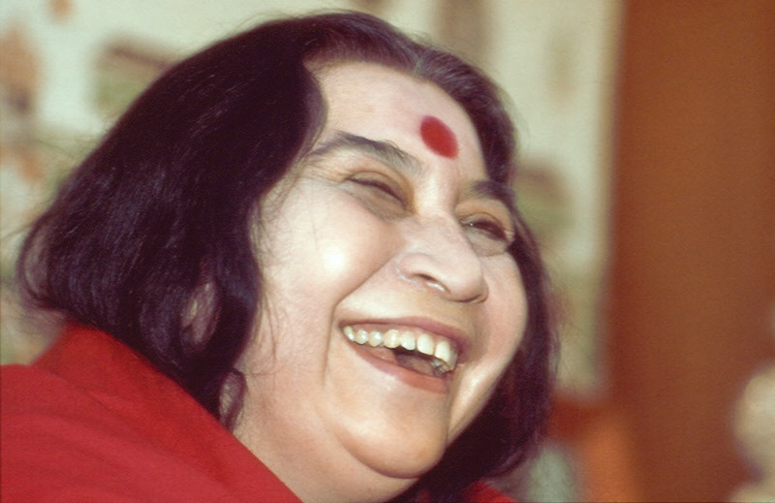
So first of all you have to cleanse yourself and accept your own problems, your own misgivings. These are to be faced.
And challenge yourself.
What are you doing?
[]This is the beginning of introspection, and it’s very important.

Slide 5
When you are climbing ahead into the new path of righteousness, of goodness, of compassion and love, you should see yourself, watch yourself: what are you doing? Where are you going?
You don’t cheat yourself.
So you have your self-respect, and you have your self- honour, which you value more than anybody else. And you don’t yield to anything that will spoil your image in the mirror.

Slide 6
Now what helps for this introspection
is your sense of love.
Can you love a person who is
distressful? One who is aggressive?
One who cheats you?
Can you love such a person?
You cannot.
Then how can you love yourself when you have these qualities, when you do this to yourself?
So the first thing is the pure love for yourself, pure love. It’s such a great thing to have pure love.
Like, you may like to have a very nice bed to sleep, you may like to have a very beautiful house, you may like to have all the wealth of the world, but all this, will it make you love yourself? If you love your Self, you don’t want anything, because you enjoy your Self!
To enjoy your Self is the greatest enjoyment.

Slide 7
to face yourself, lovingly, sincerely and with
no judgement.
The more in thoughtless awareness you are, the deeper this love and sincerity
true introspection means

Slide 8
more aware of vibrations
2. THOUGHTLESS AWARENESS makes you

Slide 9
what stops us from feeling vibrations?
Baddhas(obstruction/hindrance): manifested as catches.
Vikalpa(doubt): comes when vibratory awareness is not clear-cut.

Slide 10
Realisation people get it, vibrations they do get, but your capacity to be steady into that state is only possible if you, yourself, you are determined to get it.
Otherwise you are again thrown into the same dream.
Like if you are getting drowned and somebody tries
to save you, brings you on the boat, but still
you are not sure whether you are in the boat
or sinking in, and slip down back again.
Again he puts you back. Again, you slip down.
And the thing goes on. But if you could stick
on to the boat with a little determination
it helps much more.
Because that is how you are going to know
your meaning of life.

Slide 11
IN ORDER TO BE MORE IN THOUGHTLESS AWARENESS AND FEEL MORE VIBRATIONS, YOUR DETERMINATION, YOUR DESIRE, IS CRUCIAL.

Slide 12
the kundalini to work through us
3. THOUGHTLESS AWARENESS helps

Slide 13
1.You go beyond
the ego and
superego, so…
2.your sahasrara
opens more…
3.you feel
more joy and less worries
4.You become an instrument of the divine

Slide 14
And remember!
It´s a NATURAL process, you cannot force it.
The most important thing is that you have the Sincere Desire to be in Thoughless Awareness.
Again, you cannot force it. You can just Surrender to it.
And make sure you enjoy it!

