Slide 1
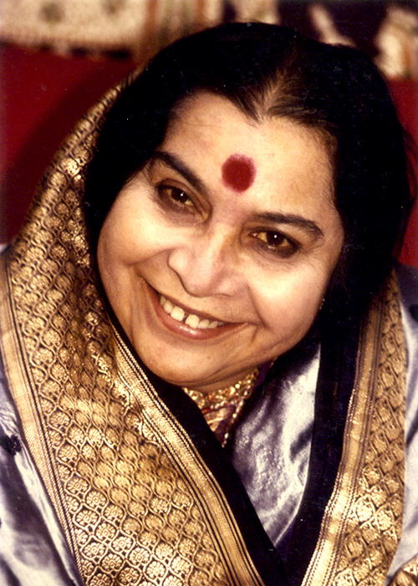

Slide 2
FULL MANTRA AND 3 MAHA-MANTRAS
Divine Sounds
© VND-Colombia

Slide 3
MANTRAS STRUCTURE
OM, TWAMEVA SAKSHAT
SHRI ADI-SHAKTI MATAJI,
SHRI NIRMALA DEVI,
NAMOH NAMAHA.
NAMOH NAMAHA.
SHRI …………… SAKSHAT

Slide 4
THE THREE MANTRAS OF THE SAHASRARA
1. OM TWAMEVA SAKSHAT
SHRI MAHA- LAKSHMI
MAHA- SARASWATI
MAHA- KALI
TRIGUN-ATMIKA
KUNDALINI SAKSHAT,
SHRI ADI-SHAKTI MATAJI,
SHRI NIRMALA DEVI,
NAMOH NAMAHA.

Slide 5
THE THREE MANTRAS OF SAHASRARA
2. OM, TWAMEVA SAKSHAT:
SAKSHAT,
SHRI ADI-SHAKTI MATAJI,
SHRI NIRMALA DEVI
NAMOH NAMAHA.
SHRI KALKI

Slide 6
THE THREE MANTRAS OF SAHASRARA
3. OM TWAMEVA SAKSHAT
MATAJI,
SHRI NIRMALA DEVI,
NAMOH NAMAHA.
SHRI KALKI SAKSHAT,
SHRI SAHASRARA SWAMINI
MOKSHA PRADAYINI

