Slide 2
What do you practice?
Notes:
Finding and living in alignment with the inner purpose is the foundation for fulfilling your outer purpose.

Slide 3
Joy: Inner and outer purpose
Your life has an inner and an outer purpose.
Inner purpose involves Being. It is primary. Essentially, it means Awakening and transferring more ‘knowledge’ from unconscious to consciousness.
Outer purpose involves doing. It is secondary.
To fulfil our outer purpose, we need to align it with our inner purpose.
Notes:
Finding and living in alignment with the inner purpose is the foundation for fulfilling your outer purpose.

Slide 4
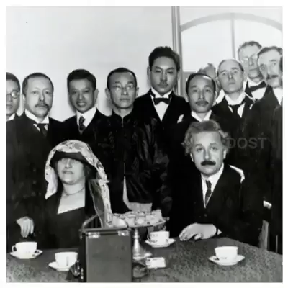
Notes:
Focus on outer purpose – need to find our inner purpose

Slide 5
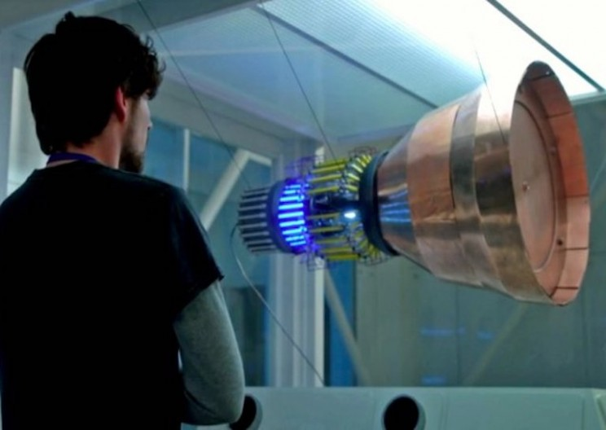
Evolution
mental
spiritual
emotional
physical
Notes:
From the TV series, Salvation

Slide 6
What is the source of Joy?
The Spirit is reflected in your heart
The seat of the Spirit is in the fontanel
When the Kundalini rises it touches the seat of the Spirit in the fontanel
Notes:
When the Kundalini rises it touches the seat of the Spirit in the fontanel and you feel the cool breeze from your head.
Bringing the Spirit to the brain = enlightenment.
Spirit =
° the divine (God) in us
🡪 we identify ourselves with that which is divine
° the original source of life in us and in the Universe
° a pure state of being, pure consciousness
° the silent witness of all our experiences
The Kundalini is the Holy Ghost

Slide 7
The nature of the Spirit
Sat - Truth
Chit - Awareness
Ananda - Joy
Notes:
When the Kundalini rises it touches the seat of the Spirit in the fontanel and you feel the cool breeze from your head.
Bringing the Spirit to the brain = enlightenment.
Spirit =
° the divine (God) in us
🡪 we identify ourselves with that which is divine
° the original source of life in us and in the Universe
° a pure state of being, pure consciousness
° the silent witness of all our experiences
The Kundalini is the Holy Ghost

Slide 8
Joy - Awakened doing
Awakened doing is aligning our outer purpose (what we do)—with our inner purpose (awakening and higher consciousness).
3 states of awakened doing
Each one has a certain vibrational frequency of consciousness
If we are not in one of these states: we create suffering for ourselves and/or others
Notes:
There are three ways in which consciousness can flow into what you do and thus through you into this world, three modalities in which you can align your life with the creative power of the universe.
Modality means the underlying energy-frequency that flows into what you do and connects your actions with the awakened consciousness t
If you are not in the state of either acceptance, enjoyment, or enthusiasm, look closely and you will find that you are creating suffering for yourself and others

Slide 9
Joy - 1. Acceptance
Accept (be aligned with) what happens. Non-resistance.
We are at peace while we do something. This peace is consciousness.
If we can’t enjoy, or accept what we’re doing—STOP or CHANGE!
Notes:
ACCEPTANCE Whatever you cannot enjoy doing, you can at least accept that this is what you have to do. Acceptance means: For now, this is what this situation,
this moment, requires me to do, and so I do it willingly. EXAMPLE OF CHANGING FLAT TIRE UNDER RAIN
That peace, that subtle energy vibration, is consciousness, and one of the ways in which it enters this world is through surrendered action, one aspect of
which is acceptance. If you can neither enjoy or bring acceptance to what you do—stop.

Slide 10
Joy - 2. Enjoyment
Joy is the dynamic aspect of Being.
It’s a constant inner state that comes from fulfilling our inner purpose.
Joy doesn’t come from what we do. It flows from deep within us into what we do. And so into the world.
Notes:
The peace that comes with surrendered action turns to a sense of aliveness when you actually enjoy what you are doing. .
Joy is the dynamic aspect of Being. When the creative power of the universe becomes conscious of itself, it manifests as joy.
You don’t have to wait for something “meaningful” to come into your life so that you can finally enjoy what you do. There is more meaning in joy than you will ever need.
The misperception that joy comes from what you do is normal, and it is also dangerous, because it creates the belief that joy is something that can be derived from something else, such as an activity or thing.
You then look to the world to bring you joy, happiness. But it cannot do that. This is why many people live in constant frustration. The world is not giving them what they think they need.
Then what is the relationship between something that you do and the state of joy? You will enjoy any activity in which you are fully present, any activity that is not just a means to an end.
It isn’t the action you perform that you really enjoy, but the deep sense of aliveness that flows into it. That aliveness is one with who you are. This means that when you enjoy doing something, you are really experiencing the joy of Being in its dynamic aspect

Slide 11
Joy - 3. Enthusiasm
Enjoying what we do, combined with a goal or vision
Not an inflated image of ourselves (hidden form of ego) or confrontational (no winners or losers)
We are connected to other human beings as well as to the whole.
We feel we are a channel through which energy flows from the Source of all life through us, for the benefit of all.
Notes:
Enjoyment of what you are doing, combined with a goal or vision that you work toward, becomes enthusiasm. Even though you have a goal, what you are doing in the present moment needs to remain the focal point of your attention; otherwise, you will fall out of alignment with universal purpose. Make sure your vision or goal is not an inflated image of yourself and therefore a concealed form of ego, such as wanting to become a movie star, a famous writer, or a wealthy entrepreneur. Also make sure your goal is not focused on having this or that, such as a mansion by the sea, your own company, or ten million dollars in the bank
Instead, make sure your goals are dynamic, that is to say, point toward an activity that you are engaged in and through which you are connected to other human beings as well as to the whole. Instead of seeing yourself as a
famous actor and writer and so on, see yourself inspiring countless people with your work and enriching their lives. Feel how that activity enriches or deepens not only your life but that of countless others. Feel yourself being an
opening through which energy flows from the unmanifested Source of all life through you for the benefit of all.

Slide 12
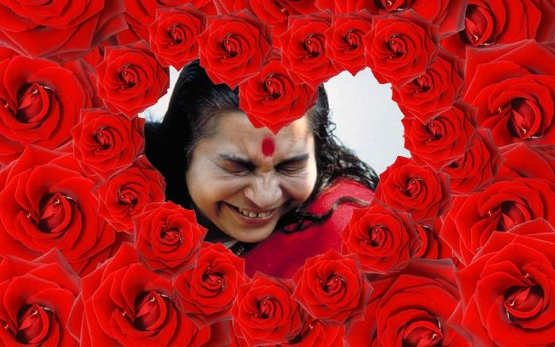

Slide 13
Shri Mataji on Joy
“For people who know that they have found the Spirit, they should know that they have found the joy. Spirit is the source of joy, and that should be evident when you talk. No inhibitions, no curbing, it’s complete freedom.
But do not try to mold yourself into the molds of the people who are not realized. Now you are different, you are changed, it is irreversible. Whatever you may try, say after two years or three years, all of you will be bubbling with laughter. But why not do it now? If it is going to happen later, why not have the blossom time now?”

Slide 14
Shri Mataji on Joy
“This power of enjoyment is inexhaustible. I want you all to enjoy that, to drink that nectar of your Spirit, and to forget about all these artificial problems that you have.
You just enjoy, because now you are drenched in your Spirit. So enjoy that. Why worry? Do not stop your progress by lingering with this load around your neck.
Let the Kundalini take you up. But She likes light things – she’s a light thing herself, that’s why she rises. Everything that is heavy within you she’ll burn, but do not make yourself additionally heavy.”

Slide 15
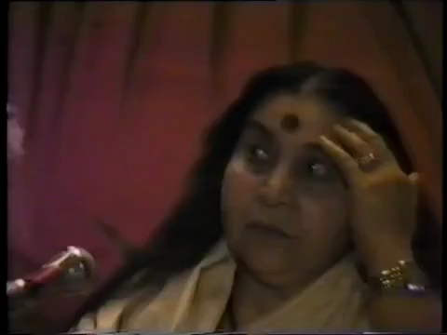
Notes:
1983-09-10 Seekers of Joy, Rome, Italy, 97'
Excerpt: play from “The third nature of your spirit is joy.” 46.37 to end.
Link to full talk:
https://www.amruta.org/1983/09/10/seekers-of-joy-rome-1983/
And another talk on Joy:
https://vimeo.com/520115621
Another talk on Joy:
https://www.amruta.org/1991/11/10/diwali-puja-1991/?highlight=Joy
Diwali Puja 1991.
Play from 26.10 ("We harm ourselves more than anybody else can sometimes”) until 38.10 (“And when you start thinking like that I mean you start becoming smaller and smaller and smaller and smaller, the lotus collapses. I mean, it is so great to think of others”).

Slide 17
Shri Mataji on Joy
“We start thinking about it, we start worrying about it, there’s nothing like that. Our problems are solved, our lives are beautified, everything is so nice and good, just to make you happy.
Still if you are not happy, still if you are worried, then the Divine recedes, it recedes. It’s like sunshine. If you do not want to face the sunshine, you do not get it. You have to face the sunshine.
Every tree moves to the sunshine, every leaf tries to be towards the sunshine. They have innately built wisdom, in the same way you should be, and you will see that with this – your life will change completely. Every moment you’ll enjoy. Every minute of life you’ll enjoy. Everything that you do you’ll enjoy. Every small thing you do you’ll enjoy...”

