Slide 1
SUPEREGO
Badhas and Conditionings
HOW TO OVERCOME IT

Slide 2
Negative emotions
Negative thought produces a disturbing emotion that causes a reaction in the body
Negative emotions feed negative energy back to the thoughts
Creates a vicious circle
Thoughts about the past can become a burden and become part of your sense of self
Notes:
The ego tells a story that the body believes in and reacts to. Those reactions are the emotions.
The emotions, in turn, feed energy back to the thoughts that created the emotion in the first place.
This is the vicious circle between thoughts and emotions.
When thoughts about the past take you over completely they turn into a burden and become part of your sense of self.
For example feelings of guilt, you learned from your parents that you have to be a good person. That meant maybe taking care of others, keeping things neat, not being lazy, doing your homework well etc. etc. Of course there have been many moments in your life that you didn’t succeed in all these things. So now you have your own standards of how to be a good person, but if you don’t succeed, you feel guilty in that moment and at the same time all the other feelings of guilt accompany that feeling so it gets totally out of proportions. You might start feeling that you are totally hopeless… Same with sadness or fear, when you are afraid or sad because something happens now all the sadness and fears from the past might join that feeling….
You have to in stead feel self respect! If you respect yourself others will also look with respect at you, because you possess that charisma, you exude self confidence.

Slide 3
Badhas
All disturbing emotions that you carry around, fed by thoughts
Disturbing emotions often remain inside you, sometimes for years
Remnants of pain (not dealt with) create an energy field in your cells
New painful emotions trigger more badhas
Notes:
Because of the human tendency to perpetuate old emotions, almost everybody carries an accumulation of old emotional pain, which can be called “badhas”
Any negative emotion that is not fully faced in the moment it arises, leaves behind a remnant of pain.
The remnants of pain form an energy field that lives in the cells of your body.
Any ‘new’ emotionally painful experience can be used as ‘food for badhas’.
It thrives on negative thinking as well as drama in relationships.
The badha is addicted to unhappiness, so it can exist.
Other person’s badha can awaken yours, so that both badhas mutually energize each other.

Slide 4
Badhas
Body can’t tell the difference between reality and a thought. It reacts to every thought as if it were a reality. It doesn’t know it is just a thought.
Build-up of energy with no outlet
Part is fed back to the mind (more anxious thought)
Rest of the energy turns toxic
Notes:
Although the body is very intelligent, it cannot tell the difference between a real situation and a thought.
It reacts to every thought as if it were a reality. It doesn’t know it is just a thought.
There is a build-up of energy, but since the danger is only a mental fiction, the energy has no outlet. You cannot start running or fighting or crying or … etc.
Part of it is fed back to the mind and generates even more anxious thought.
The rest of the energy turns toxic and interferes with the harmonious functioning of the body. This means you can think yourself sick!!!
Shri Mataji says about this: it is all a myth that upsets you.

Slide 5
Notes:
The left out feeling is another feeling that can easily stay and come up. You think you are left out, but it is not so in reality.

Slide 6
Notes:
Here for example if the lady would join the others, they might start talking with her as well. Or she discovers that they don’t talk about her, or maybe just one of them doesn’t like her cloth, but all the others are fine with it or…… etc.

Slide 9
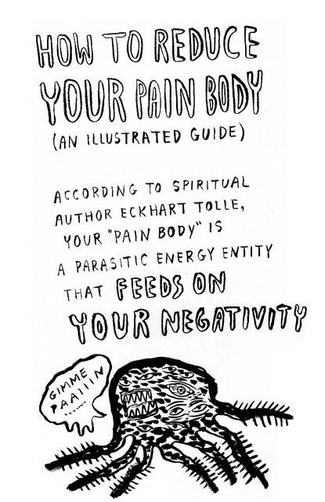

Slide 10
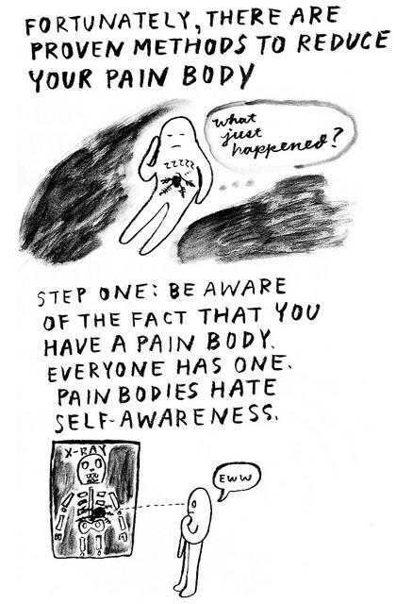
Notes:
Just looking at your emotions make them less heavy and serious.

Slide 11
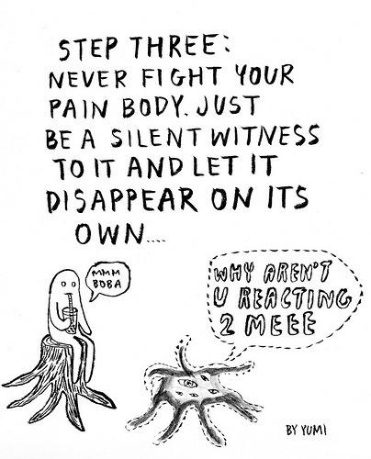
Notes:
Don’t react!
Introspect

Slide 12
The Superego in your life
Fear Loneliness
Sadness Insecurity
Tiredness Feeling guilty
Nobody understands me
Why does this always happen to me?
I can’t help it
This is how I am
Forgive me for existing
It is all my fault
Notes:
Self-awareness: How to recognise the Superego
When you keep feeling guilty: you don’t forgive yourself and / or you don’t face yourself and / or you don’t respect yourself
Feeling of powerlessness

Slide 13
What is Normal ???
Notes:
Let us say eating at 18.00 is very normal in Holland, but in Spain…
Coming on time for appointments is very normal in Holland, but in India
Keeping a distance is very normal in Holland, but in Indonesia
Eating one or two biscuits with the tea is very normal in Holland, but in India
Other examples, certain clothing,

Slide 14
Conditionings
Habits, Prejudices, Thought patterns
Where do they come from?
Education Body (addiction, food)
Culture Family
Religion, New Age Spirituality Friends
Country (climate, district) Work
Language Hobby
NORMAL ?
Notes:
We have the word ‘gezellig’, it doesn’t exist in many other languages. It says something about our culture.
Colder countries have a faster rhythm than warmer countries.
You like your daily cup of coffee or chai, you think you need it.
Without education you have less connections in your brain, so you think differently.
Our culture is quite equal and individual, not much hierarchy: others are more autocratic and collective (China)
If you parents tell you Italian are cordial people, you love Italians. But if they tell you they are all Mafiosi, you might see a Godfather in every Italian…
Appearance: children don’t see a ‘skinhead’, they see a person without hair…
What do you see when you look at blind people, or handicapped people? Do you see a person who cannot see, or do you see a miserable person….?

Slide 15
Overcoming our Superego
Be aware of its existence
Understanding, knowledge, recognition
Be the witness, don’t identify, see the play
Don’t react (don’t fight, don’t criticise)
Forgive your emotions and let go
Use humour, laugh about it, no seriousness
Do identify with the Spirit, you are love, peace and joy
For that we need
Thoughtless awareness, so meditate and …
Notes:
This is also how to overcome the ego, understanding the causes that led to your badhas & conditionings to be able to recognize it
Just to remind you why you meditate ….

Slide 16
Notes:
This picture hopefully makes you silent inside. It brings you in a joyful state

Slide 17
Joy is a State of Thoughtless Awareness
In this state you
Start to spontaneously understand life
Feel relaxed and peaceful
See the beauty of everything
Feel love inside and outside
Notes:
Joy is Not happiness, because then you can still feel unhappy as well. Joy is absolute and singular and …. Wonderful.
Another reason why you meditate …

Slide 18
Witness the Superego … a song
Just to be aware,
enjoy and laugh

